Slide 1

Missed or Misidentified Microorganisms:
Francisella and Brucella Species

Slide 2
Objectives
Upon completion of this session, the participant will be able to:
  Describe the clinical significance of Francisella and Brucella species and the potential impact of misidentification on patient outcomes and public health.
  Identify the limitations of current diagnostic methods for bacterial culture and identification.
  List strategies to enhance detection and improve identification of Francisella and Brucella species.

Slide 3
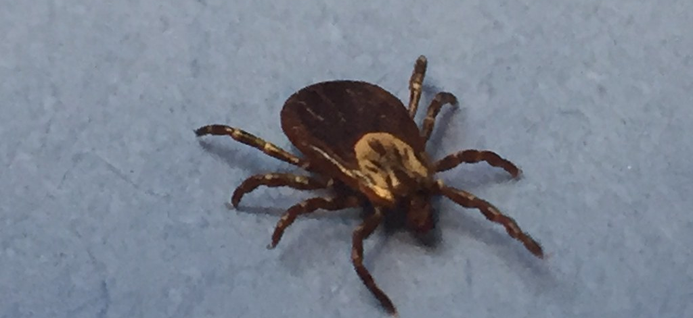
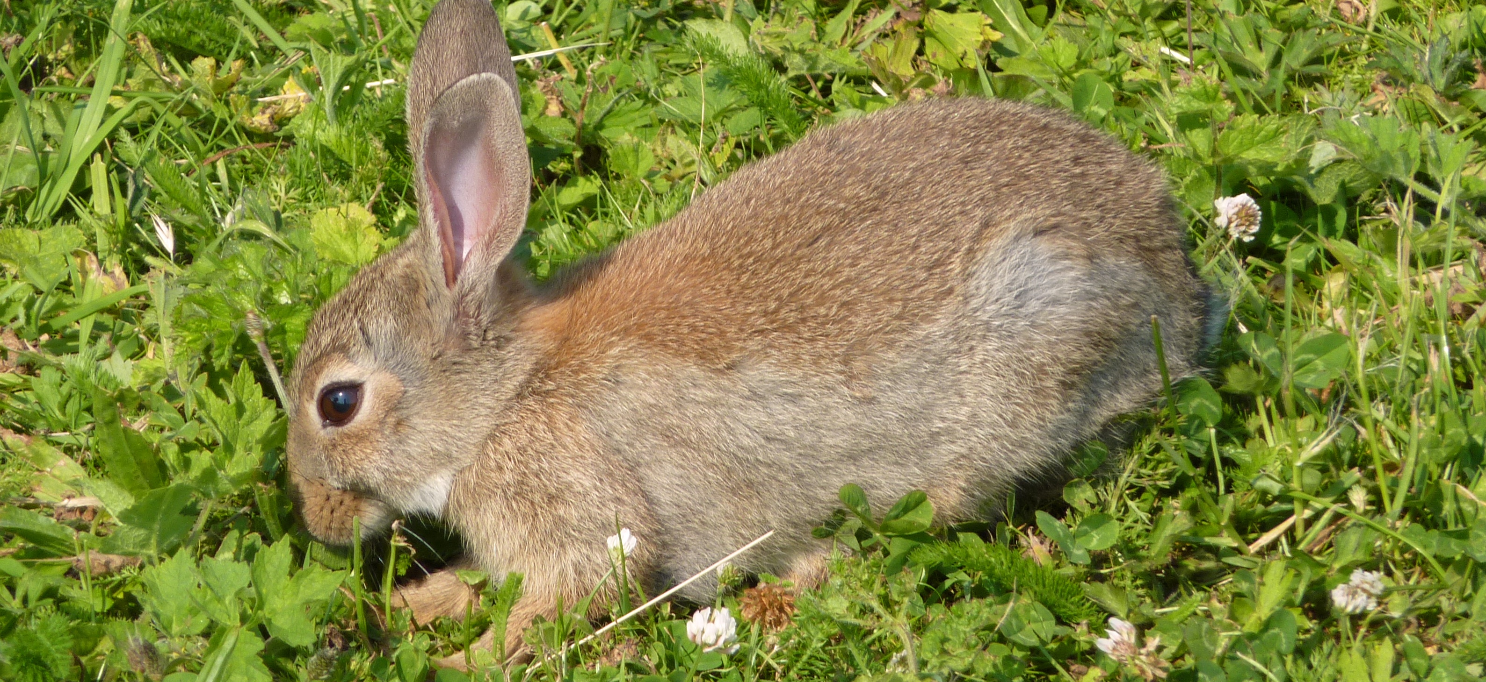
Tularemia
Causative agent: Francisella tularensis
  Fastidious, tiny, gram-negative coccobacillus
Tier 1 Select Agent
Primary hosts for F. tularensis are believed to be small rodents (hares, voles, muskrats, etc)
Ticks, mosquitoes, and biting flies also implicated as capable vectors
Notes:
The most likely exposure in a bioterrorism attack is from an aerosol and the pneumonic form would likely be the primary clinical presentation. F. tularensis was actively pursued as a biological warfare agent by both the United States and the former Soviet Union.
The bacterium’s low infective dose (<10 organisms) and ability to infect via aerosol not only make it a potential bioterrorism agent but also a significant occupational hazard in the clinical microbiology laboratory.

Slide 4
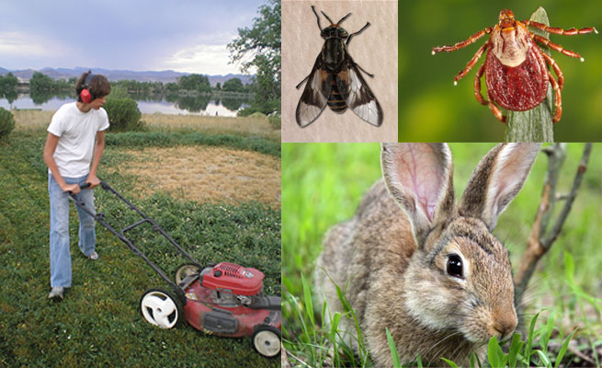
Transmission
Tick or Deer Fly Bites
Infections due to tick and deer fly bites usually take the form of ulceroglandular or glandular tularemia (80% of cases)
Ulceroglandular=cutaneous ulcer with regional lymphadenopathy
Handling infected animals
Hunting or skinning infected rabbits, muskrats, prairie dogs and other rodents
Domestic cats are very susceptible
Other exposures
Inhaling dust or aerosols leading to pneumonic tularemia (rare)
Farming or landscaping activities
“Lawnmower disease”
Person to person has not been reported
Notes:
Ulceroglandular-bacteria replicates at localized site of penetration, where an ulcer usually forms. From the penetration site(s), bacteria are transported by the lymphatic system to regional lymp nodes which serve as a secondary site for continued replication. In severe cases, the bacteria may then disseminate through the bloodstream to other sites including the lungs, liver and spleen.

Slide 5
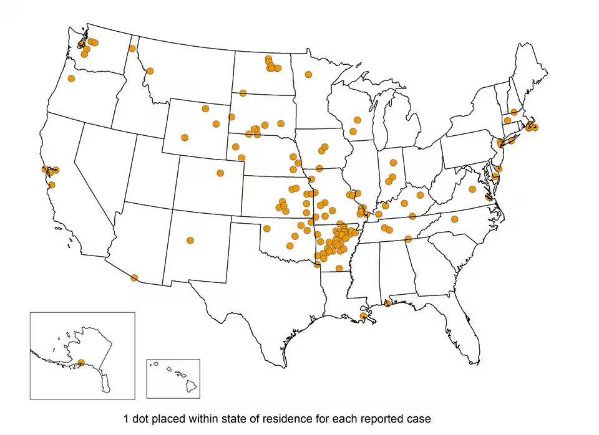
Human Cases 2010 to 2020
Notes:
Tularemia has been reported from all states except Hawaii, but is most common in the south central United States, the Pacific Northwest, and parts of Massachusetts, including Martha’s Vineyard.
2020 – 150
2019 – 274
2018 – 229
2017 – 239
Has gone down. Highest 1950 - 927

Slide 6
Clinical Presentation
Ulceroglandular (80% of cases)
Non-healing ulcers on extremities, lymphadenopathy
Glandular
Like ulceroglandular form, but no ulcer
Oculoglandular
Painflu, purulent conjunctivitis, lymphadenopathy
Oropharyngeal
Typhoidal
Pneumonic
Notes:
Oropharyngeal - Sore throat which is painful beyond its appearance and does not respond to penicillin
Typhoidal (systemic) - Bacteremia, delirium, prostration and shock
Pneumonic - Dry, nonproductive cough, dyspnea, fever

Slide 7
Specimen Collection
Pulmonary
Sputum, bronchial or tracheal washing
Glandular/ulceroglandular form
Lymph node aspirate or biopsy
Ulcer aspirate, swan or scraping
Septicemia
Blood Culture

Slide 8
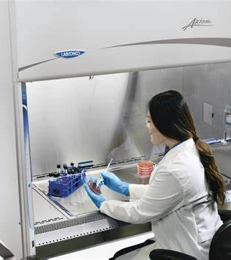
Biosafety
F. tularensis is highly infectious
  10-50 CFU is sufficient to cause disease
Tularemia is one of the most common laboratory acquired diseases
  >400 lab acquired cases since the 1920’s
Always work in a BSC if trying to rule out F. tularensis
Initial processing of specimen: BSL-2
Cultures or aerosol-generating procedures: BSL-3

Slide 9
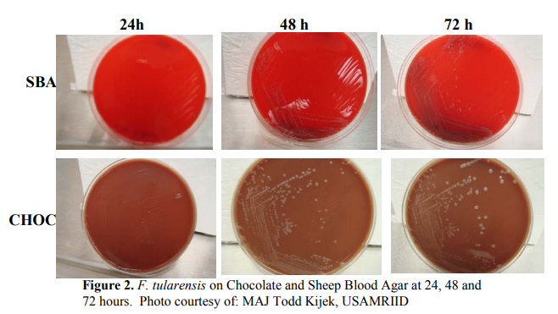
Colony Morphology
Notes:
Culture characteristics/morphology
Fastidious, slow-growing organism
Grows poorly or not at all on agar lacking Cysteine
SBA-May grow initially, but may not grow after subsequent subpassing
No growth on MAC
If it’s growing on BAP’s, it’s probably getting Cysteine from the source specimen but may not subpass to another one
Usually too small to be seen at 24 hours individually on any media
Cystine or L-cysteine-enriched media commonly available at clinical laboratories
Chocolate agar (CHOC)
At 48 hours 1 mm colonies are shiny, gray-white and flat, with smooth, entire edges
At 72 hours, 2-3 mm gray-white opaque, smooth colonies
Thayer-Martin (T-M) (selective media containing antibiotics and antifungals)
Typically grows slower on Thayer-Martin compared to other cysteine containing media
Buffered Charcoal Yeast Extract (BCYE)

Slide 10
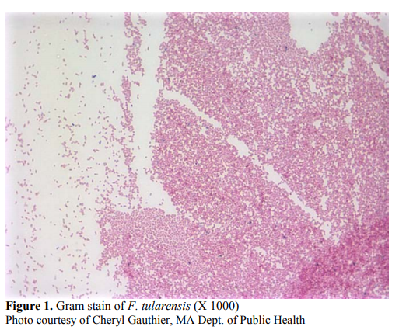
Gram Stain
  Very tiny gram-negative coccobacilli
    Poor counterstaining with safranin

Slide 11
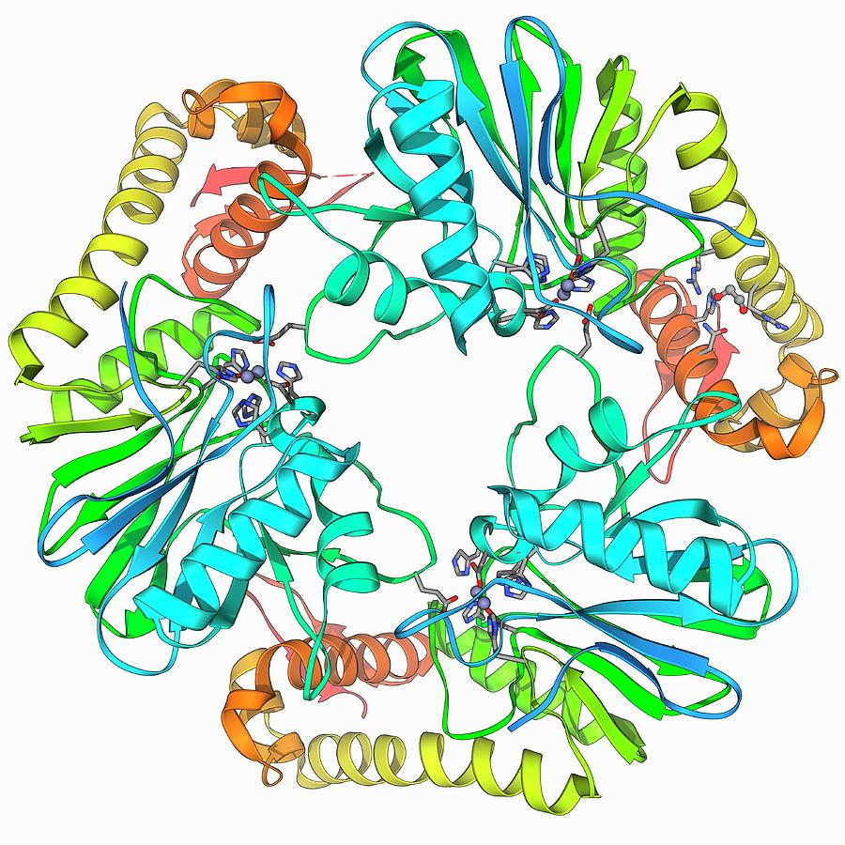
Biochemicals
Oxidase = Negative
Catalase = Weakly Positive
Urease = Negative
Beta Lactamase = Positive within 5 minutes
Satellite Growth=Negative
*Indole=Negative

Slide 12
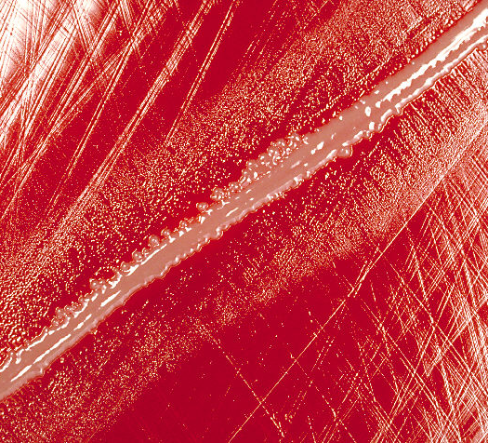
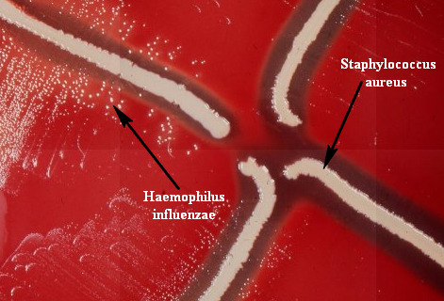
Satellite Test
Staph aureus is inhibitory to F. tularensis whereas
H. influenza will grow well with the satellite test
This Photo by Unknown Author is licensed under CC BY-SA
Notes:
F. Tularensis is negative, whereas H. influenza will grow well with the satellite test
Blood agar – only X is available, V is inside the RBCS therefore you get smaller colonies
The Staph aureus streak lysis the RBCS in the agar providing access to the V factor
The farther away - the smaller the colonies get

Slide 13
Automation
Not recommended for identification of F. tularensis
Biosafety issues
F. tularensis is often misidentified
Haemophilis, Aggregatibacter
F. tularensis is slow growing and biochemically inactive
The number of F. tularensis strains used to generate databases is typically very limited

Slide 14
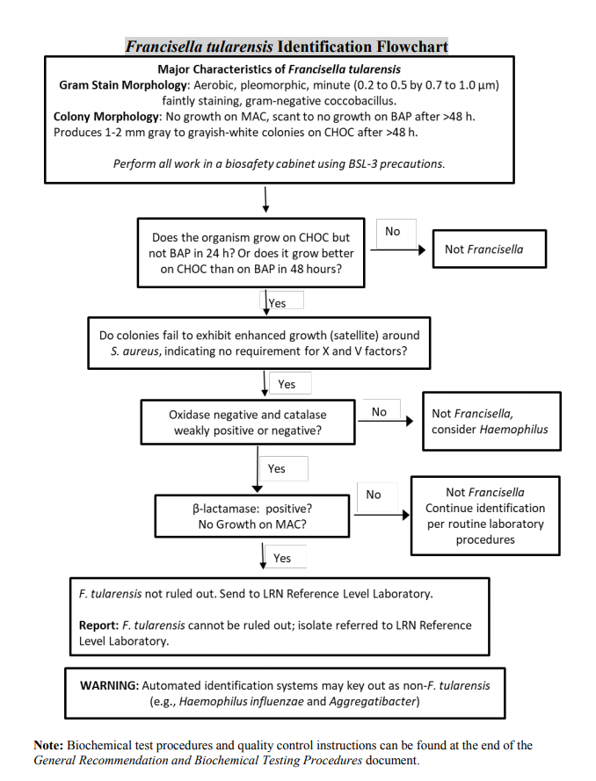
Sentinel Lab Flow Chart
https://www.hhs.nd.gov/Laboratory-services/biothreat

Slide 15
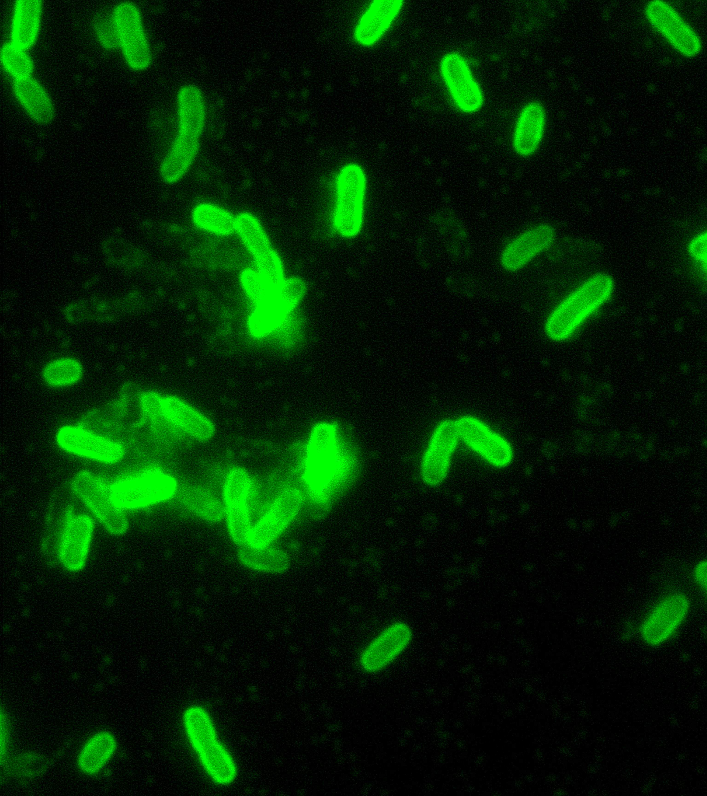
LRN Reference Lab Tests
Growth on CHAB (Cystine Heart Agar)
Gram Stain
PCR Testing
Direct Fluorescent Antibody (DFA) (Confirmatory)

Slide 16
Decontamination
Autoclave or incinerate
Generally, all plates, tubes and clinical material that contain the organism should be autoclaved or incinerated on-site
If no autoclave is available, contaminated items should be soaked in fresh 10% bleach or 10% formalin for 24 hours.

Slide 17
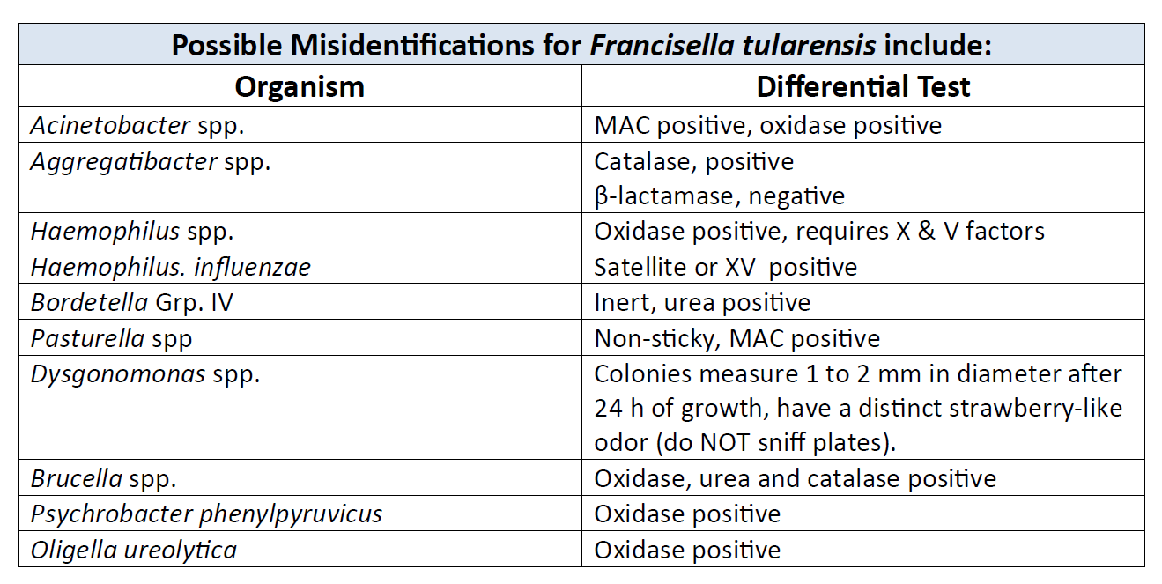
Ways to Prevent Misidentification
Notes:
Don’t forget to remember Francisella when working up any slow grower
Haemophillis is the most common

Slide 18
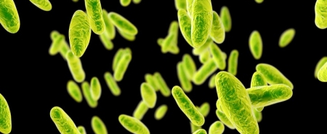
Brucella

Slide 19
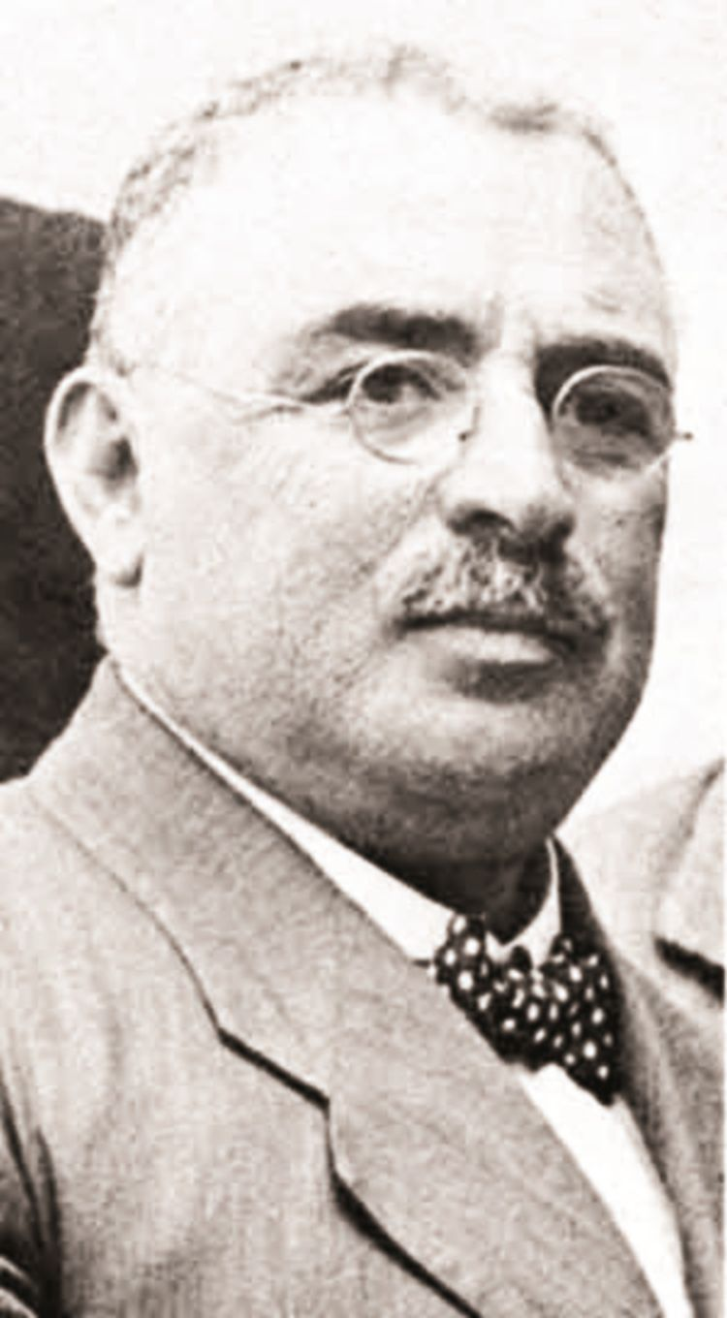
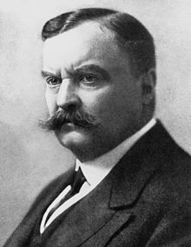
History
David Bruce isolated the organism from four fatal cases in 1887 and named it Micrococcus melitensis.
A Greek physician working with Bruce demonstrated in 1905 that the Maltese goat
  often with no clinical signs of illness
  carried the organism and served as the source of infection through consumption of unpasteurized milk by military personnel.
Goat’s milk was banned
Notes:
The disease we know as brucellosis was first discovered in Malta when Britain had a military base on this island during the 18th and 19th centuries.
During this period, several British doctors provided vivid descriptions of illness in troops and physician David Bruce was dispatched to investigate; he isolated the
organism from four fatal cases in 1887 and named it Micrococcus melitensis. A Greek physician
working with Bruce, Themistokles Zammit, demonstrated in 1905 that the Maltese goat – often
with no clinical signs of illness – carried the organism and served as the source of infection through consumption of unpasteurized milk by military personnel. Goat’s milk was banned and
the illness in troops ended in 1906.

Slide 20
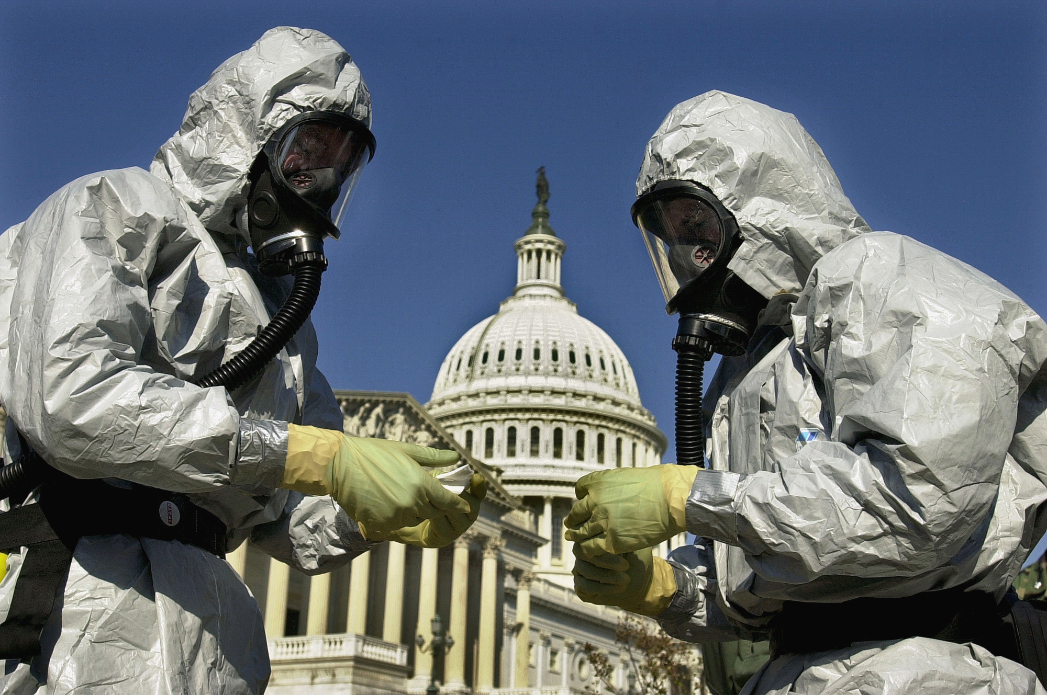
Biothreat
Brucella as a biological weapon resides in the fact that it is transmissionable through a spray
10 to 100 bacteria would be enough to infect people
In 1954, B. suis was the first infectious agent used as a biological weapon in the United States.
Several other countries have been suspected of studying the agent as a biological weapon, but to date, no use of Brucella in a bioterrorist attack has been reported.
Notes:
The interest of Brucella as a biological weapon resides in the fact that transmission through a spray is possible, as has been reported with human contamination during abortion of infected animals or bacterial spraying in laboratories. The bacteria is highly contagious. It is suggested that 10 to 100 bacteria would be sufficient to produce a contaminating spray for humans.
In 1954, B. suis was the first infectious agent used as a biological weapon in the United States. Several other countries have been suspected of studying the agent as a biological weapon, but to date, no use of Brucella in a bioterrorist attack has been reported. Brucella, and notably B. melitensis and B. suis, are considered as agents unlikely to be used as biological weapons: their incubation is long, the majority of infections are asymptomatic and mortality is low. However, the morbidity of this agent should not be underrated since it leads to chronic and disabling pathologies.
Brucella spp. Is listed among CDC’s category B bioterrorism agents.

Slide 21
Select Agent
Discussion of removal of all Brucella species from the select agent list
Rationale
  Low fatality rate
  Causes mild clinical symptoms
  No evidence of person-person transmission (under normal circumstances)
  Humans are typically exposed by animals or animal products
  Ample and effective antibiotics
Notes:
Low fatality rate in detected cases
Humans are a dead end host
B. Suis was one of the first bioweapons developed by the us in the 1950s. Since then there have been more insidious and potent pathogens that have been identified in the past 70+ years
Was open to public comment until April 1st

Slide 22
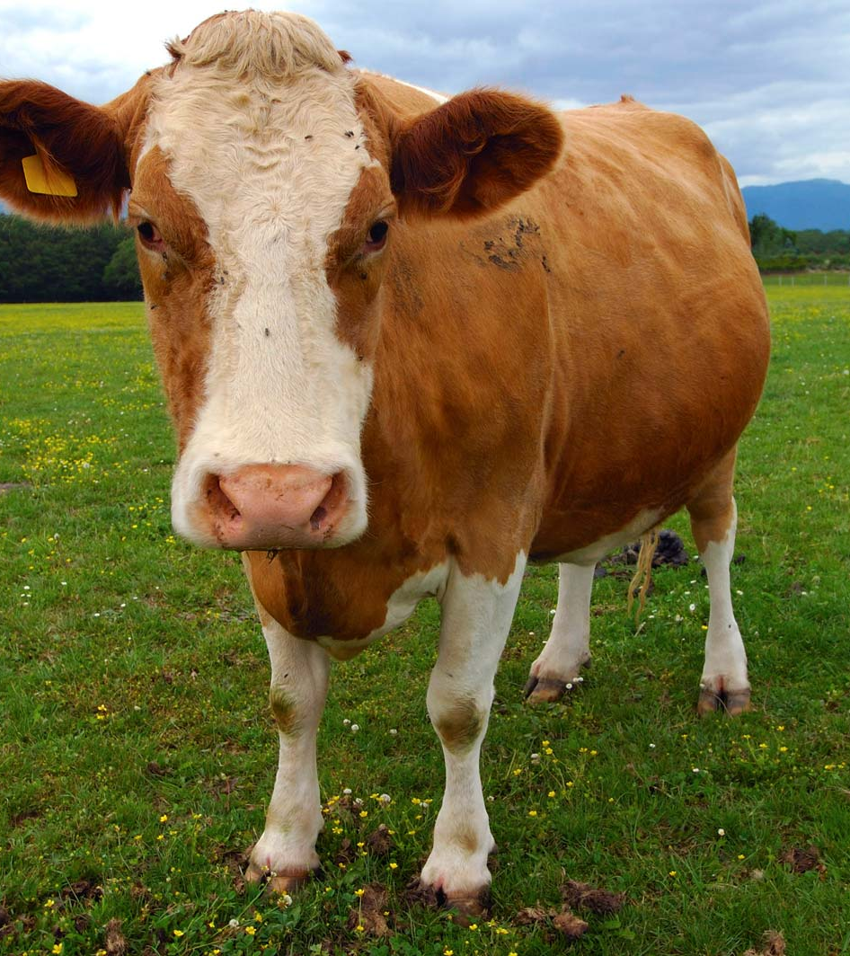
Brucella
Zoonotic disease caused by:
B. abortus – cows
B. melitensis – sheep and goats
B. suis – pigs
B. canis. - dogs
Notes:
Brucellosis formally called Maltese Fever is a zoonotic disease which means it’s a disease of animals that is transmitted to humans. It is caused by various Brucella spp. but predominately B. abortus, B. melitensis, and B. suis, with rare cases reported due to infection with B. canis. Each species associated with a particular animal. B. abortus is associated with cows, B. Melitensis with sheep & goats. B. Suis with pigs. and B. canis, is associated with dogs. Although brucellosis is highly endemic in many countries such as Peru, Mexico, Spain, Greece, Iraq, Iran, Jordan, and Kuwait, it is rare in the U.S., with approximately 100 cases per year.

Slide 23
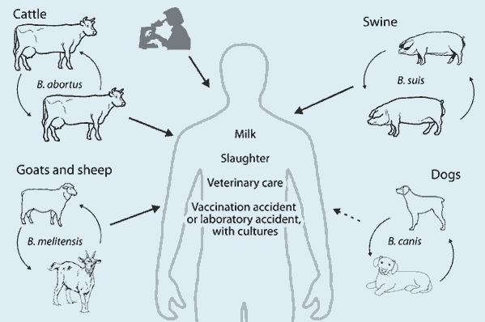
Transmission
Notes:
The most common mode of brucella transmission is the consumption of unpasteurized dairy products. When sheep, goats, cows, or camels are infected, their milk becomes contaminated with the bacteria.
If the milk from infected animals is not pasteurized, the infection will be transmitted to people who consume the milk and/or cheese products.
Brucella can also be transmitted through direct contact with infected animal tissues and bodily fluids, and is an occupational hazard for farmers, veterinarians, butchers, and laboratory workers. Although person-to-person transmission is not epidemiologically significant aerosols containing Brucella spp. are considered to be highly infectious. Inhalation of between approximately 10-100 bacteria is sufficient to cause a Brucella infection in humans. Brucellosis is also one of the most commonly reported laboratory-acquired infections

Slide 24
Clinical Presentation
Acute Disease
Chronic Disease
Fever (usually at night)
Profuse sweating
Malaise
Headache
Muscle pain
Relative lymphocytosis
Develops if left untreated
Chronic fatigue
Depression
Ocular damage
Spondylitis
Naturally occurring brucellosis has a low mortality rate
(<2%) yet can be extremely incapacitating and disabling.
Notes:
The clinical presentation of Brucellosis is variable, which makes it hard to diagnose. The incubation period for brucellosis is also highly variable, ranging from 5 days to 2 months. The acute disease usually starts with flu like symptoms including fever (usually at night), profuse sweating, malaise, headache, and muscle pain. The white count tends to be normal or reduced, with a relative lymphocytosis. On physical exam splenomegaly may be the only finding. Some patients may recover on their own but others continue with other symptoms. If left untreated with continued symptoms, a chronic form of the disease may develop. Chronic brucellosis is characterized by chronic fatigue, depression, ocular damage, and spondylitis. Naturally occurring brucellosis has a low mortality rate (< 5%), yet can be extremely incapacitating and disabling. Relapses may occur months after the initial episode, even after apparently successful treatment. Brucella infections are intracellular & usually hard to root out.

Slide 25
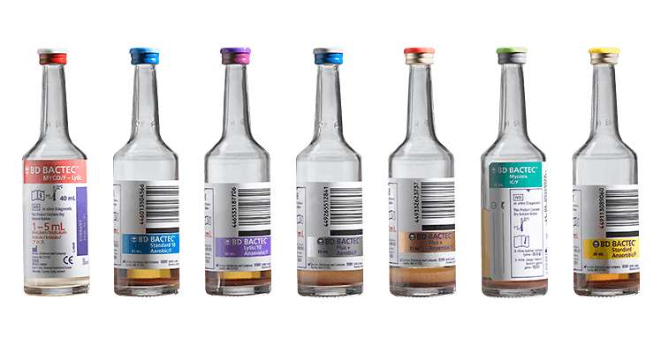
Blood Cultures and Bone Marrow
**Incubate for a minimum of 14 days if Brucella is suspected**
Notes:
The Specimen of choice due to the intracellular nature of the organism is Blood culture and Bone marrow. Current blood culture systems can detect Brucella spp incubated for as little as 5 days. However, due to the fastidious nature of thses organisms, cultures of suspected brucellosis patients should be incubated for a min of 14 days prior to discard.

Slide 26
Other Acceptable Specimens
  CSF
  Synovial Fluid
  Biopsy material from lymph nodes, liver or spleen
  Nasal swabs: only useful in the first 24 hours of exposure
Notes:
Other Acceptable specimens for culture include: CSF, synovial fluid, Biopsy material from lymph nodes, the liver or spleen, and Nasal swabs. However, nasal swabs are only useful in the first 24 hours of exposure.
Set up the specimen on Bld, Choc, and Mac and incubate at 35 degrees.
When culturing from nonsterile body sites, you may add a Martin Lewis or Thayer Martin plate to keep down contaminants.

Slide 27

Biosafety
BSL-2: Required when working with potentially infectious clinical material
BSL-3: Required when working with suspected or confirmed isolates
Brucella is a highly infectious organism and the infective dose is very low

Slide 28
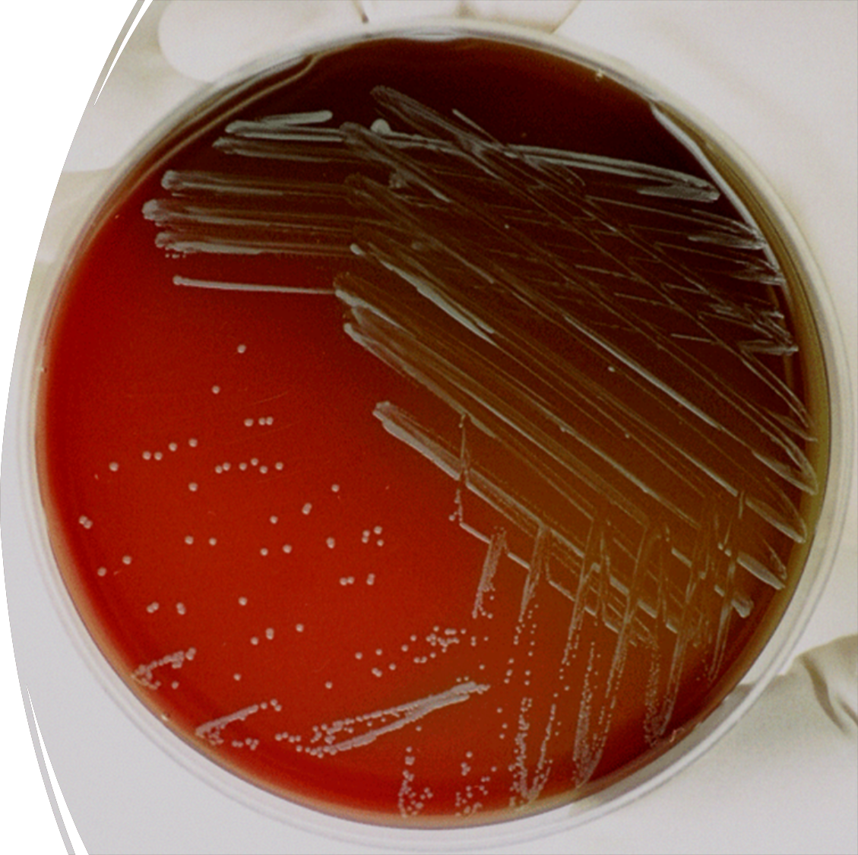
Colony Morphology
24 Hours
  May not be visible
48 Hours
  Small
  Raised
  Glistening
  White-cream to gray
  Non-hemolytic

Slide 29
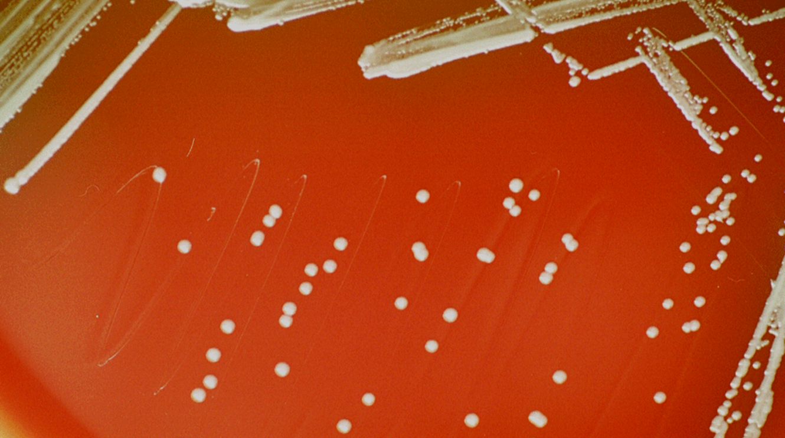
http://phil.cdc.gov/phil/details.asp

Slide 30
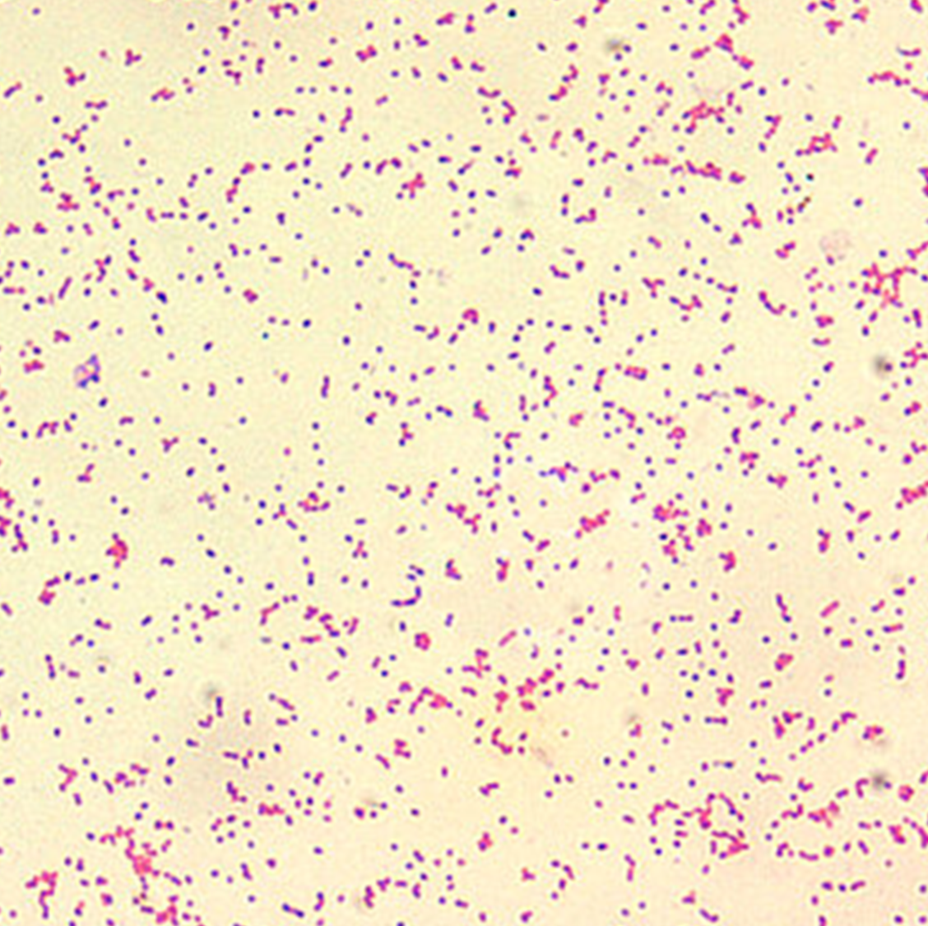
Gram Stain
Very tiny
  0.5-0.7 by 0.6 microns
Faintly staining
Gram negative coccobacilli
“Fine sand”

Slide 31
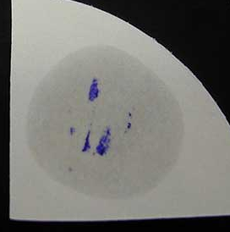
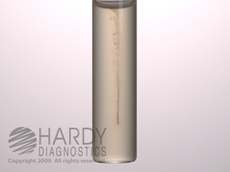
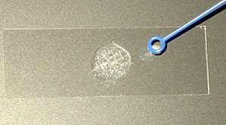
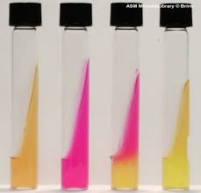
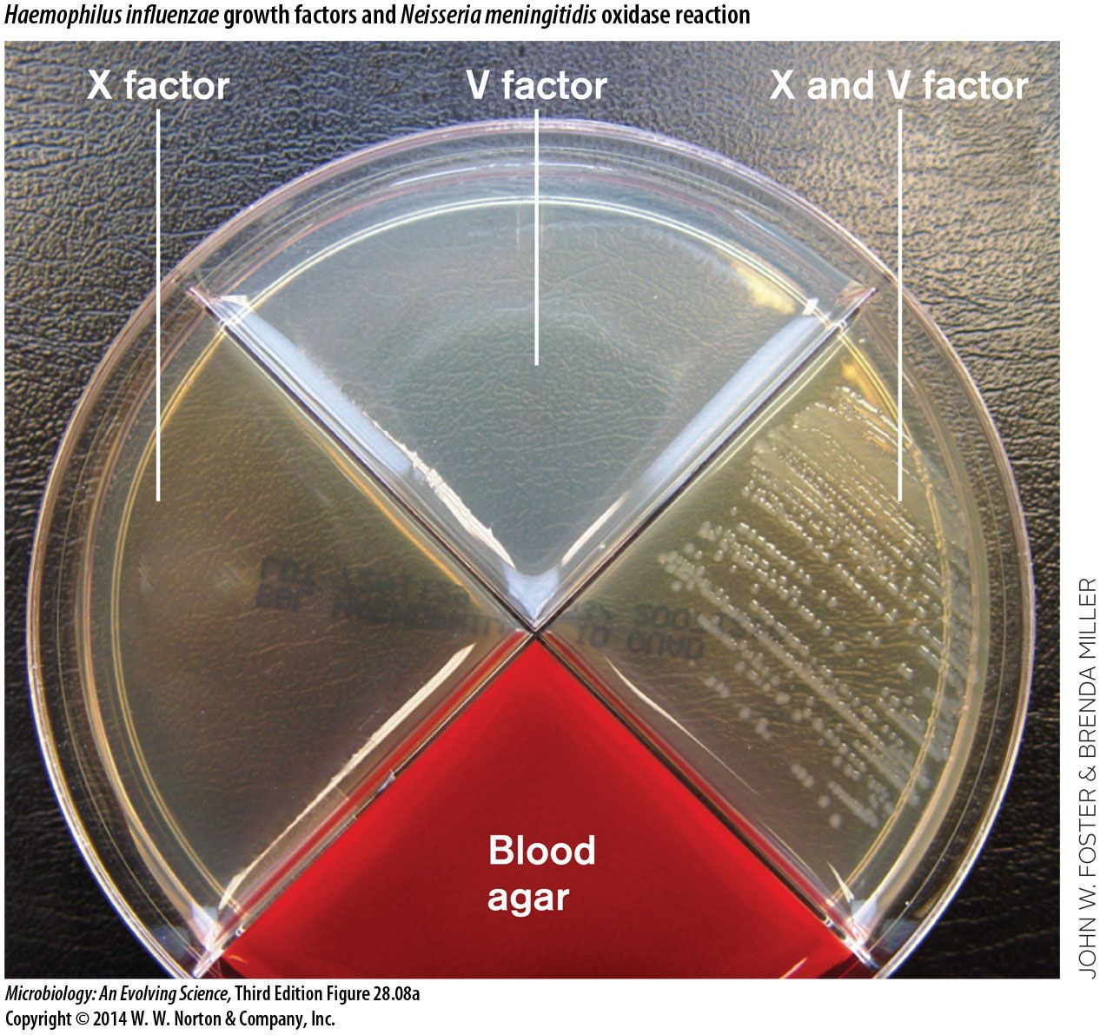
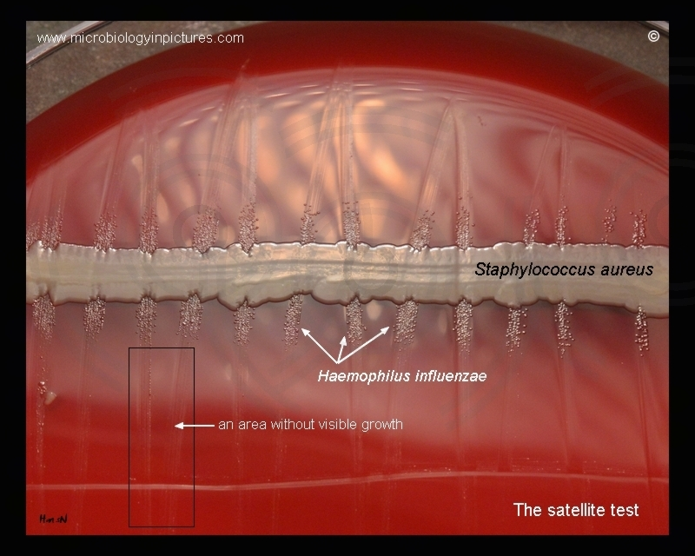
Biochemicals
  Oxidase – positive
  Catalase - positive
  Motility – negative
  Does not need X or V factor
  Urea – positive
  B. canis and B. suis will
  be positive in <5 mins

Slide 32
LRN Reference Lab Tests

Slide 33
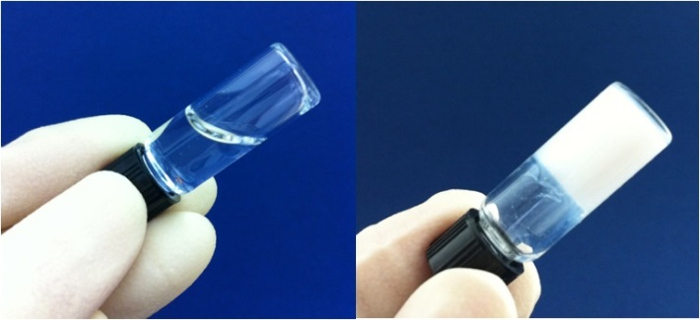
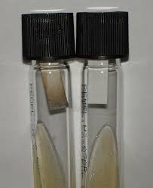
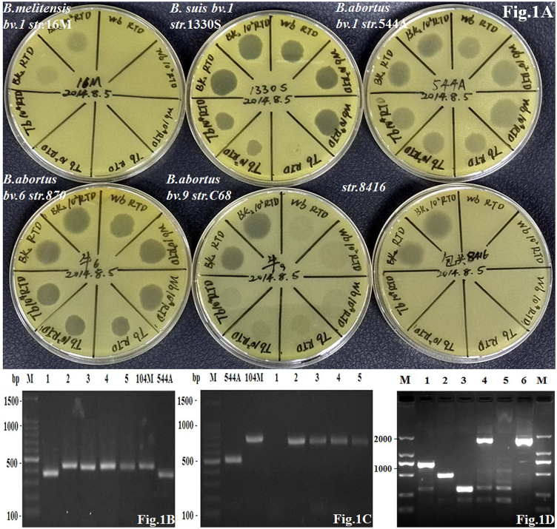
Notes:
The tubes in the upper left hand corner show how we test for H2S production. The tube with the black strip is positive for H2S. B. suis and abortus are both variable according to our chart from the previous slide so they might show a positive H2S. The middle picture is showing our Tbilisi phage test. In the upper right hand corner we have our Urea tubes. B. canis and B. suis will usually be positive within 5 mins of inoculation so they would look like the further right tube where is has pink on top and yellow on the bottom. After 24 hrs of incubation those 2 organisms would look like the middle tube and B. melitensis and abortus will look like the tube on the right. The tube on the left is what a negative urea test would look like. The bottom picture is showing our gel formation test. The right tube is forming a gel so it is positive and the left one is negative. B. canis is the only one that should form a gel in this test.

Slide 34

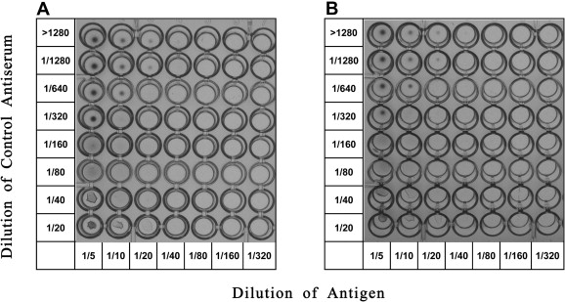
LRN Reference Lab Tests
PCR
Brucella Microagglutination test (BMAT)
Notes:
PCR is used as a confirmatory test for B. canis, suis, abortus, and melitensis. But doesn’t differenate between the 4 strains. In addition to culture and PCR, serology is frequently used for diagnosis of brucellosis. The Brucella microagglutination test (BMAT) is considered to be the gold standard and a fourfold rise in titer yields a definitive diagnosis of brucellosis.

Slide 35
Case Study
Microbiologist A
  September 28 - presented with symptoms
  October 22 - hospitalized
  October 26 - an unidentified blood culture isolate from microbiologist A (isolate A) was submitted for identification to a Minnesota clinical laboratory and determined to be Brucella spp
  July 17, microbiologist A had subcultured on an open laboratory bench an unidentified isolate (isolate C) from a referring laboratory.
    Isolate C subsequently was forwarded for identification to the same Minnesota clinical laboratory and identified as Brucella spp.
Microbiologist B
October 25 - hospitalized and recovered with treatment
November 9 - the Minnesota laboratory identified a blood culture isolate from microbiologist B (isolate B) as Brucella spp.
Microbiologist B didn’t handle isolate A from microbiologist A
However they had handled two unidentified isolates identified as Brucella spp
First exposure had occurred on July 21 while handling isolate C
The second exposure had occurred on August 8 during testing of an isolate from a Texas referring clinical laboratory (isolate D)
Notes:
Indiana. On September 28, 2006, a microbiologist aged 47 years (microbiologist A) who worked at a clinical laboratory had onset of high fever, sweating, malaise, anorexia, headache, and hip pain. Initially, her symptoms were not severe; she did not seek medical treatment until 3 weeks later, after her symptoms had progressively worsened. The microbiologist was hospitalized on October 22 and recovered fully with treatment. On October 26, an unidentified blood culture isolate from microbiologist A (isolate A) was submitted for identification to a Minnesota clinical laboratory and determined to be Brucella spp.; both MDH and IDSH were notified of the finding. Epidemiologic investigation later revealed that, on July 17, microbiologist A had subcultured on an open laboratory bench an unidentified isolate (isolate C) from a referring laboratory. Isolate C subsequently was forwarded for identification to the same Minnesota clinical laboratory and identified as Brucella spp.
Minnesota. On October 25, a microbiologist aged 61 years (microbiologist B), who worked at the same Minnesota clinical laboratory that received microbiologist A's isolate, had onset of low-grade fever, fatigue, and night sweats. She was hospitalized and recovered with treatment. On November 9, the Minnesota laboratory identified a blood culture isolate from microbiologist B (isolate B) as Brucella spp. and notified MDH. The subsequent investigation determined that microbiologist B had not handled isolate A from microbiologist A. However, previously she had handled on an open bench two unidentified isolates subsequently identified as Brucella spp. Her first exposure had occurred on July 21 while she was handling isolate C, which had been forwarded from the Indiana clinical laboratory. The second exposure had occurred on August 8 during testing of an isolate from a Texas referring clinical laboratory (isolate D).

Slide 36
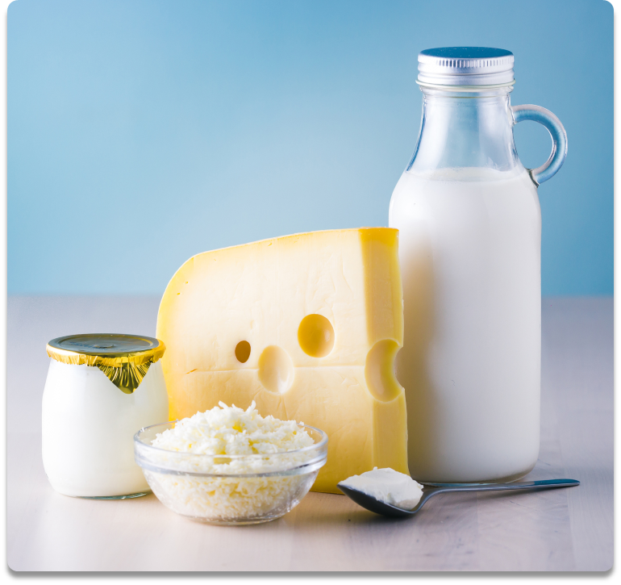
Case Study
June 1 to Aug. 7, 2017
Exposures in Alabama, Arkansas, California, Ohio, North Dakota, Tennessee and Texas
Milk from herd was tested, 2 samples were positive
RB51 is a strain used to vaccinate cattle and may be passed through the milk
Notes:
Another case delt with with Brucella RB51 in raw milk. Brucella RB51 is a vaccine strain for cattle; they are vaccinated to protect against Brucella infections, which helps prevent spontaneous abortions and Brucellosis in cattle.
Humans may be exposed to Brucella RB51 accidentally while administering the vaccination or by drinking raw milk; if infected, long-term effects of brucellosis include problems with the heart, liver, and spleen; arthritis, and nervous system problems.
If exposed, Prophylaxis is recommended to prevent infection and long-term effects and to prevent miscarriage in pregnant women.
A Brucella RB51 exposure event occurred in the US in the summer of 2017. Exposures were believed to have occurred from June 1 to Aug 7, 2017. The exposures were traced back to a dairy farm in Texas who sold unpasteurized milk at their farm.

Slide 37
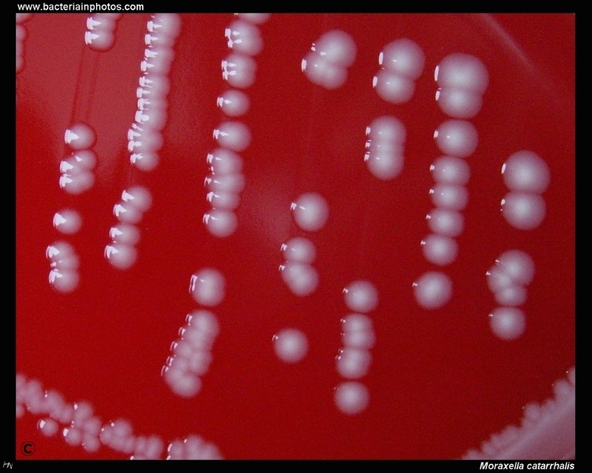
Misidentification
Moraxella spp.
  Shown in image
“slow-growing” Staph
Micrococcus spp.
Haemophilus spp.
Ochrobactrum anthropic
  Reclassed to Brucella
Acinetobacter spp.
Chryseobacterium indologenes
Notes:
Automated identification systems will most likely misidentify this organism
All Ochrobactrum species reclassified in to Brucella genus to align taxomical nomenclature with phylogenic analysis
Ways to differentiation original ochrobactrum
- rapid colony growth on MAC (24)
- classic Brucellas will be 72 or no growth on MAC
- Mucoid morphology
- Positive motility
If you report these organisms simply as Brucella species with report comments or education, clinicians who are unaware of the alternate name may inappropriately treat patients as having Brucellosis which implies disease due to classic brucella species.

Slide 38
Missed Organisms
Slow-growing, gram negative organisms
Francisella
  There is a seasonality to the organism
    Think of tick season (March – October)
Brucella
  May see increased cases from the unrestricting of selling unpasteurized milk products
Notes:
Anything slow-growing should trigger you to do rule-outs
Don’t write off as a facultative anaerobe
BUT!! We have seen it in December
Ask the healthcare team for any help with possible exposures if working up a slow grower

Slide 39
References
“Managing Potential Laboratory Exposures to Francisella Tularensis.” Centers for Disease Control and Prevention, Centers for Disease Control and Prevention, 13 Dec. 2018, https://www.cdc.gov/tularemia/laboratoryexposure/index.html.
Centers for Disease Control and Prevention. (2018, December 13). Signs & symptoms. Centers for Disease Control and Prevention. Retrieved August 4, 2022, from https://www.cdc.gov/tularemia/signssymptoms/index.html
Centers for Disease Control and Prevention. (2018, December 13). Transmission. Centers for Disease Control and Prevention. Retrieved August 4, 2022, from https://www.cdc.gov/tularemia/transmission/index.html
Dennis DT, Inglesby TV, Henderson DA, et al. Tularemia as a Biological Weapon Medical and Public Health Management. JAMA. 2001; 285: 2763-2773.
https://microbe-canvas.com/tests.php?p=2083# (12 September 2022)
“CDC - Home - Brucellosis.” Centers for Disease Control and Prevention, Centers for Disease Control and Prevention, www.cdc.gov/brucellosis/index.html.
North Dakota Department of Health, “Bench Guide for Bioterrorism Agents” 2018.

