Slide 1
Urothelial Carcinoma Screening Process During Routine Urinalysis
Erin Holdman, MLS(ASCP)^{CM}
Lead Clinical Laboratory Scientist, Transfusion Service and Urinalysis
Fargo VA HCS
April 2026

Slide 2
Overview/Objectives
Describe the elevated incidence of urothelial carcinoma within the veteran population and the factors contributing to this trend.
Identify key service‑related exposures associated with increased urothelial carcinoma risk.
Explain current VA presumptive policies relevant to urothelial carcinoma and their clinical implications.
Discuss the traditional role of urinalysis in screening for urothelial carcinoma, including its limitations.
Evaluate the Fargo VA Laboratory’s screening approach utilizing routine urinalysis microscopic evaluation,
including its workflow, diagnostic value, and potential impact on early detection.

Slide 3
Urothelial Carcinoma in Veterans – Key Facts
Urothelial carcinoma is the 4th most diagnosed cancer among VA patients, with ~3,200 new annual cases (VA News, 2022).
VA treatment data show a 61% rise in urinary (bladder, kidney, ureter) cancer between 2000–2018 in VA facilities. (McClatchy Analysis).
Agent Orange, Burn Pits, and Contaminated water/PFAS all contribute to increased risk (JAMA, 2023), (Federal Register, 2025), (VA News, 2022).
In 2021, bladder cancer was added to the list of presumptive conditions related to Agent Orange – (presumptive condition means the VA assumes that a veteran's service caused the condition).
Smoking has high correlation with bladder cancer.

Slide 4
Urothelial Carcinoma Definition and Diagnosis
Definition: Cancer arising from the urothelial lining of the bladder, ureters, or renal pelvis
Clinical Presentation: Typically presents with hematuria/microhematuria or urinary symptoms
The American Urological Association states microhematuria should be defined as ≥ 3 rbc/hpf
Clinicians may perform a risk-based evaluation and proceed accordingly:
  Repeat UA in 6 months
  Cystoscopy
  Upper tract imaging
  Tumor markers

Slide 5
Urine Cytology
Urine cytology on a clean-catch urine sample is used to
  Screen for urothelial carcinoma
  Evaluate for inflammatory or reactive changes
  Monitor patients with cancer history or who have high risk
Ordered as part of workup after clinician reviews patient symptoms
Non-invasive and can detect high grade carcinomas, and examines individual cells rather than tissue clusters
Valuable tool, but should be followed up with additional testing, including biopsy of tissue.

Slide 6
Urinalysis
Includes a physical exam, chemical exam, and microscopic exam.
Serves multiple purposes, and is ordered as part of
  Routine screening
  Diagnosis of health conditions
    UTI
    Kidney stone
    Diabetes, etc…
  Monitoring progression of chronic disease and effectiveness of treatment
Non-invasive and easy to obtain
Valuable tool

Slide 7
Historical Role of Urinalysis in Detection of Urothelial Carcinoma
Urinalysis is not typically used as a direct screening tool for diagnosing bladder cancer (Cells)
Screening for Urothelial Carcinoma from Urinalysis typically includes:
  Elevated RBC in urine by chemical and/or microscopic review of sediment
  Other symptoms?
  Evaluated by clinician after result entry
Urine microscopic components are well defined but do not typically include malignant cells in differential
  RBC, WBC, Squamous Epithelial cells, Non-squamous epithelial calls (transitional and renal epithelial cells)

Slide 8

Unidentified/Suspicious cells at Fargo VA
Fargo VA staff observed an increase in unidentified or “Suspicious” cells in urine sediment.
Cells did not fit into a category for microscopic sediment
No formal training to identify these cells or formal process to refer these cells for review.
Nothing in urinalysis textbooks for guidance.

Slide 9
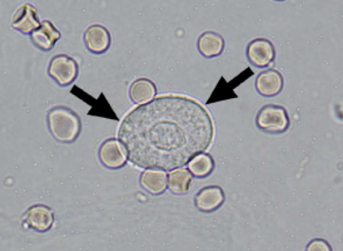
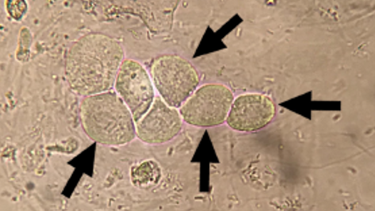
Microscopic Examination
Routine urinalysis sediment examination
Transitional epithelial cells and Renal epithelial cells images as provided from CAP (College of American Pathologists)

Slide 10
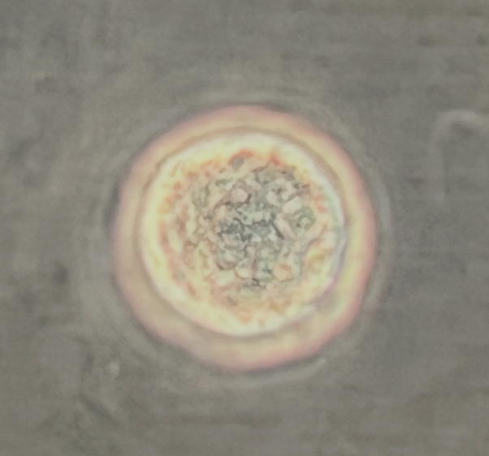
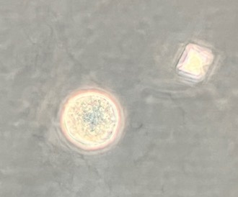
Examples of Unidentified Cells
Increase in unidentified urothelial cells
What did the unidentified cells look like?

Slide 11
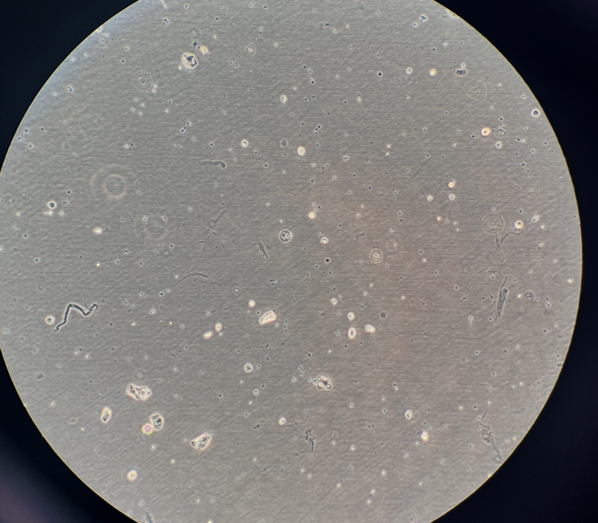
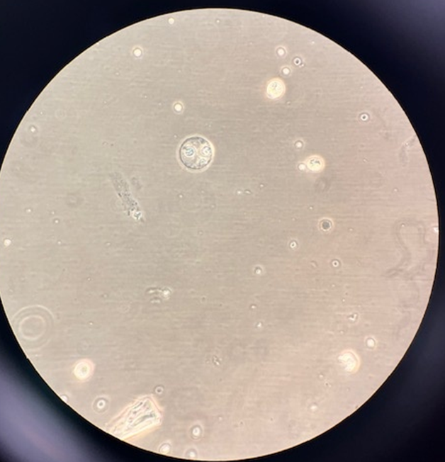
Examples of Unidentified Cells

Slide 12
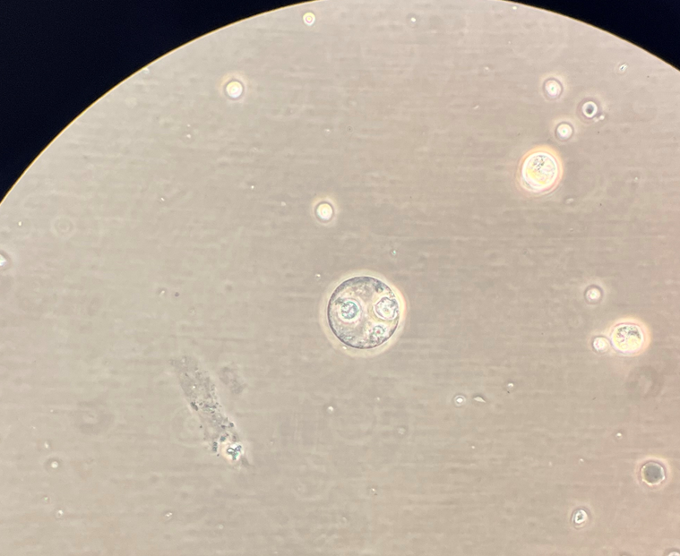
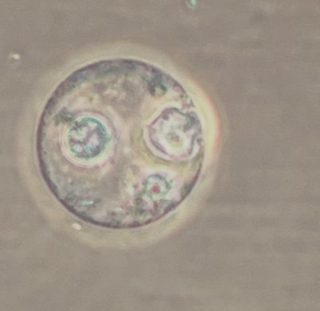
Examples of Unidentified Cells

Slide 13
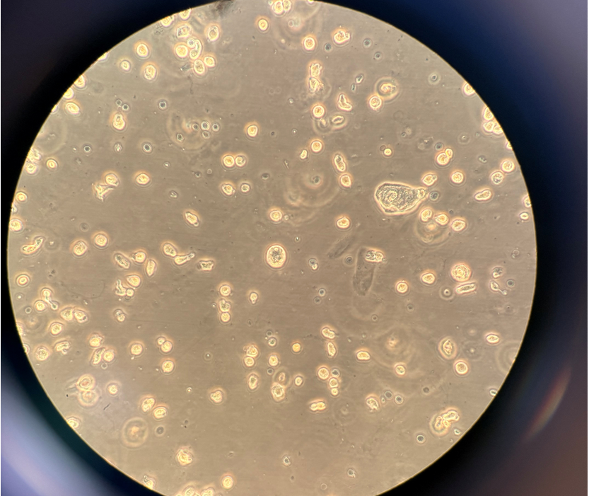
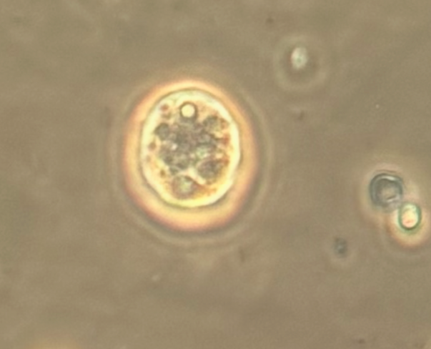
Examples of Unidentified Cells

Slide 14
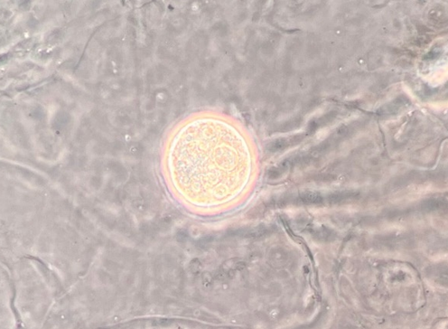
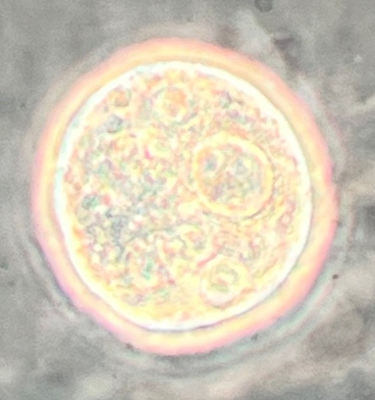
Examples of Unidentified Cells
Example of Unidentified cells - microscopic examination of Urine Sediment

Slide 15
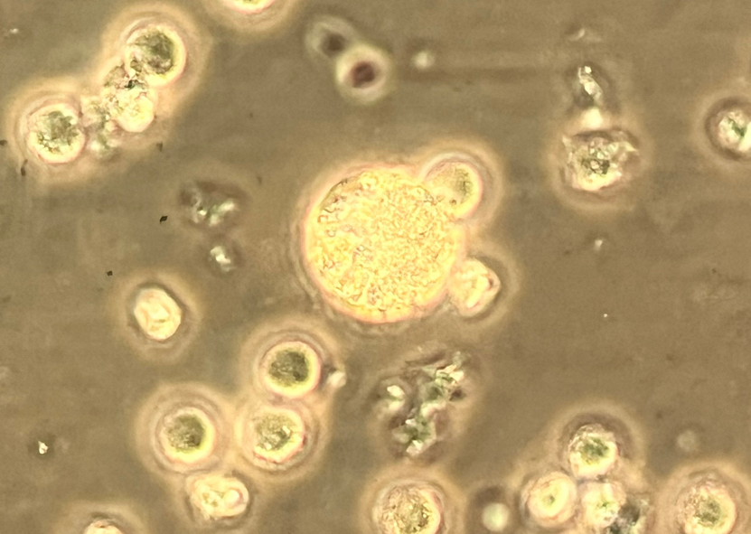
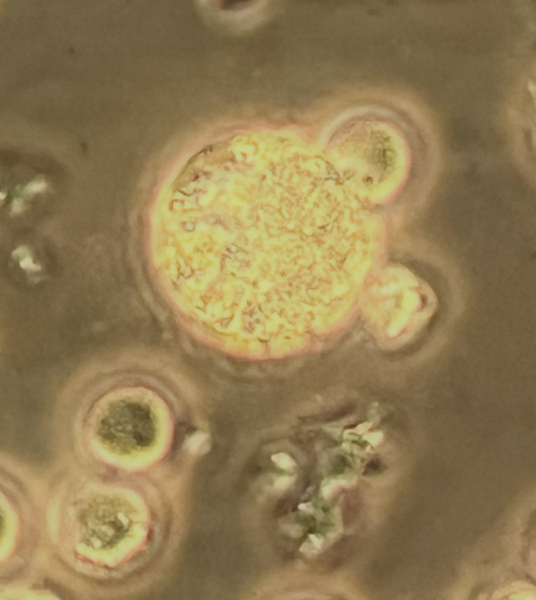
Examples of Unidentified Cells

Slide 16
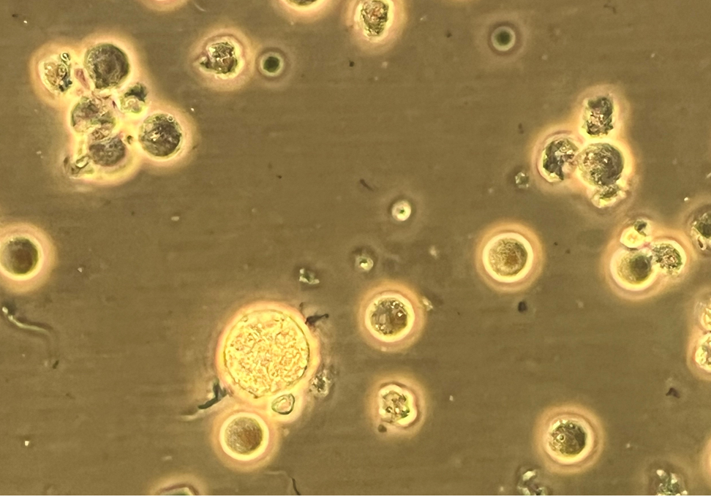
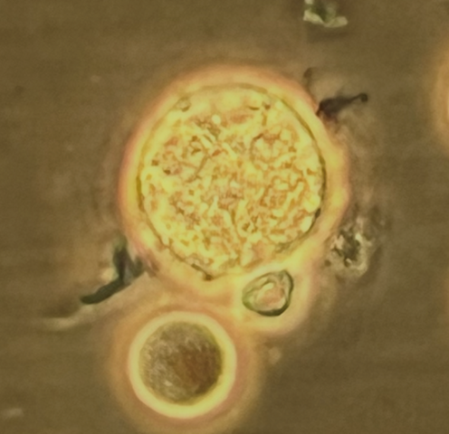
Examples of Unidentified Cells

Slide 17
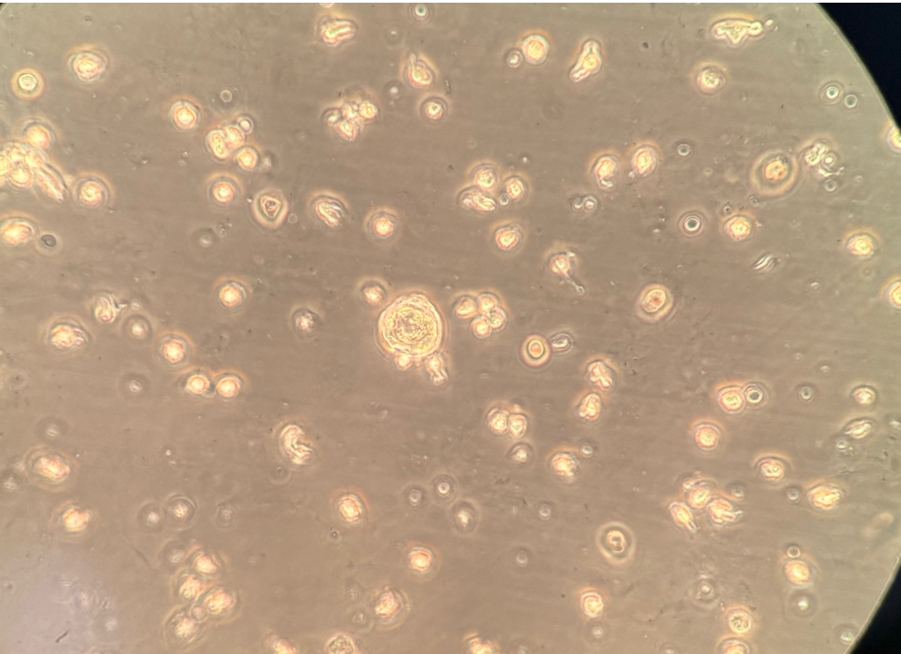
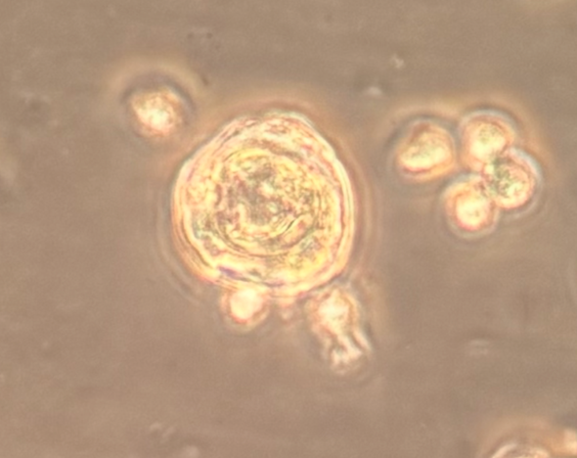
Examples of Unidentified Cells

Slide 18
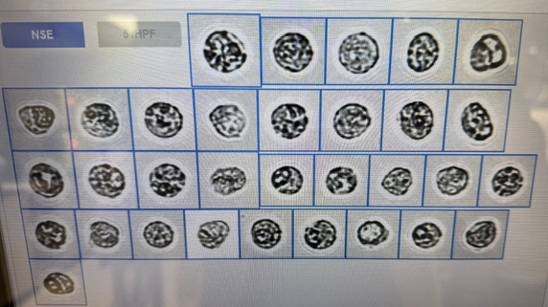
Examples of Unidentified Cells
Example of Unidentified cells on DxU 840
Notes:
Define NSE -

Slide 19
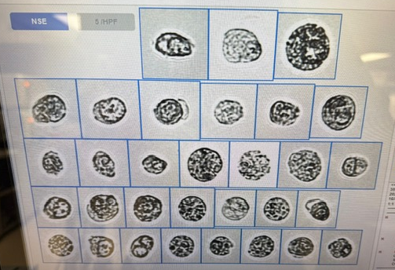
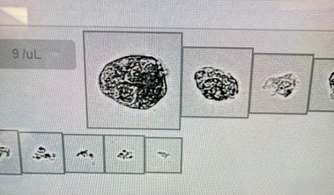
Examples of Unidentified Cells
Example of Unidentified cells on DxU 840

Slide 20
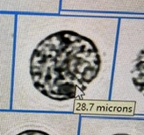
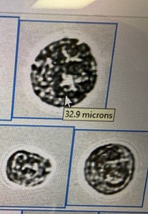


Examples of Unidentified Cells
Example of Unidentified cells on DxU 840

Slide 21
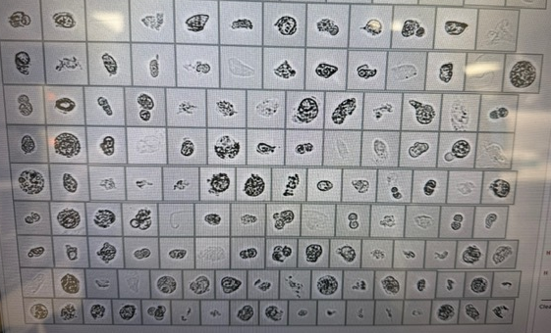
Examples of Unidentified Cells
Example of Unidentified cells on DxU 840

Slide 22
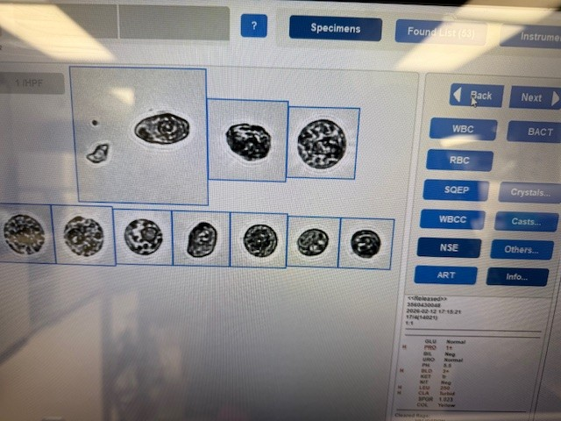
Examples of Unidentified Cells
Example of Unidentified cells on DxU 840

Slide 23
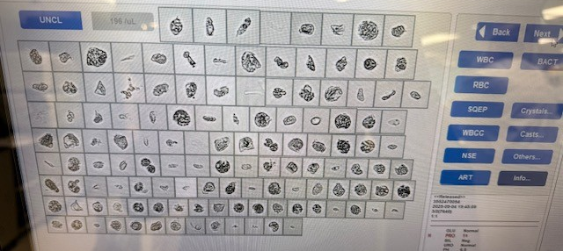
Examples of Unidentified Cells
Example of Unidentified cells on DxU 840

Slide 24
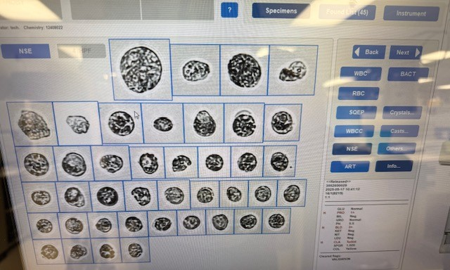
Examples of Unidentified Cells
Example of Unidentified cells on DxU 840

Slide 25
What do we do?
No MLS training to know what these cells are
  Maybe on the job training? Not common
  “Skiptocyte”?
No process for Pathologist to review cells -
  Do we send them back? Wet sample? Cytospin with heme stain?
  Do we order a test? Reflex??
  How do these results get documented?
Tech has no authority to reflex a Urine Cytology
  Costly test that may not be warranted
No process to provide feedback to techs
  Who are the techs correctly identifying
  What circumstances included the positive carcinoma? (RBC, WBC, etc…)
Notes:
Pathologist cannot diagnose on a wet mount, requires special stain.

Slide 26
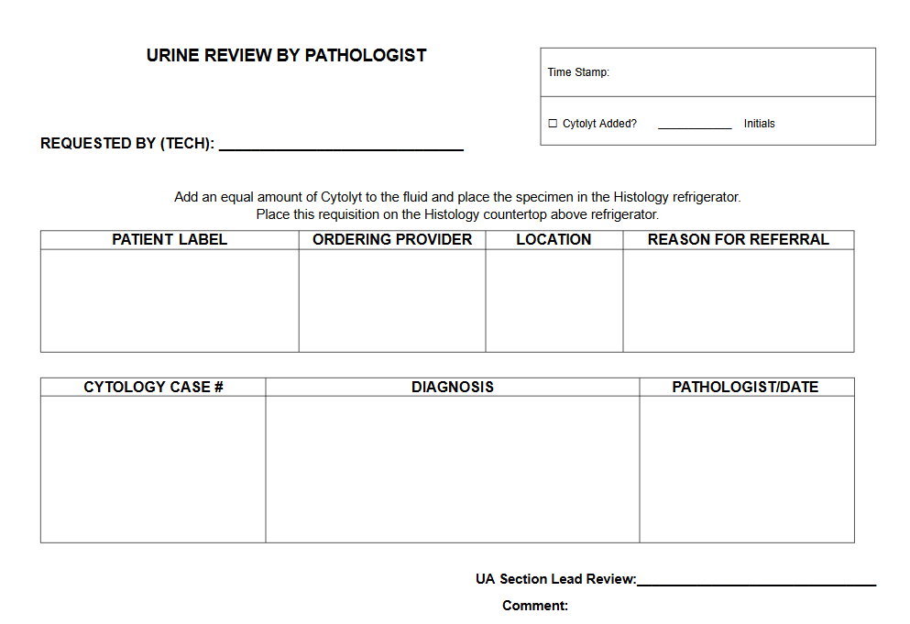
Initial Process

Slide 27
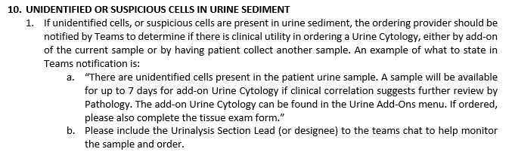
Procedure – Provider Notification

Slide 28
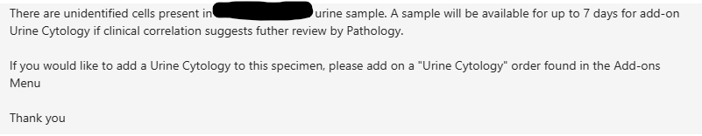

Example of Notification to Provider via Teams

Slide 29
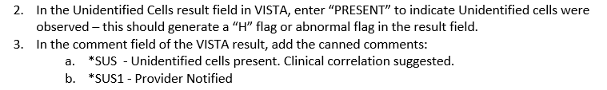

Procedure – Result Entry

Slide 30
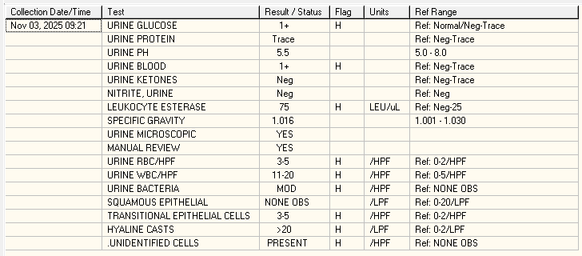
Example of Patient Result Report

Slide 31
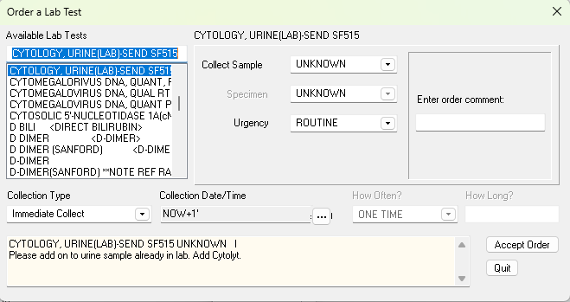
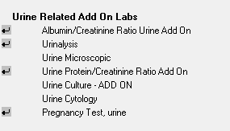
Example of Urine Add On process

Slide 32
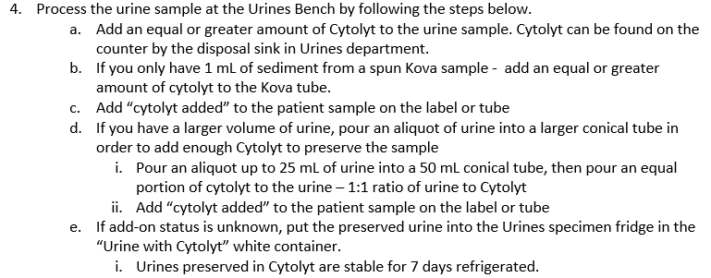
Procedure – Specimen Processing

Slide 33
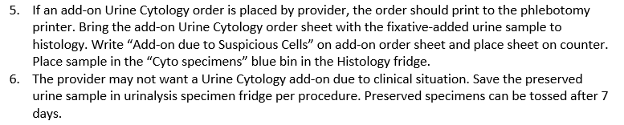
Procedure – Specimen Processing

Slide 34
Detection Rate for Fargo Techs
Detection rate when Technologist notifies ordering provider of “unidentified cells” – Provider led reflex Urine Cytology
Date | Unidentified Cells Reported | Add-ons requested | Positive for Urothelial carcinoma | Percent detection rate (add-on:positive)
11/2025 | 1 | 1 | 1 | 100%
10/2025 | 2 | 0 | 0 | NA
9/2025 | 7 | 5 | 4 | 80%
8/2025 | 5 | 2 | 2 | 100%
7/2025 | 2 | 0 | 0 | NA
6/2025 | 6* | 0 | 0 * | NA * (patient positive by cystoscope sample)
05/2025 | 7 | 4 | (2 were atypical) | 0-50%
04/2025 | 10 | 9 | 1 (5 atypical) | 10-60%
03/2025 | 6 | 3 | 1 | 33%

Slide 35
Detection Rate for Fargo Techs
Detection rate when Technologists were reflexing urine cytology reviews based on urine sediment exam
Date | Reflexed review by techs | Positive for Urothelial Carcinoma | Positive for Atypical Urothelial cells | Detection Rate
11-2023 to 07-2024 | 41 | 9 | 10 | 22% and 24% (46%)

Slide 36
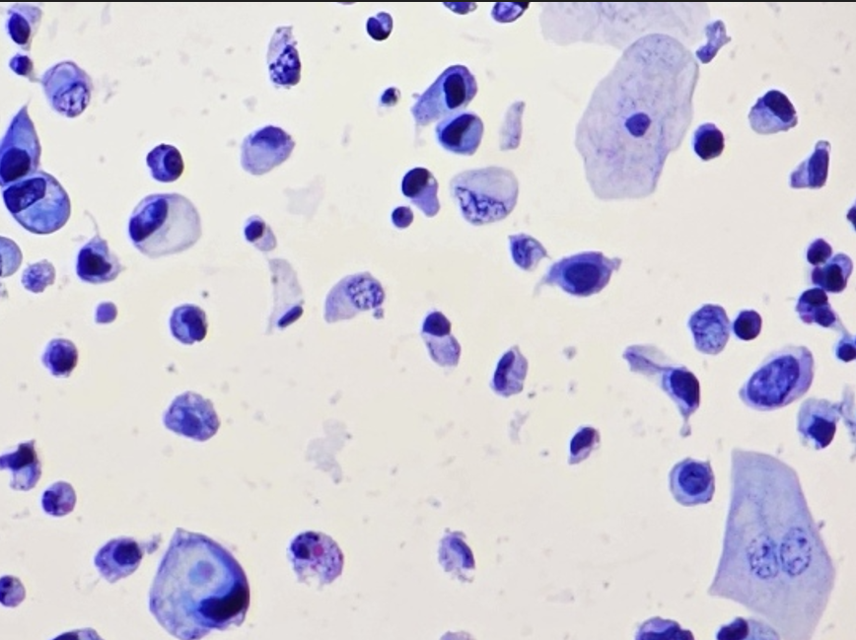
Urine Cytology – Neoplastic Cells

Slide 37
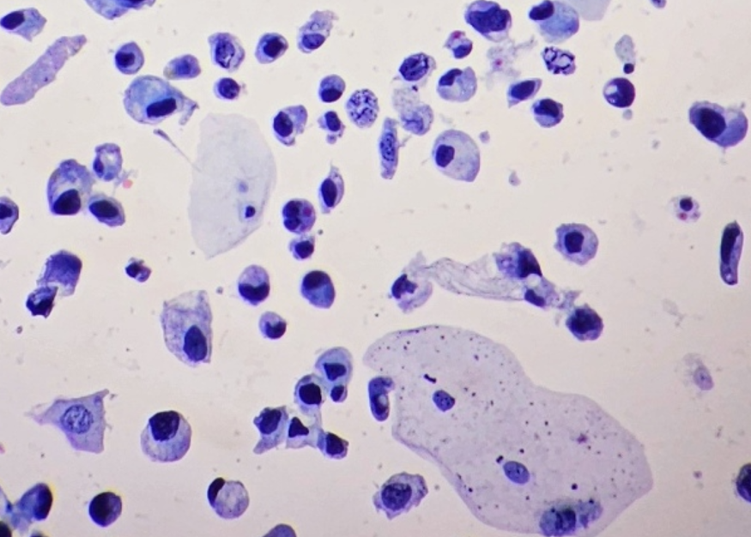
Urine Cytology – Atypical and Neoplastic Cells

Slide 38
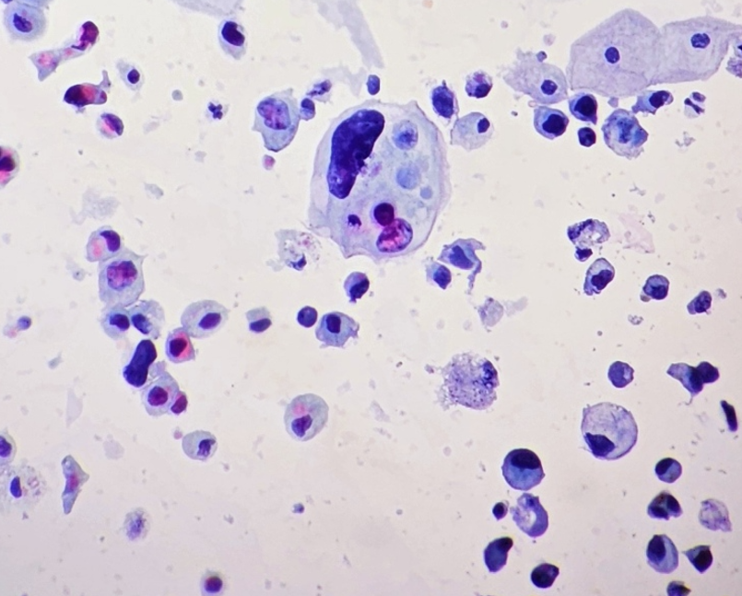
Urine Cytology – Atypical and Neoplastic Cells

Slide 39
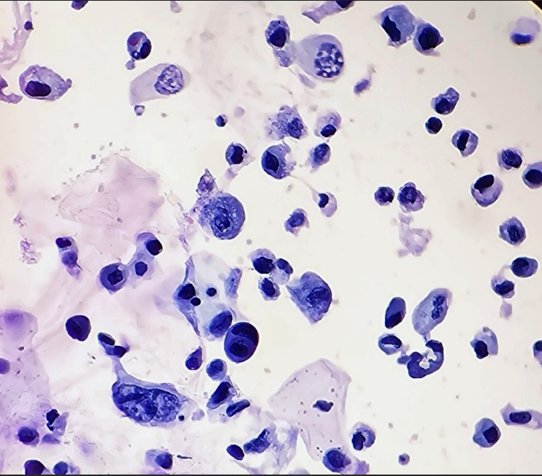
Urine Cytology – Atypical and Neoplastic Cells

Slide 40
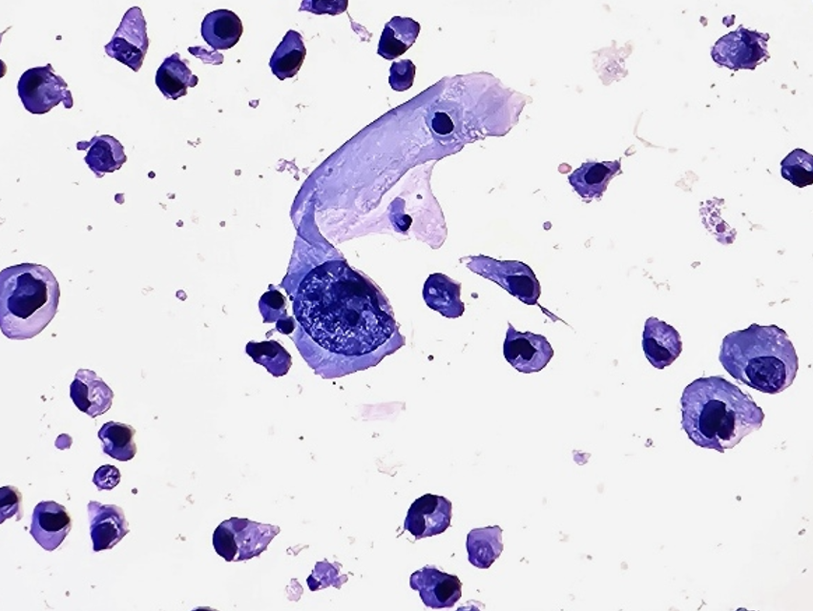
Urine Cytology – Atypical and Neoplastic Cells

Slide 41
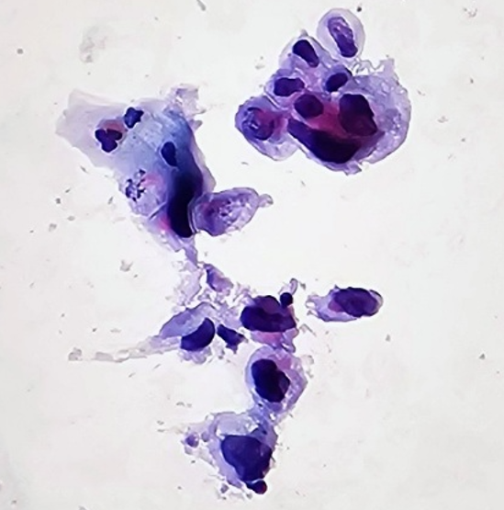
Urine Cytology – Atypical and Neoplastic Cells

Slide 42
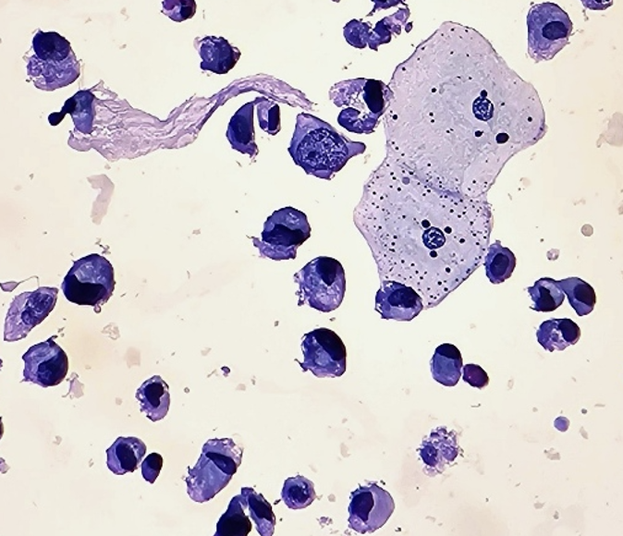
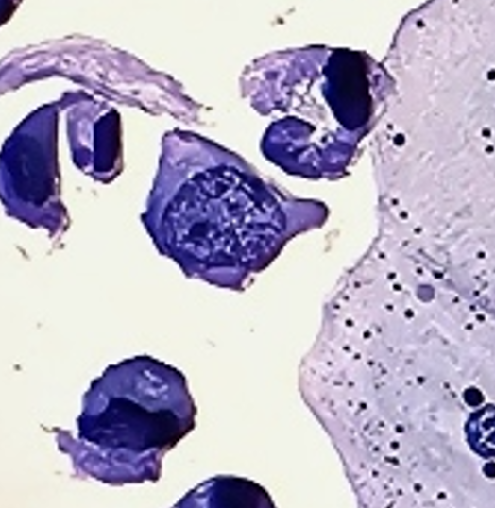
Urine Cytology – Atypical and Neoplastic Cells

Slide 43
Feedback and Education
Continue to refine process, provide feedback and education to all urinalysis- trained technologists
  UTI increases inflammatory cells, less likely to be positive for Urothelial carcinoma upon review
  Red blood cells have higher correlation
    Pay attention to unclassified and NSE categories on DxU when red cells are increased.
  Share drive with access for all techs including pictures or wet samples, DxU pictures, and urine cytology cases with confirmed neoplastic cells
  Explore methods that decrease cost, improve accuracy, include providers,
    Cytologist?

Slide 44
Feedback and Education
Name | SSN | Sex | AccessionNumber | Collection Date | Completed Date | Result | Abnormal | TestName | Location | Provider | Add on? | Result
X | X | M | UR 0904 61 | 9/4/2025 15:08 | 9/4/2025 15:51 | PRESENT | H | .UNIDENTIFIED CELLS | FAR SC KIDNEY HYPER TEAM 2 | X | Yes | Negative for Urothelial carcinoma
X | X | M | UR 0911 58 | 9/11/2025 13:08 | 9/11/2025 14:16 | PRESENT | H | .UNIDENTIFIED CELLS | FAR SUR UROLOGY PA 1 | X | Yes | FISH positive for Carcinoma
X | X | M | UR 0924 31 | 9/24/2025 10:44 | 9/24/2025 20:50 | PRESENT | H | .UNIDENTIFIED CELLS | FER LAB | X | No | NA
X | X | M | UR 0923 74 | 9/23/2025 17:45 | 9/23/2025 18:25 | PRESENT | H | .UNIDENTIFIED CELLS | FAR PC EMERGENCY DEPARTMENT | X | No | NA
X | X | M | UR 0917 29 | 9/17/2025 10:30 | 9/17/2025 11:51 | PRESENT | H | .UNIDENTIFIED CELLS | FAR PC EMERGENCY DEPARTMENT | X | Yes | POSITIVE FOR CARCINOMA
X | X | M | UR 0904 54 | 9/4/2025 13:55 | 9/4/2025 21:10 | PRESENT | H | .UNIDENTIFIED CELLS | MIN PC PACT TEAM 3 | X | Yes | POSITIVE FOR CARCINOMA
X | X | M | UR 0908 38 | 9/8/2025 10:35 | 9/8/2025 23:17 | PRESENT | H | .UNIDENTIFIED CELLS | MIN PC PACT TEAM 3 | X | Yes | POSITIVE FOR CARCINOMA

Slide 45
References
Bladder Cancer and Veterans: What You Need to Know. VA News (May 11, 2022) 1
McClatchy/Freedom of Information analysis: 61% increase in urinary cancer rates in VA (2000–2018)
Kronstedt S, et al. Exposures and Bladder Cancer Risk Among Military Veterans: A Systematic Review and Meta-analysis (Urology, Dec 2024) 3
Williams SB, Janes JL, et al. Exposure to Agent Orange and Risk of Bladder Cancer Among US Veterans. JAMA Network Open (June 2023): HR=1.04 (95% CI 1.02–1.06) 4 5
Federal Register Interim Rule (Jan 2, 2025): Presumptive genitourinary cancers & PM2.5 exposure 6
https://www.auanet.org/guidelines-and-quality/guidelines/microhematuria

Slide 46

Questions?
  Questions?

