Slide 1
Veterinary Tales Illustrating the MLS Role in One Health
By: Sarah Gefroh, MLS (ASCP)^{CM}, SM^{CM}

Slide 2
Objectives
Describe how laboratory findings from veterinary cases can impact human public health.
Recognize the role of MLS professionals in detecting, interpreting, and communicating laboratory results.
Analyze a case-based example where routine microbiology work contributed to broader surveillance, prevention, or public health response.

Slide 3
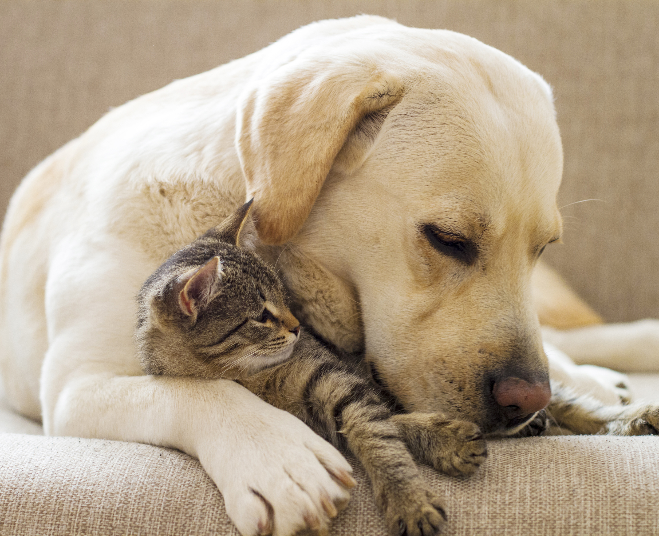
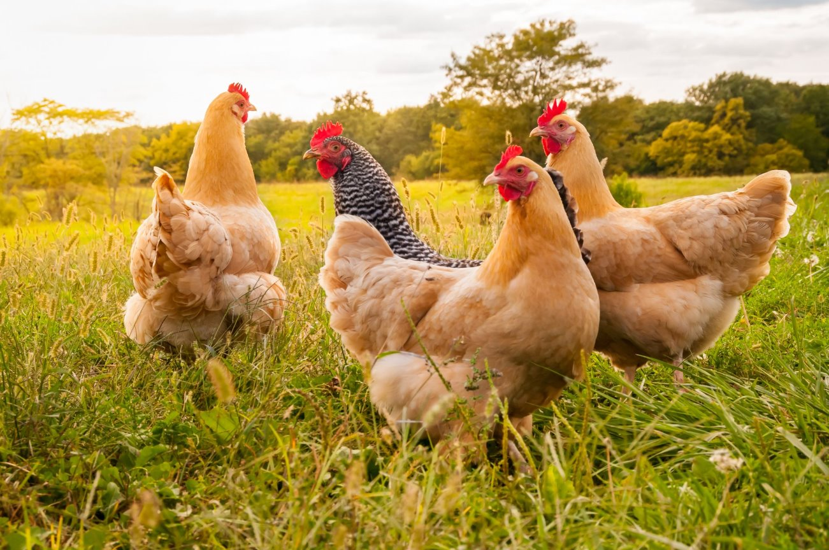
Why Veterinary Diagnostics Matter
Health of all types of animals
Impact food supply, economy, way of life, the environment & more
75% of emerging diseases are zoonotic
Animals can be predictors of disease

Slide 4
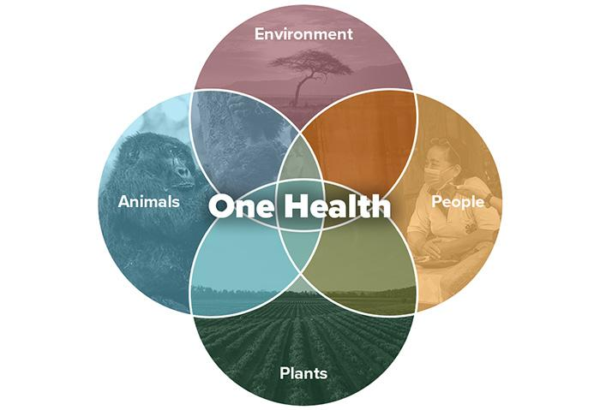
One Health

Slide 5
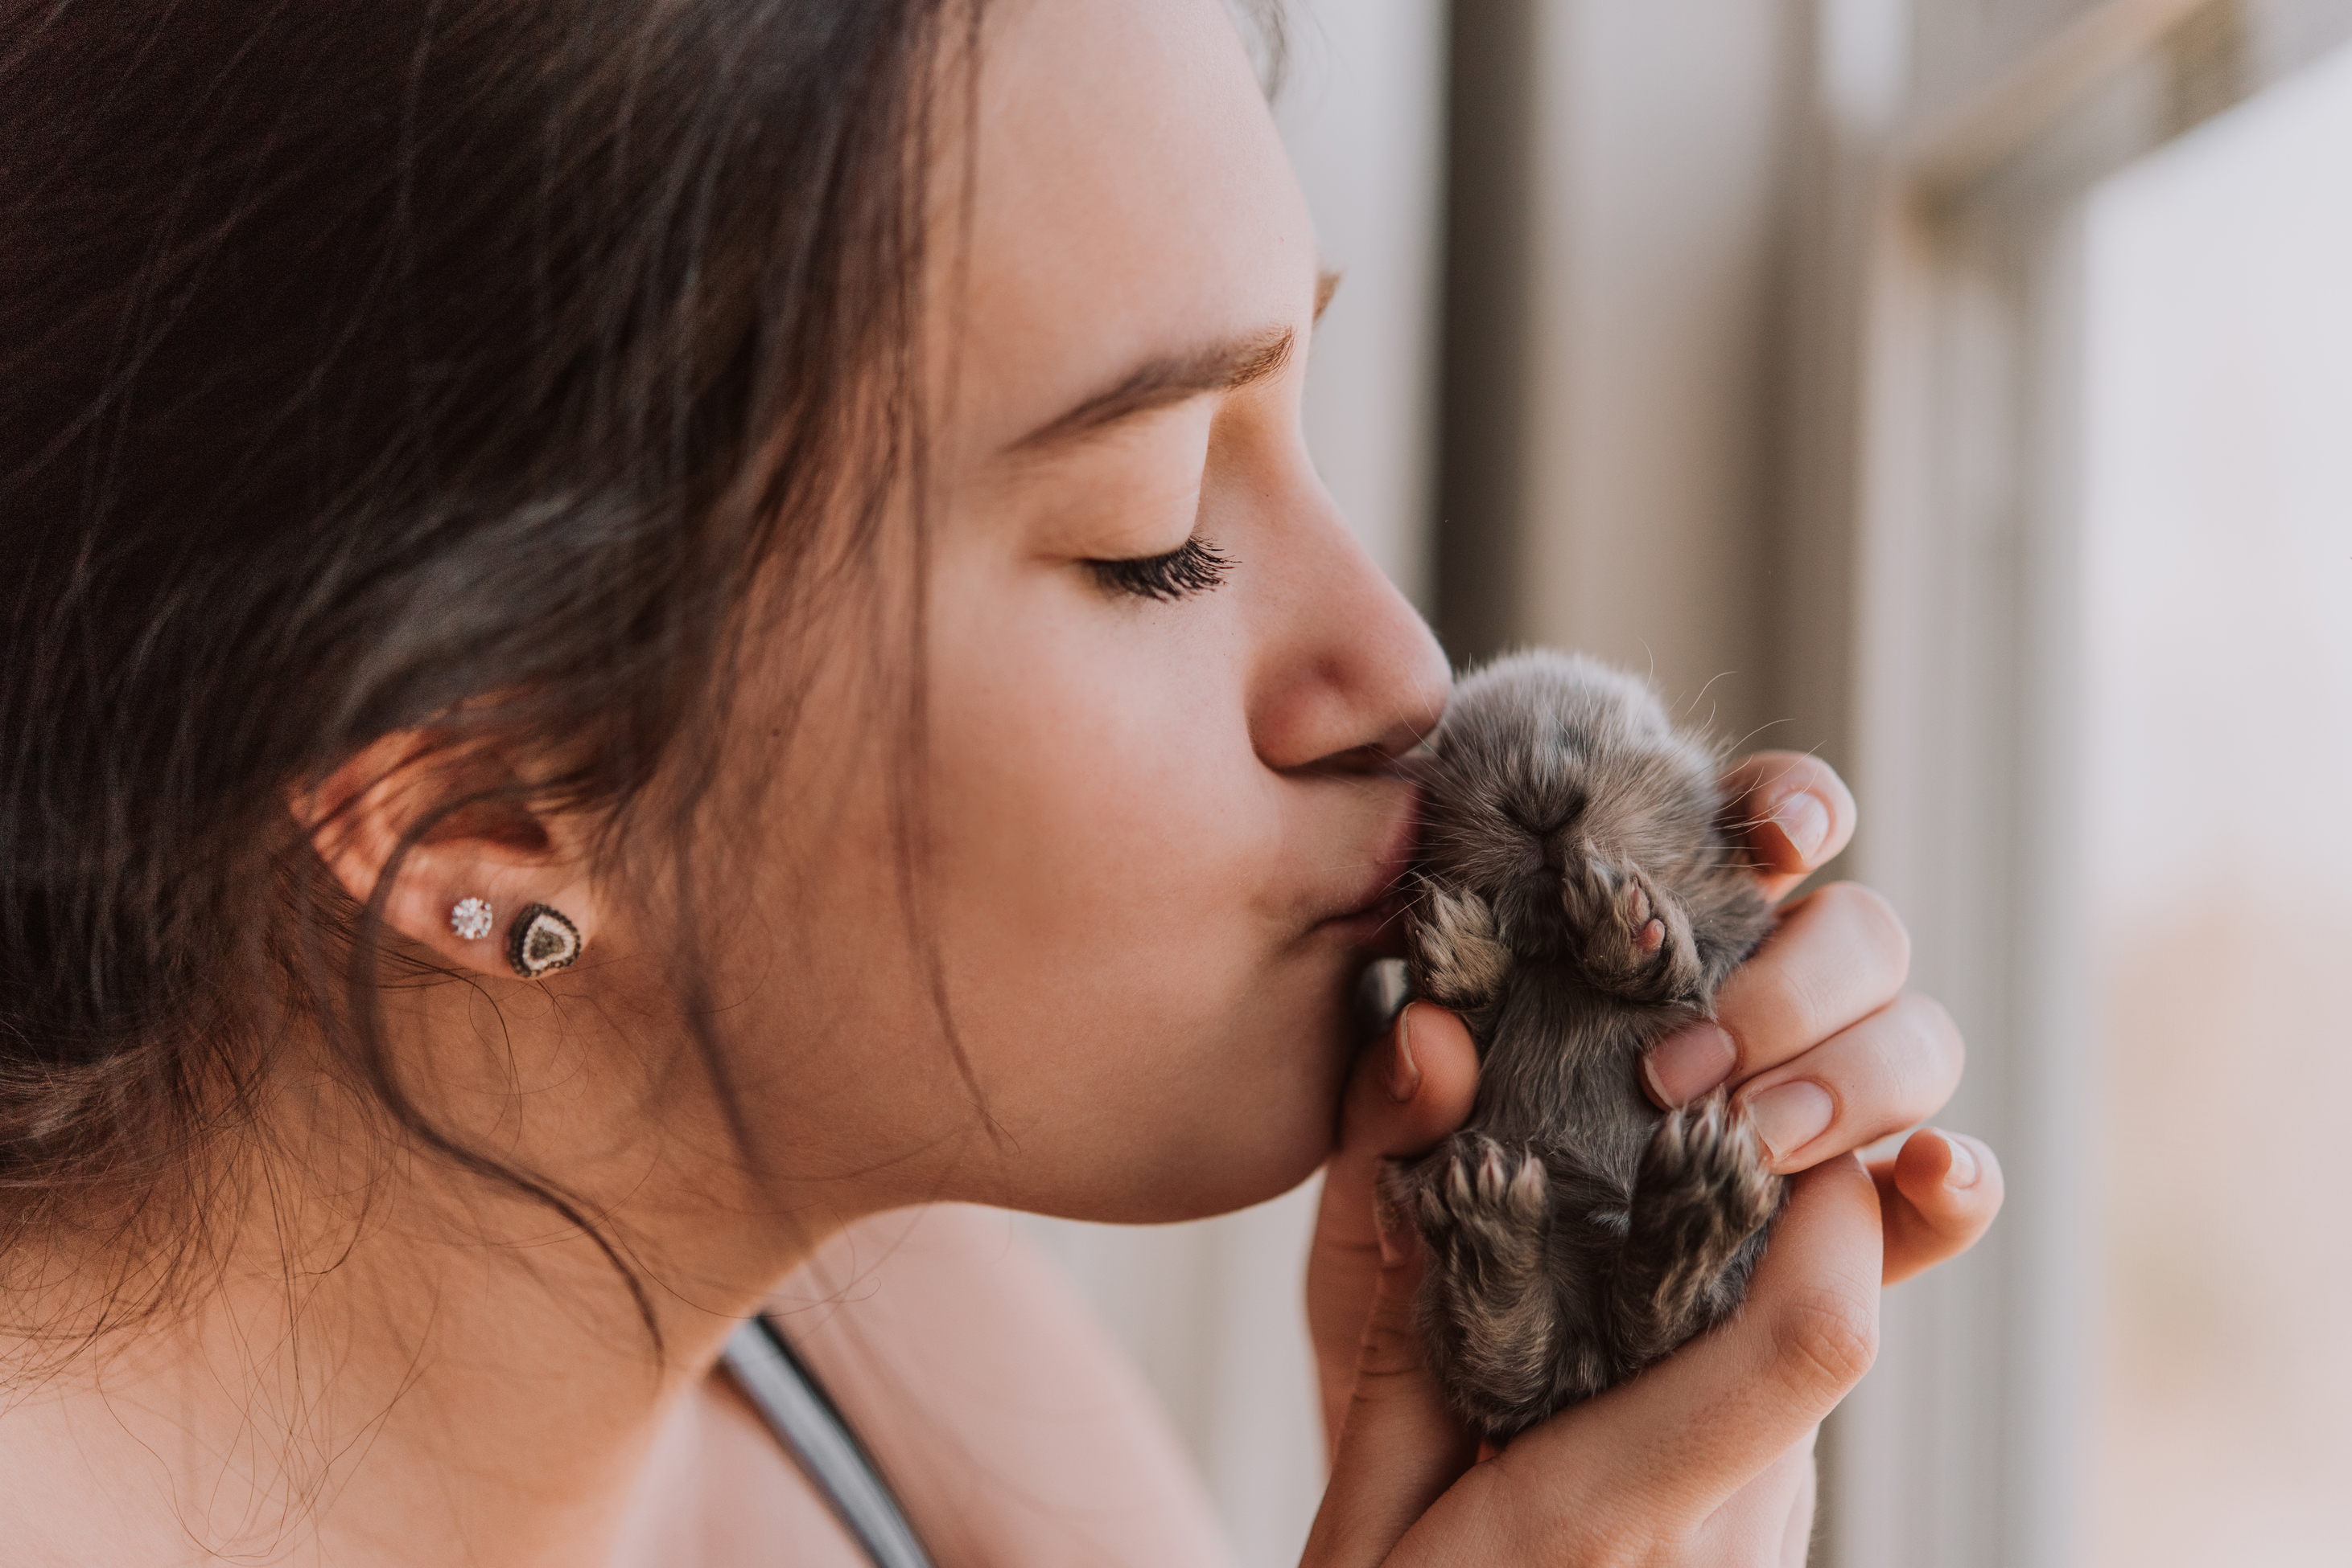
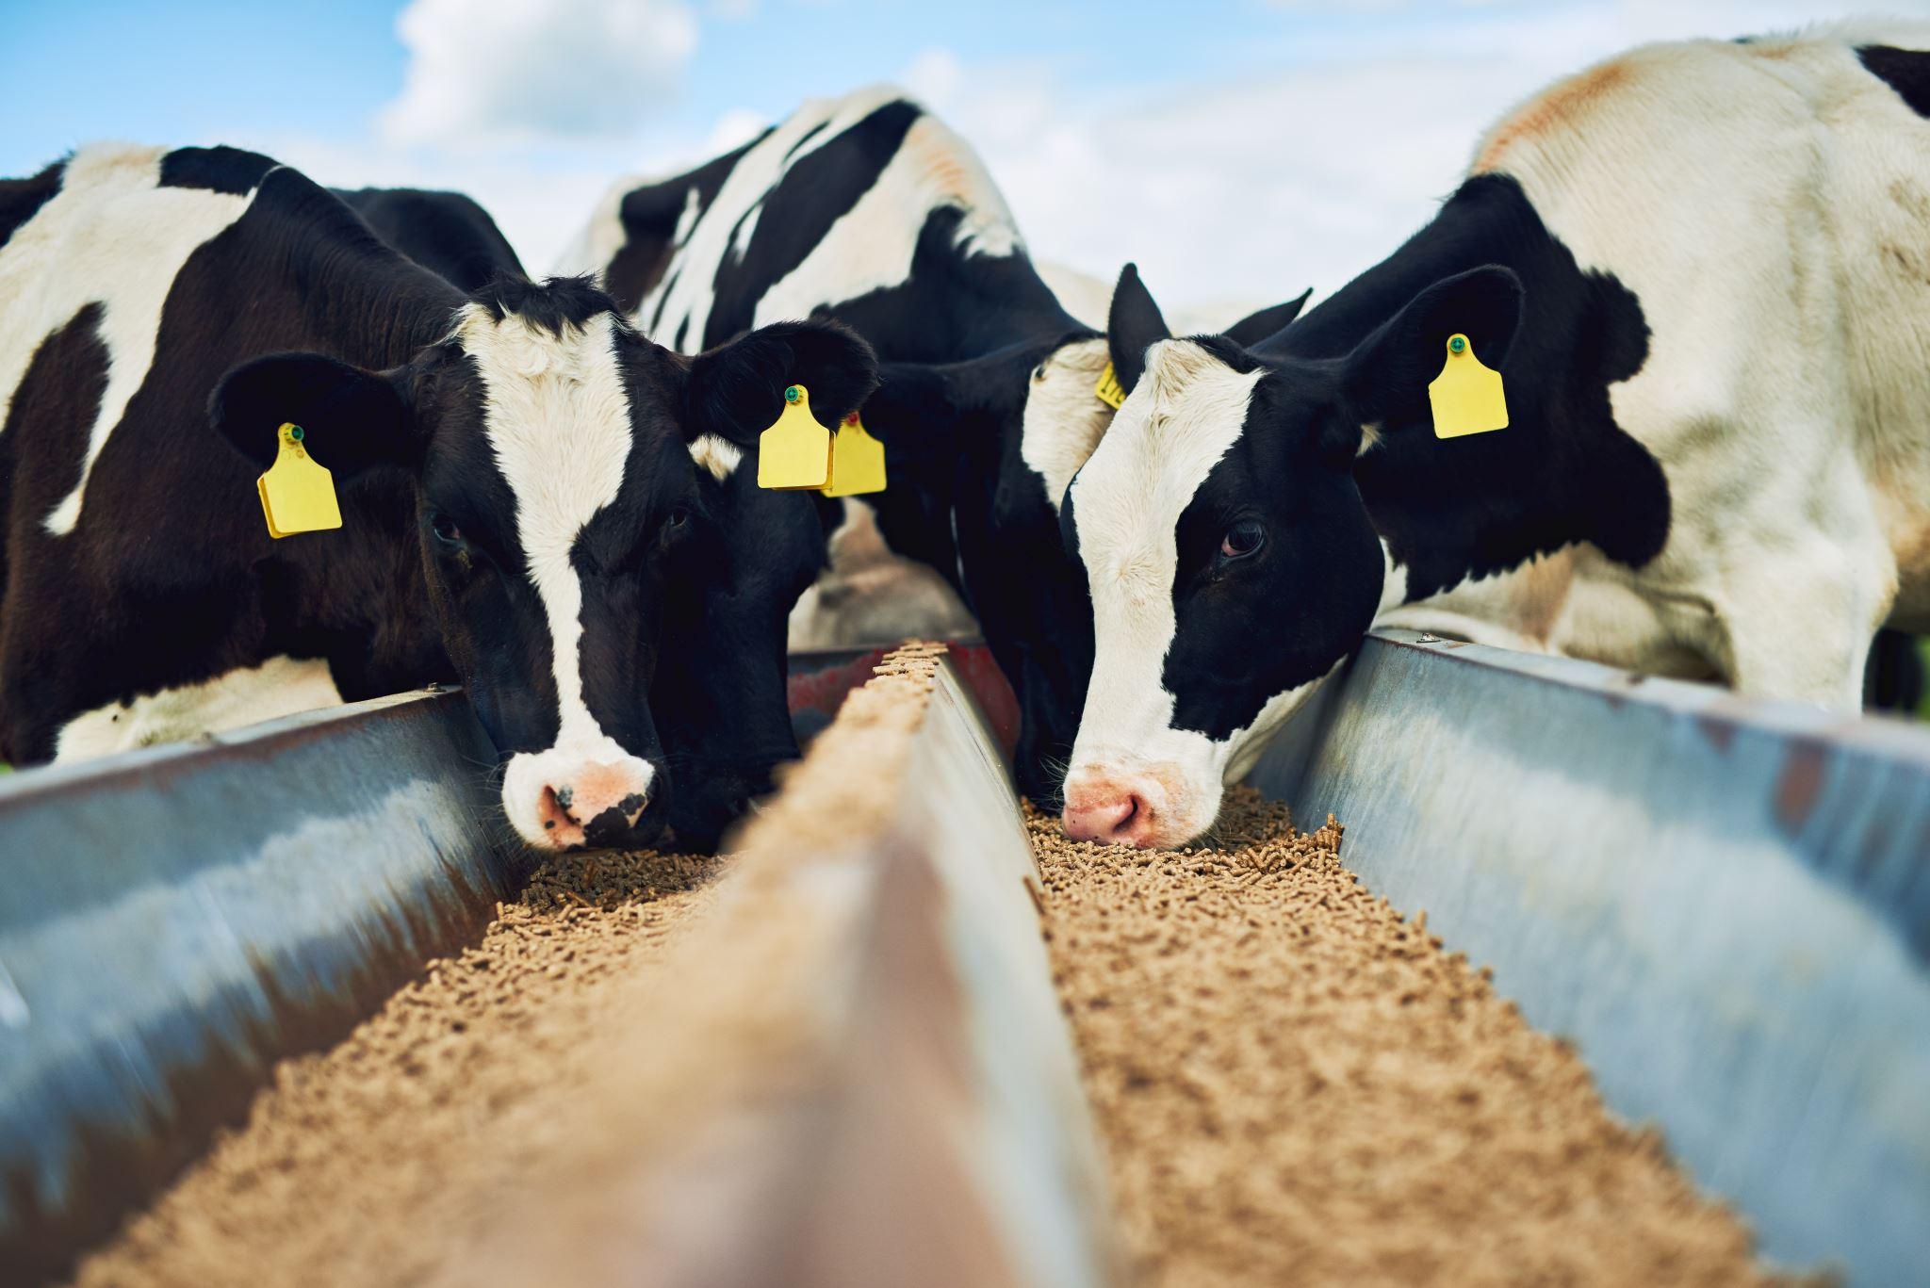

MLS Role in One Health
Perform and validate diagnostic testing (culture, PCR, AST) & QC
High standards
Interpret results in clinical and zoonotic context
Communicate with veterinarians and public health agencies
Contribute data to surveillance and antimicrobial resistance monitoring systems.

Slide 6
One Health Case #1

Slide 7

Case Study #1
Patient History
  Baxter escaped from the house and disappeared for a part of the day.
  Returned with a wound on right, back leg.
  3 weeks later, demonstrated neurologic symptoms, drooling and aggression.
  A child is bitten

Slide 8
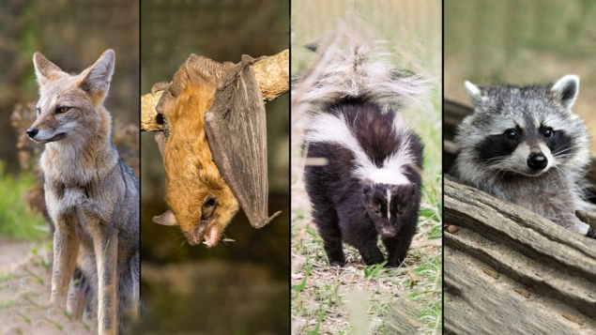
Case Study #1 -Rabies
Biosafety
Lyssavirus
Spread primarily by saliva
Common reservoirs
Attacks neurologic tissue
Vaccination importance

Slide 9
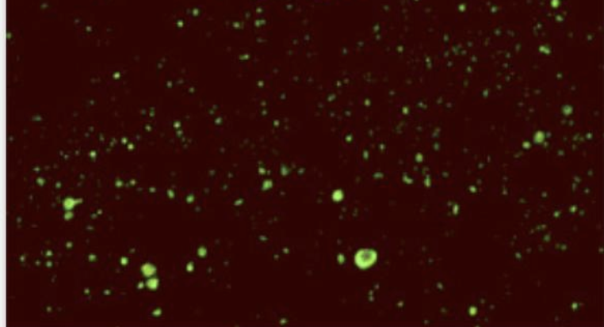
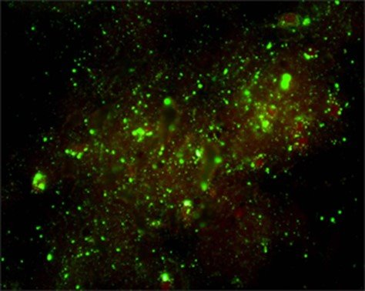
Case Study #1 -Diagnostics
Sample=Brain
Direct fluorescent antibody test
Gold Standard
  Positive=apple green fluorescence
  Reportable

Slide 10
Case Study #1 –What happens after a positive result?
CDC & DOH notified
Post-exposure prophylaxis initiated
Exposure risk assessment (household + lab)

Slide 11
Case Study #1 - One Health Impact
Human health
Animal health
Lab safety
Public health response

Slide 12
One Health Case #2

Slide 13
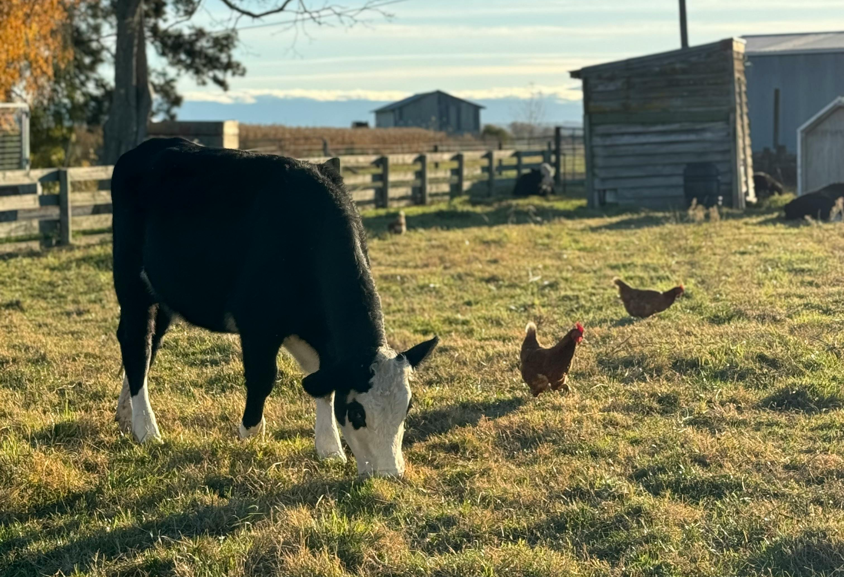
Case Study #2
Mixed‑species farm
Diarrhea & mortality in cattle and chickens
Fecal samples sent for testing

Slide 14
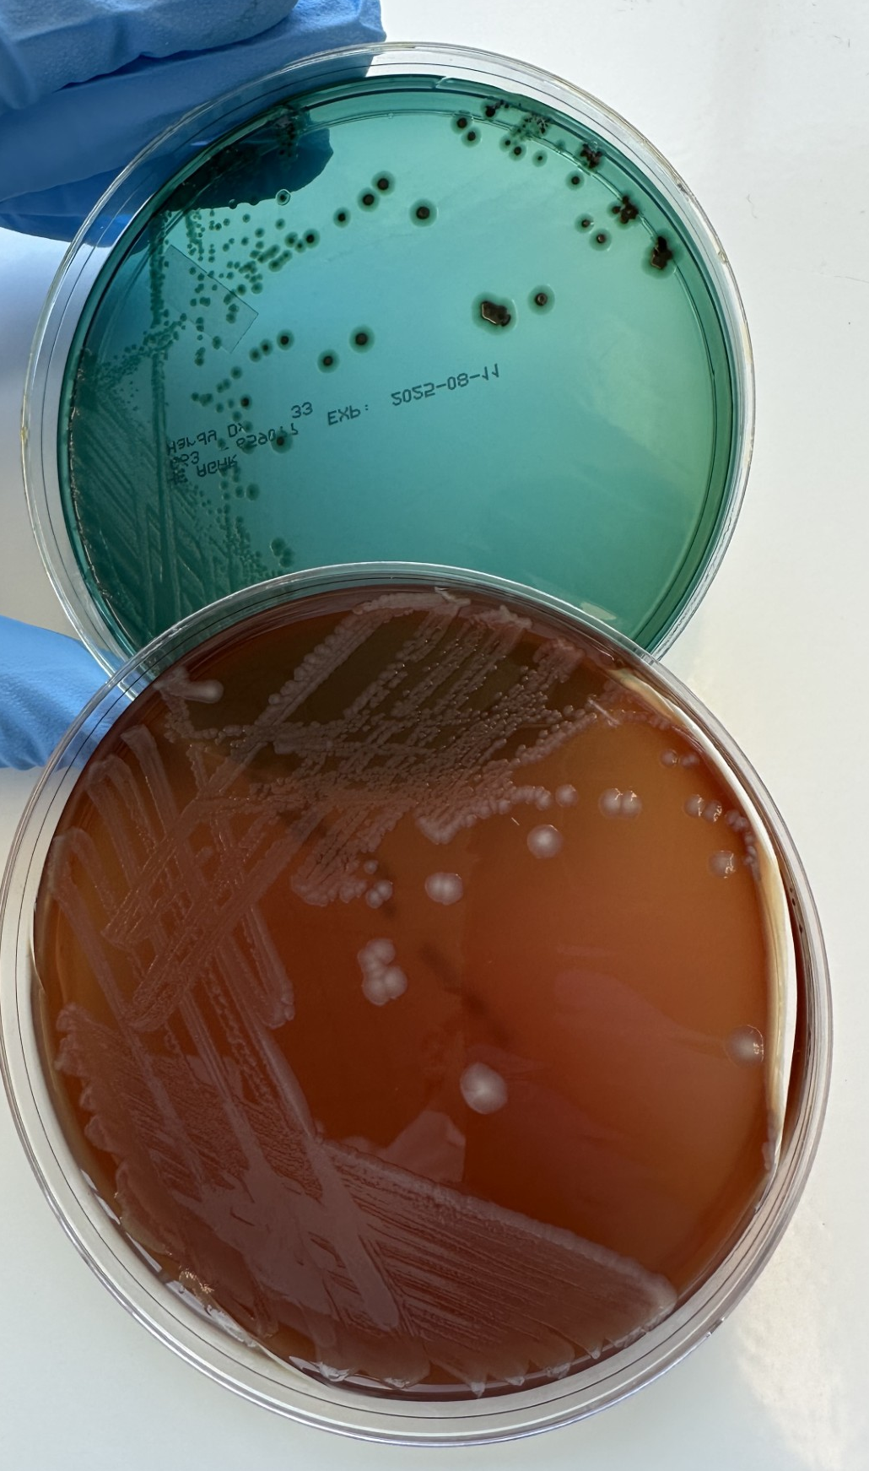
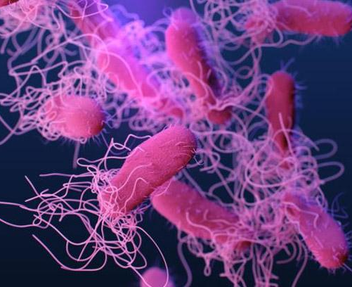
Case Study #2- Diagnostic Findings
Dairy cows and chickens
Culture = Salmonella enterica
Serovar=Typhimurium
Reportable to Board of Animal Health, State Vet; federal surveillance programs

Slide 15

Case #2-One Health Impact
From Farm to Population
  Foodborne illness risk
  Household exposure
  Environmental contamination
  Surveillance + outbreak detection
These outcomes affect animal health, farm economics, and food supply stability.

Slide 16
One Health Case #3

Slide 17

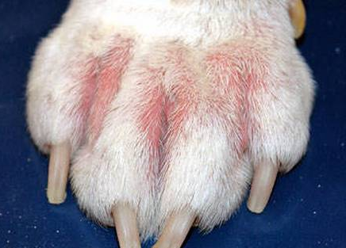
Case Study #3: Antimicrobial Resistance
Recurrent canine pododermatitis
Multiple antibiotic failures
Culture requested after months of treatment

Slide 18
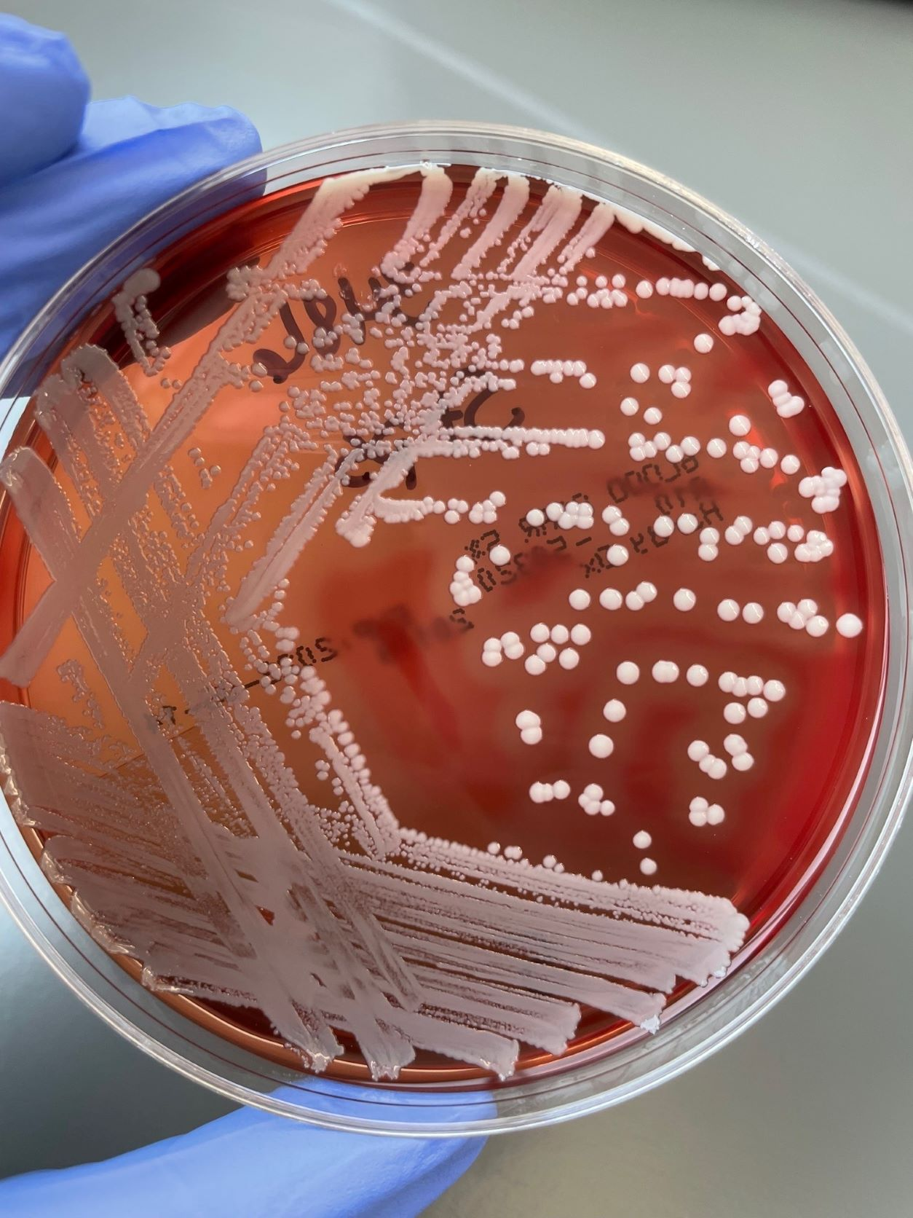
Case Study #3:Diagnostic Findings
Staphlococcus pseudintermedius isolated
  Common in dogs
  The "Staph aureus of vet med"
  Opportunistic pathogen
  AST performed

Slide 19
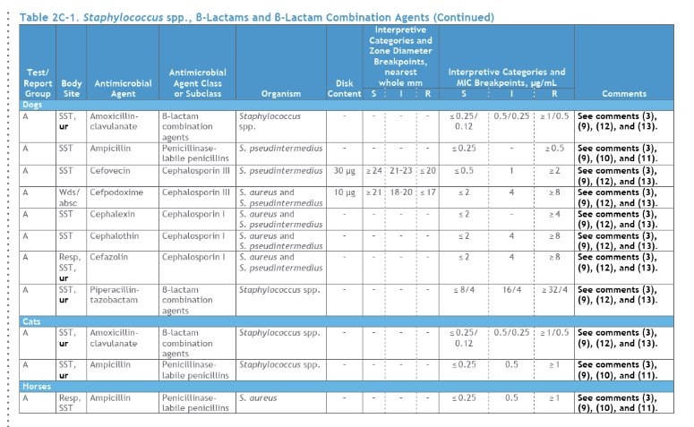
Case Study #3- Breakpoints

Slide 20
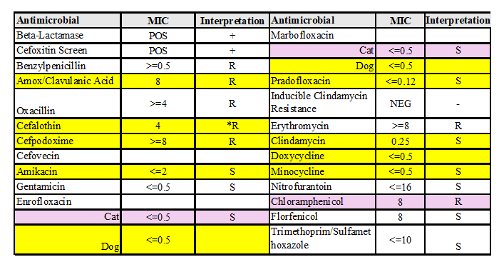
Case Study #3: The Problem
No Universal Breakpoints
Human ≠ dogs ≠ cats
Some drugs: no interpretations available
Gaps exist in CLSI Vet Standards
0.5
0.5

Slide 21
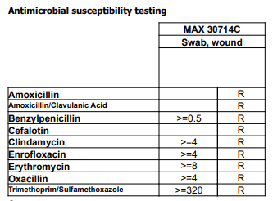
Case Study #3 – AST Result
Oxacillin 0.5 µg/mL
Dogs=0.5 µg/mL Resistant
Human=1 µg/mL Resistant
Surrogate
Oxacillin used as a predictor of cephalosporin and β-lactam/combo agents
0.5

Slide 22
Case Study 3: Clinical Impact
Limited antimicrobial options
Risk of continued treatment failure
Selection for resistance
Zoonotic implications

Slide 23
Case Study #3: One Health Impact
Companion animal ↔ human interface
Antimicrobial stewardship
Surveillance data contribution
Cross-species resistance trends

Slide 24
Case Study #4

Slide 25
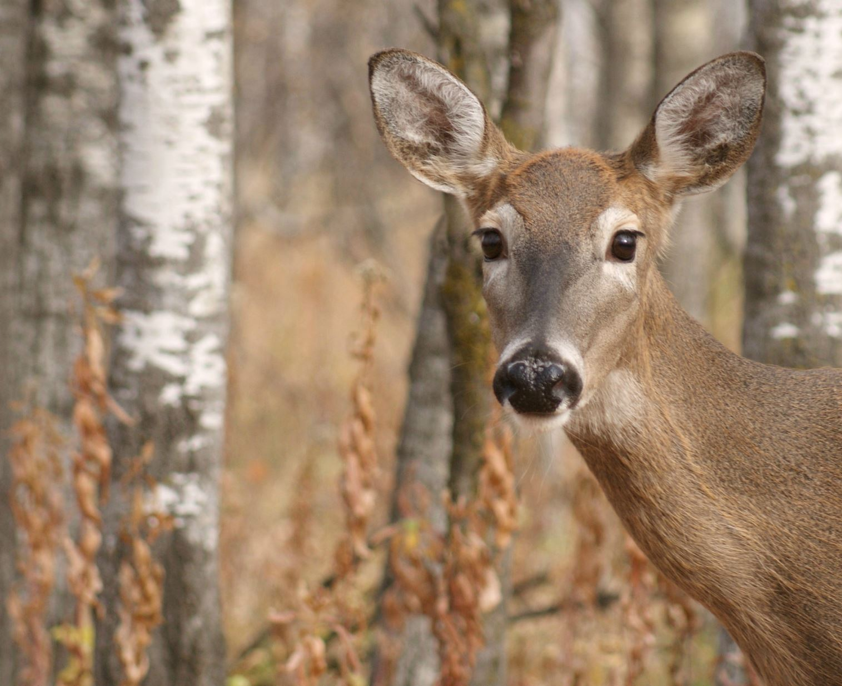
Case Study #4
Cattle: neurologic signs, sudden deaths
Nearby wildlife also affected
No clear infectious pattern

Slide 26
Case Study #4-Initial Workup
Infectious disease testing negative
No consistent pathogen
Multi-species involvement
Suspicion-environmental contaminant

Slide 27
Case Study #4- Diagnostic Findings
Lead testing
Elevated blood/tissue lead levels
Source: contaminated environment
Example: batteries, paint, debris
Communication
Animal decisions

Slide 28
Case Study #4- One Health Impact

Slide 29
Review

Slide 30
What These Cases Have in Common
Animals as sentinels
Quality diagnostics
Interdisciplinary communication
Environmental drivers

Slide 31
The MLS Professional as a One Health Sentinel
Early detection
Pattern recognition
Communication

Slide 32
Key Takeaways
One Health Starts in the Lab
Biosafety
Exposure history
Flag/report key results
Build partnerships

Slide 33
Final Thought
One Health doesn't begin with outbreaks or policy-it begins with laboratory diagnostics done well and MLS professionals performing work with accuracy, communicating with public health agencies and contributing to surveillance platforms.
Every test you perform has the potential to influence health far beyond the bench.

Slide 34
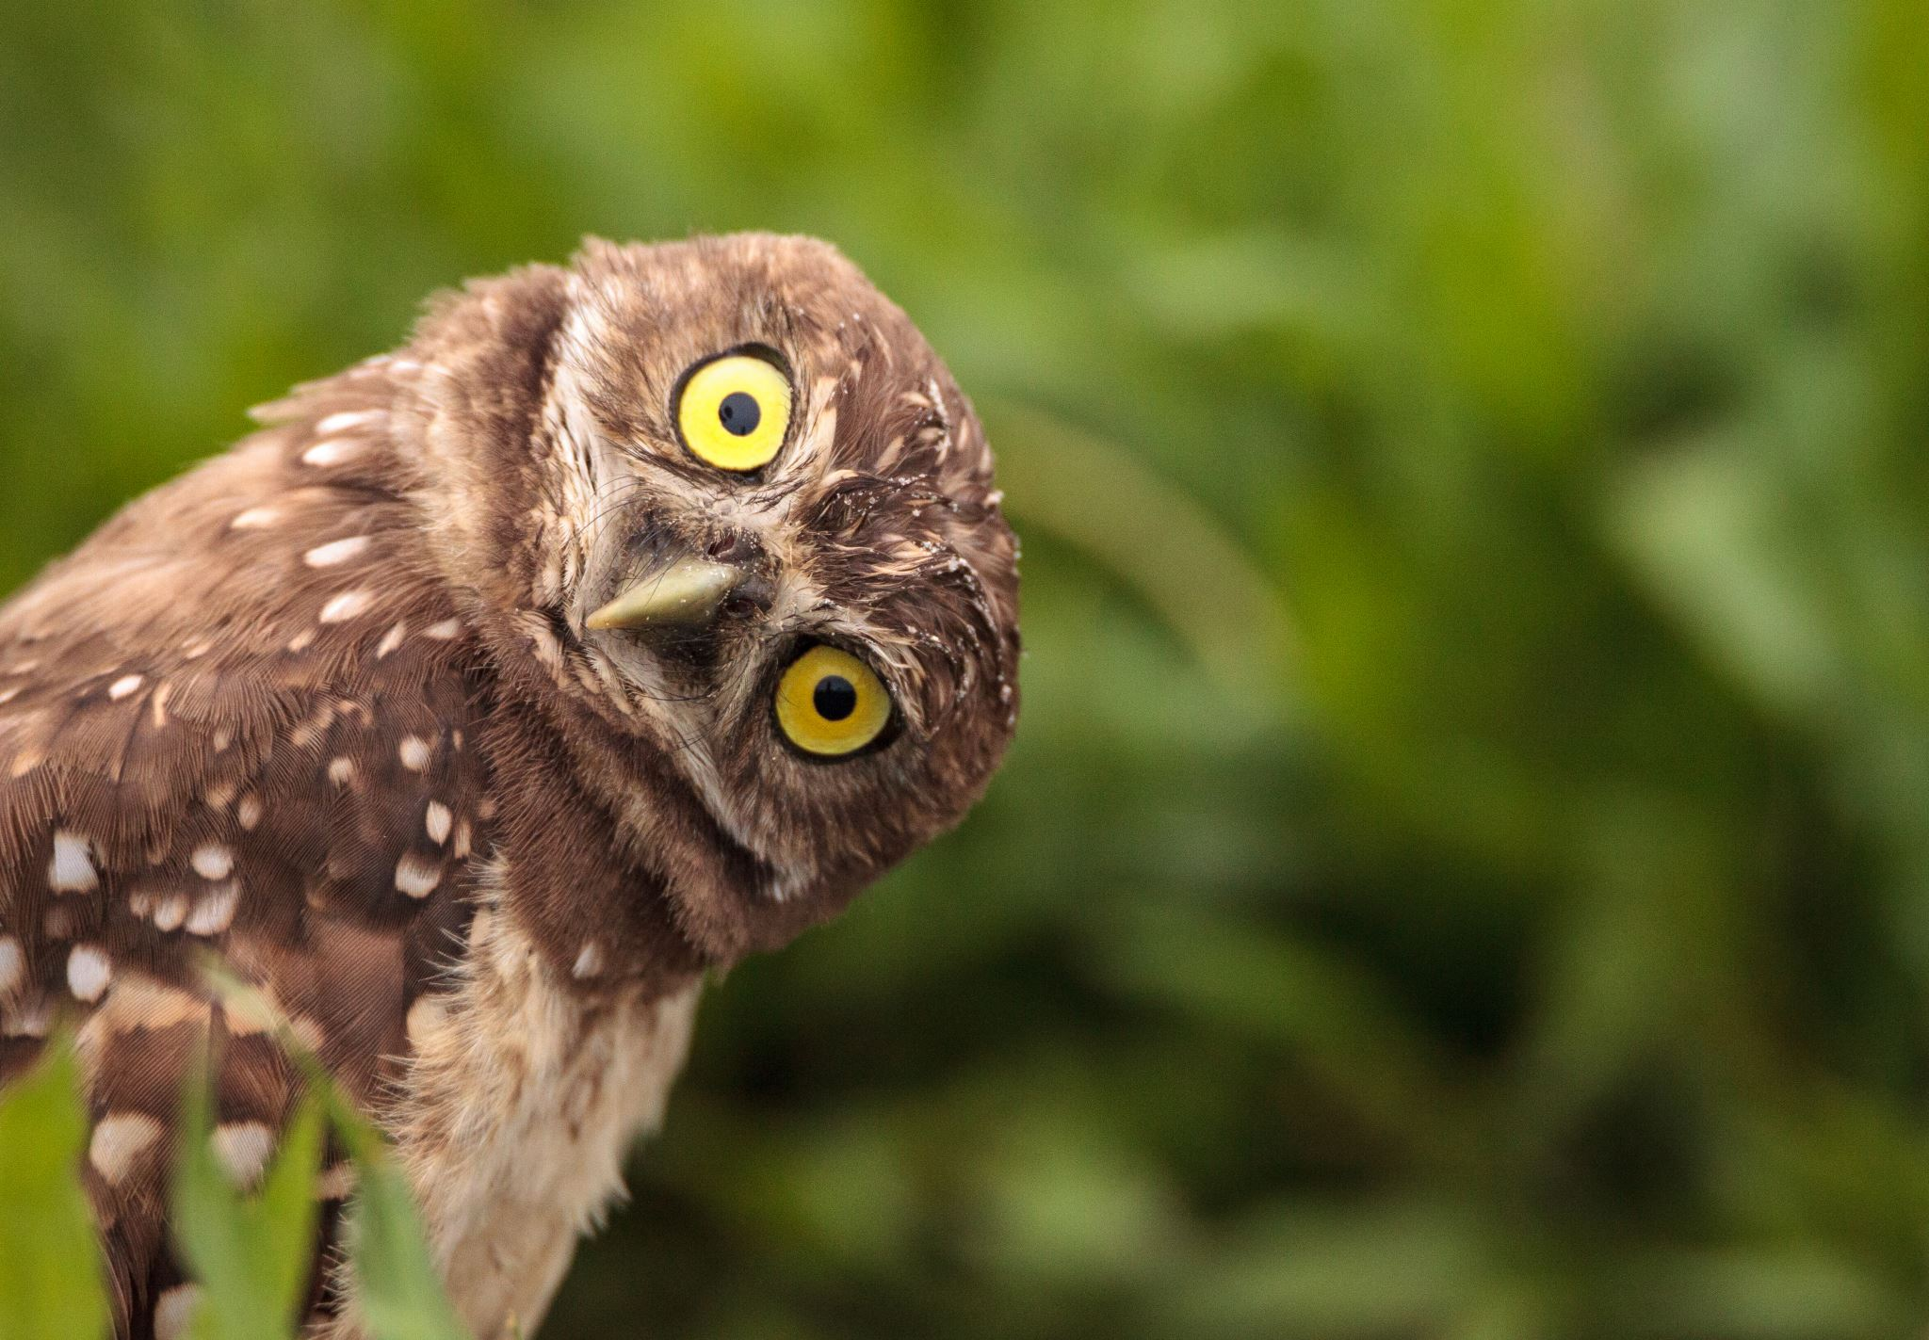
Thank You!
Contact me: sarah.gefroh@ndsu.edu

