Slide 1
Case Studies in Hematologic Malignancy Mutations
ASCLS-ND Presentation, Monday April 20, 2026
mary.coleman@UND.edu
MS,MS,MLS(ASCP)^{CM}, CG(ASCP)^{CM}, SH(ASCP)^{CM}

Slide 2
Objectives
The participant will be able to:
  recognize various hematologic malignancy mutations
  Correlate various mutations with specific hematologic malignancies
  Correlate specific hematologic malignancies with the 2022-2025 classification system of hematologic malignancies(WHO and the ICC)
Notes:
International Consensus Classification (ICC)

Slide 3
Introduction
I have no conflict of interest or financial disclosures. I do mention a company and some books a few times but not endorsing, just for information.
My reason for the topic choice: to learn more about this interesting and important topic in hematologic malignancies
In the last 30 years, what has happened in the field of hematopathology:
  A classification system has been developed defining distinct, real entities, as outlined in the WHO classification of hematologic neoplasms.
  Advances ihave been made in sophisticated immunophenotyping such as flow cytometry, and most recently an explosion in molecular/genetic testing that greatly expands how we understand the pathophysiology of hematologic disease.
Some of these advances in hematologic malignancy diagnosis will be discussed.
Notes:
I suggested this topic to Alice Hawley and told her to find a speaker and she Molecular Hematopathology, Beck and Moore, preface: In the last 30 years, the field of hematopathology has undergone several revolutionary periods, including the development of a classification system defining distinct, real entities, as outlined in the WHO classification of hematologic neoplasms, advances in sophisticated immunophenotyping such as flow cytometry, and most recently an explosion in molecular/genetic testing that greatly expands how we understand the pathophysiology of hematologic disease. Some of these advances if hematologic malignancy diagnosis will be discussed.
As malignant hematology care grows more complex, LL&M Congress remains focused on delivering evidence-based, clinically relevant education that supports real-world decision-making across leukemia, lymphoma, multiple myeloma, and CLL.

Slide 4
Questions for You
How many do fluorescence in-situ hybridization (FISH) in your lab? Or a send out?
How many do next generation sequencing in your lab? Or a send out?
How many do flow cytometry for CD markers in your lab? Or a send out?
How many of you have heard of clonal hematopoiesis?
How many of you have heard of CHIP: clonal hematopoiesis of indeterminate potential?
How many have heard of these mutations: TP53, IHC,MYC BRAFV600E, FLT3, RUNX?

Slide 5
The 2022 WHO Classification System
The WHO 2022 5th ed online classification system is said to be 60 years in the making ( 1962- 2022, 2026)
The 5th ed included 400 experts building consensus about the hematopoietic neoplasms.
The classification system is meant to be implemented with multidisciplinary input that emphasizes a holistic approach to patient management with diagnosis through disease monitoring.
The classification system relies heavily on molecular, FISH, conventional karyotyping, immunophenotyping, and somewhat on morphology and rarely on cytochemical stains to classify the neoplasms.
Notes:
Cytochemical stains only needed with biphenotype and ambiguous leukemias
CML BCR ABL and blast crisis – not really necessary, but if CML has transformed to blast crisis, not so many mutations
AML with BCR ABL1 difference with CML in blast crisis. AML with the BCR ABL1 is a late stage mutation, so you would see other genetic aberrations
What to teach for BOC exam: We all share the struggle. WHO morphology need to retain but less and less prominent as more genetic mutations occur. Those genetic mutations are defining the treatment and prognosis, following the TKI model.
More homework to do: international Consensus classification system
Is there a good marker for ABL1 like disease? Only significant mutations if it has a prediction for therapy and prognosis, give me the name of disease, treatment, and prognosis
Books websites: podcasts by professions, books McKenzie and Rodak. The future: ID the key mutation and then medication to overcome the block or multiple blocks. How are we going to pay for it is Tim’s concern.

Slide 6
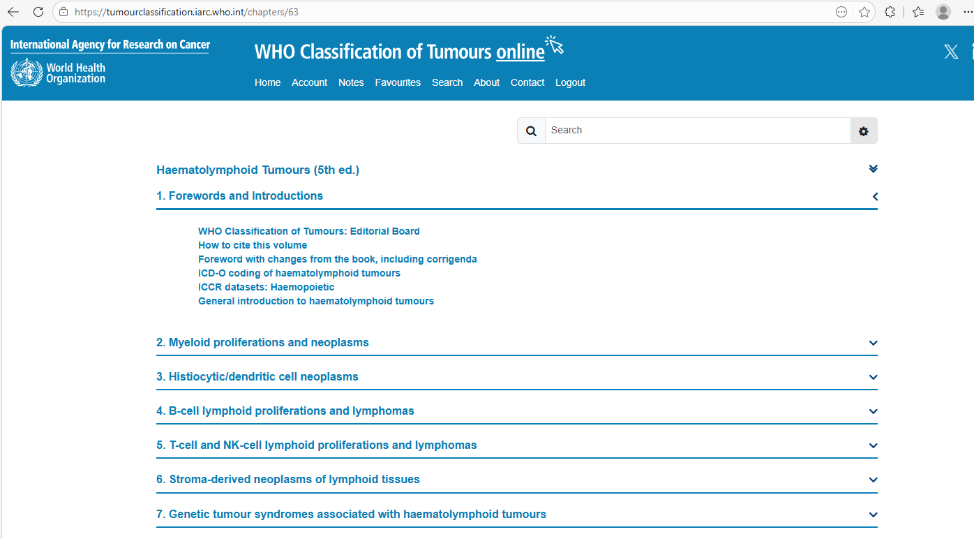
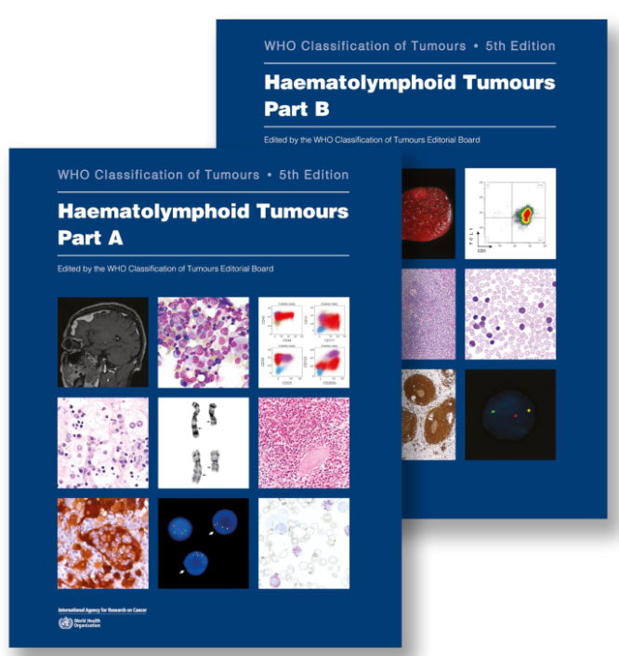
Table of Contents
On Amazon for $277
WHO Classification of Tumours Editorial Board. Haematolymphoid tumours [Internet]. Lyon (France): International Agency for Research on Cancer; 2024 [cited 2026,04/18]. (WHO classification of tumours series, 5th ed.; vol. 11). Available from: https://tumourclassification.iarc.who.int/chapters/63.
Notes:
Table of Contents

Slide 7
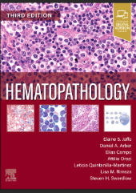
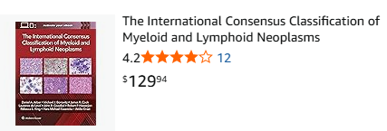
The International Consensus Classification(ICC)
Follows the approach of the 3rd, 4th, and revised 4th editions of the WHO Classification of Tumours of Haematopoietic and Lymphoid Tissues, with changes informed by input from a Clinical Advisory Committee (CAC). Elaine Jaffe was an editor for the 4th ed WHO but led the way for the ICC approach
This approach relies on a combination of clinical, morphologic, immunophenotypic, genetic, and other biological features to define specific disease entities—a logical approach similar to that followed by a clinician and a pathologist working together to reach a diagnosis in a patient suspected of having a myeloid or other hematologic neoplasm or malignancy.
On Amazon for $188,
Jaffe ES, Arber DA, Campo E, Orazi A, Quintanilla-Martini L, Rimsza L, Swerdlow SH. Hematopathology. 3rd ed. Philadelphia: Elsevier. 2025. ISBN: 978-0-323-83165-9.
Notes:
Neoplasms: abnormal growth of cells, malignancy cancerous neoplasm capable of invading tissues and spreading to other parts of the body. From Jaffee, 2025, p. 831. The relative contribution of each feature varies, depending on the case. Only through familiarity with the classification system and with the criteria for each entity can the appropriate studies be chosen to arrive at an accurate diagnosis in an expeditious manner. Although perhaps overused as an example of the prototype for the classification of myeloid neoplasms, chronic myeloid leukemia (CML) symbolizes the utility of the prior WHO and current ICC 2022 approaches. This leukemia is recognized mainly by its clinical and morphologic features and is consistently associated with a specific genetic abnormality, the BCR::ABL1 fusion gene, which leads to the production of a constitutively activated protein tyrosine kinase that interacts with a number of different cellular pathways to influence the proliferation, survival, and differentiation of neoplastic cells. The protein is sufficient to cause the leukemia, but it also provides a target for therapy that has prolonged the lives of thousands of patients with this disease.6 The diagnosis of CML, however, is not based on any single parameter. There are other myeloid leukemias that mimic its clinical presentation and morphology, and the BCR::ABL1 fusion is seen not only in CML but also in some cases of de novo acute lymphoblastic leukemia, acute myeloid leukemia (AML), and mixed phenotype acute leukemia (MPAL). Thus, CML is a perfect model for the integration of all pieces of relevant information to define an entity in a classification scheme. Furthermore, there are still mysteries regarding CML, so there is still more to learn (see Chapter 47). As the focus in all neoplasms turns increasingly to the genetic infrastructure of malignant cells and to molecular abnormalities that may be targets for therapeutic agents, it is only natural that more genetic and molecular data are incorporated into the diagnostic algorithms or nomenclature of classification schemes. The 2001 3rd edition of the WHO classification included, for the first time in any widely used system, genetic information as criteria for the diagnosis of not only CML but also some subtypes of AML.7 By the time the 2008 4th edition and 2016 revised 4th edition of the WHO classification were published, a number of significant genetic abnormalities were discovered that are associated with subgroups of myeloid neoplasms or with specific disease entities within the subgroups. Since that time, an even larger number of genetic and epigenetic events associated with myeloid neoplasms have been described, making an approach that uses these data for both classification and prognostication more challenging. In some instances, such as myeloid/lymphoid neoplasms with eosinophilia and tyrosine kinase gene fusions, the genetic defect (coupled with the morphology and clinical findings) is the major criterion for naming the disease and for selecting specific targeted therapy (see Chapter 50). In other instances, such as the BCR::ABL1-negative myeloproliferative neoplasms (MPNs) that are often but not invariably associated with the JAK2 V617F mutation, the presence of the genetic defect is an objective criterion that identifies the myeloid proliferation as neoplastic. Additional criteria are necessary to define the specific disease associated with the mutated JAK2 and to distinguish it from other MPNs that share the same mutation (see Chapter 47). Therefore, although the ICC 2022 incorporates an increased number of genetic abnormalities, a multidisciplinary approach is still required for the classification of myeloid neoplasms. This multidisciplinary approach succeeds in defining many distinct disease entities that cannot be adequately identified by relying on morphology or clinical features alone. Such a limited approach to myeloid neoplasms is no longer adequate, and a diagnosis is not complete in many cases until the results of all studies have been correlated, often requiring amended pathology reports. New entities and new diagnostic criteria for old entities in the ICC 2022 are based mainly on published clinical and scientific studies that have been extensively quoted and their significance widely acknowledged. However, to accommodate data that have not yet “matured,” the classification continues to have a number of “provisional entities” to include diseases that are clinically or scientifically important and should be considered in the classification but for which additional studies are needed to clarify their significance. Some previous provisional entities have been refined in the current classification and are now incorporated as full entities, and their presence emphasizes that the classification is ever-changing.

Slide 8
2022 WHO Classification Hematolymphoid Tumor Changes Part 1
The first portion of the classification was dedicated to myeloid neoplasms, the biology of which has been better elucidated, but their treatment remains an unmet need despite advances.
Key changes to the classification entailed the introduction of clonal hematopoiesis, reorganization and revised nomenclature of myelodysplastic neoplasms, and reorganization of acute myeloid leukemia, secondary myeloid neoplasms, myeloid/lymphoid neoplasms with tyrosine kinase fusion genes, and acute leukemias of ambiguous lineages.
Reflecting their unique lineage, histiocytic/dendritic neoplasms are classified together in a manner that naturally brought forward the distinctive features shared by many of these diseases despite their varied clinical manifestations..
The classification introduced preneoplastic diseases and tumor-like lesions that mimic B-cell and T-cell neoplasms. Lymphoblastic leukemias/lymphomas are grouped by lineage. As such, B-cell lymphoid proliferations and lymphomas covered a large swath of diseases that represent the most common lymphoid neoplasms worldwide, especially when combined with plasma cell neoplasms.
An attempt to separate the taxonomy of T-cell and NK-cell neoplasms was considered, but it was felt that such a separation remains difficult to apply in routine practice.
Notes:
Emerging entities are listed as disease subtypes under a novel rubric of other defined genetic alterations. This is envisioned as a landing spot in the classification to incorporate new/rare entities whose recognition is increasing as high-throughput molecular diagnostic tools become more available. This approach replaces the assignment of provisional status to such entities. It is recognized that the diagnosis of such subtypes might not be feasible in all practice settings. A set of decision support guidelines was adopted to aid in determining what subtypes would qualify in this context; they include: (1) having distinct molecular or cytogenetic features driven by established oncogenic mechanisms; (2) not meeting subtype criteria under other tumour types with defining genetic abnormalities; (3) having distinct pathologic and clinical features, including - but not limited to - response to therapeutic interventions; and, (4) at least two quality peer-review publications by distinct investigator groups. The classification retains the use of the term “not otherwise specified” (NOS) to designate disease types for which no defining attribute is known currently. As such, the term should not be used to classify a case due to technical limitations (e.g. insufficient material) or resource limitations (e.g. lack of availability of certain diagnostic modalities). Such limitations, particularly the latter, could be mitigated by going up the classification hierarchy to the family level or category level. As in other volumes in this edition, the term “unclassifiable” is no longer used, as it represents a contradiction within a classification scheme.

Slide 9
2022 WHO Classification Hematolymphoid Tumor Changes Part 2: Nomenclature Information
The 5th edition of the WHO Classification follows:
  the Human Genome Organisation (HUGO) Gene Nomenclature Committee (HGNC) system for gene symbols and gene names (https://www.genenames.org/), the Human Genome Variation Society (HGVS) recommendations for sequence variants (https://varnomen.hgvs.org/) , and
  The International System for Human Cytogenetic Nomenclature (ISCN) 2020 reporting guidelines for chromosomal alterations [McGowan-Jordan J, Hastings RJ, Moore S, editors. ISCN 2020: an international system for human cytogenomic nomenclature (2020). Basel (Switzerland): Karger Publishers; 2020.].
Gene symbols are presented in italics, but proteins and gene groups (e.g.the family of IDH genes) are not italicized. The new designation of gene fusions using double colon marks (::).
A sequence alteration relative to a transcript reference sequence is reported using the prefix “c.” for the coding DNA sequence, followed by the nucleotide number and the nucleotide change. The predicted protein sequence change then follows the prefix “p.”, specifying the reference amino acid, the amino acid number, and the variant amino acid resulting from the mutation.
For example, the most common BRAF variant is BRAF:c.1799T>A p.Val600Glu ( glutamic acid)
Notes:
Sickle cell: valine becomes glutamic acid.
(or BRAF:c.1799T>A p.V600E)if single-letter amino acid codes are preferred, as have been used throughout this volume. Notably, however, this example assumes that a particular BRAF transcript reference sequence accession and version have previously been defined (e.g.NM_004333.5)

Slide 10
Myeloid Proliferations and Neoplasms
Myeloid precursor lesions
Clonal Haematopoiesis
Clonal haematopoiesis
Clonal cytopenias of undetermined significance
Myeloproliferative neoplasms
Chronic myeloid leukaemia
Chronic neutrophilic leukaemia
Chronic eosinophilic leukaemia
Polycythaemia vera
Essential thrombocythaemia
Primary myelofibrosis
Juvenile myelomonocytic leukaemia
Myeloproliferative neoplasm, NOS
Mastocytosis
Introduction
Cutaneous mastocytosis
Systemic mastocytosis
Mast cell sarcoma
Myelodysplastic neoplasms
Myelodysplastic neoplasms, with defining genetic abnormalities
Myelodysplastic neoplasm with low blasts and 5q deletion
Myelodysplastic neoplasm with low blasts and SF3B1 mutation
Myelodysplastic neoplasm with biallelic TP53 inactivation
Myelodysplastic neoplasms, morphologically defined
Myelodysplastic neoplasm with low blasts
Myelodysplastic neoplasm, hypoplastic
Myelodysplastic neoplasm with increased blasts
Myelodysplastic neoplasms of childhood
Childhood myelodysplastic neoplasm with low blasts
Childhood myelodysplastic neoplasm with increased blasts
Myelodysplastic/myeloproliferative neoplasms
Chronic myelomonocytic leukaemia
Myelodysplastic/myeloproliferative neoplasm with neutrophilia
Myelodysplastic/myeloproliferative neoplasm with SF3B1 mutation and thrombocytosis
Myelodysplastic/myeloproliferative neoplasm, NOS
Acute myeloid leukaemia
Acute myeloid leukaemia with defining genetic abnormalities
Acute promyelocytic leukaemia with PML::RARA fusion
Acute myeloid leukaemia with RUNX1::RUNX1T1 fusion
Acute myeloid leukaemia with CBFB::MYH11 fusion
Acute myeloid leukaemia with DEK::NUP214 fusion
Acute myeloid leukaemia with RBM15::MRTFA fusion
Acute myeloid leukaemia with BCR::ABL1 fusion
Acute myeloid leukaemia with KMT2A rearrangement
Acute myeloid leukaemia with MECOM rearrangement
Acute myeloid leukaemia with NUP98 rearrangement
Acute myeloid leukaemia with NPM1 mutation
Acute myeloid leukaemia with CEBPA mutation
Acute myeloid leukaemia, myelodysplasia-related
Acute myeloid leukaemia with other defined genetic alterations
Acute myeloid leukaemia, defined by differentiation
Acute myeloid leukaemia with minimal differentiation
Acute myeloid leukaemia without maturation
Acute myeloid leukaemia with maturation
Acute basophilic leukaemia
Acute myelomonocytic leukaemia
Acute monocytic leukaemia
Acute erythroid leukaemia
Acute megakaryoblastic leukaemia
Myeloid sarcoma
Myeloid sarcoma
Myeloid neoplasms, secondary
Myeloid neoplasms and proliferations associated with antecedent or predisposing conditions
Myeloid neoplasm post cytotoxic therapy
Myeloid neoplasms associated with germline predisposition
Myeloid proliferations associated with Down syndrome
Myeloid/lymphoid neoplasms
Notes:
Myeloid/lymphoid neoplasms with eosinophilia and defining gene rearrangement Myeloid/lymphoid neoplasm with PDGFRA rearrangement Myeloid/lymphoid neoplasm with PDGFRB rearrangement Myeloid/lymphoid neoplasm with FGFR1 rearrangement
Myeloid/lymphoid neoplasm with JAK2 rearrangement Myeloid/lymphoid neoplasm with FLT3 rearrangement
Myeloid/lymphoid neoplasm with ETV6::ABL1 fusion Myeloid/lymphoid neoplasms with other tyrosine kinase gene fusions
Acute leukaemias of mixed or ambiguous lineage Acute leukaemia of ambiguous lineage with defining genetic abnormalities
Mixed-phenotype acute leukaemia with BCR::ABL1 fusion Mixed-phenotype acute leukaemia with KMT2A rearrangement
Acute leukaemia of ambiguous lineage with other defined genetic alterations
Acute leukaemia of ambiguous lineage, immunophenotypically defined Mixed-phenotype acute leukaemia, B/myeloid
Mixed-phenotype acute leukaemia, T/myeloid Mixed-phenotype acute leukaemia, rare types Acute leukaemia of ambiguous lineage, NOS Acute undifferentiated leukaemia

Slide 11
2022 WHO Classification of Hematopoietic Neoplasms
Key updates to Myeloid Neoplasms are summarized as:
  Changes in nomenclature (e.g., double colons ( [::] for fusion genes)
    Two separate gene fusions in the same cell, versus a single gene fusion where only one pair of genes is joined.
  Myeloid precursor lesions added:
    Clonal Hematopoiesis of Indeterminant Potential (CHIP)
    Clonal Cytopenia of Undetermined Significance (CCUS)
Notes:
Note atypical chronic myeloid leukemia: MDS/MPN with neutrophilia
Precursor CHIP and CCUS – MD like dysplasia hasn’t developed yet. MDS completely transformed into 3 categories

Slide 12
2022 WHO Classification of Hematopoietic Neoplasms: MPNs
Myeloproliferative Neoplasms (MPN)
MPNs that were unchanged
  Chronic Myeloid Leukemia (CML)
  Chronic Neutrophilic Leukemia (CNL)
  Polycythemia Vera (PV)
  Primary Myelofibrosis (PMF)
    Pre-fibrotic/early stage
    Overt fibrotic stage
  Essential Thrombocythemia (ET)
MPNs that were changed in 2022
  CEL-NOS renamed to Chronic Eosinophilic Leukemia
  MPN, unclassified renamed to MPN-NOS
  Juvenile Myelomonocytic Leukemia was added
    Previously in MDS/MPN category
Myeloproliferative neoplasms
Chronic myeloid leukaemia
Chronic neutrophilic leukaemia
Chronic eosinophilic leukaemia
Polycythaemia vera
Essential thrombocythaemia
Primary myelofibrosis
Juvenile myelomonocytic leukaemia
Myeloproliferative neoplasm, NOS
Notes:
The abnormal proliferation of one or more terminal differentiated myeloid cell lines in the peripheral blood gives rise to a heterogeneous group of disorders called myeloproliferative neoplasms. In 1951, Dameshek coined the term 'myeloproliferative disorders which has been reformed to myeloproliferative neoplasms (MPNs) by the World Health Organization (WHO). Chronic myeloid leukemia (CML), polycythemia vera (PV), essential thrombocythemia (ET), and primary myelofibrosis (PMF) are the four classic types of myeloproliferative neoplasms. The WHO classification also includes chronic neutrophilic leukemia (CNL), chronic eosinophilic leukemia (CEL), juvenile myelomonocytic leukemia (JMML), and MPN, not otherwise specified. The majority of patients are diagnosed in chronic phase, however, all MPN may progress into blast phase disease associated with accumulation of novel cytogenetic and molecular aberrations. Out of the classic types of MPNs, CML is BCR::ABL1 positive, but PV, ET, and PMF are BCR::ABL1 negative. The JAK2 p.V617F mutation is detectable in over 95% of patients with PV, and 50 to 60% of those with ET or PMF. Valine 617 is located in the JH2 domain of JAK2, which acts to repress its kinase activity. Many mutations in exon 12 of the JAK2 gene were reported in almost all patients with JAK2 p.V617F negative PV, usually small in-frame insertions or deletions, affecting the pseudokinase domain, these patients have a more isolated erythrocytosis, and exon 12 mutations are also not found in ET. Activating point mutations in the thrombopoietin receptor gene, MPL, were identified in 2006 in 5-10% of patients with ET and PMF, but not in PV. MPL-mutant disease is characterized by thrombocytosis and/or marrow fibrosis without erythrocytosis, reflecting activation of pathways limited to the thrombopoietin receptor, compared to JAK2-mutant disease. Mutations in the calreticulin (CALR) gene were identified in 2013 and found in 25-35% of ET and PMF but not PV patients. CALR frameshift mutations are all predicted to result in a novel C-terminal protein sequence, the commonest being 52-bp deletion (“type 1”) or 5-bp insertion (“type 2”). These are found with similar frequencies in ET; type 1 mutations are much commoner than type 2 mutations in PMF. Mutant CALR protein interacts with the thrombopoietin receptor (MPL) within the ER, leading to altered traffic of MPL to the cell surface and activation of downstream signaling pathways, and can also act as a rogue cytokine activating MPL, explaining the phenotypic similarities with MPL-mutant disease. Additional mutations in other cancer driver genes are found in over half of patients with MPN, for example TET2 (10-15% of MPN patients), ASXL1 (5-10%) and DNMT3A (5-10%), mutations affecting splicing regulators (SRSF2, SF3B1, U2AF1, ZRSR2) and other regulators of chromatin structure, epigenetic functions and cellular signaling (e.g. EZH2, IDH1, IDH2, CBL, KRAS, NRAS, STAG2, TP53) are less common. These are mutations found in other myeloid malignancies such as MDS and AML and some including JAK2 V617F are also reported in age-related clonal hematopoiesis in individuals with normal blood counts. These additional mutations are commoner in myelofibrosis and blast phase compared to PV and ET and some are known to carry a poorer prognostic risk (e.g. EZH2, IDH1, IDH2, SRSF2, U2AF1 and ASXL1 mutations in PMF). TP53 mutations are associated with leukemic transformation and identify a disease category with particularly unfavorable outlook. Germline predispositions to MPNs
Although JAK2 p.V617F or exon 12, CALR and MPL mutations are acquired, several germline factors have been found to alter the risk of development of an MPN. A number of fairly common variants that are present in control populations have been found to contribute weak predisposition to development of MPN. The JAK2 haplotype (“46/1”), present in a quarter of the population is enriched in patients with MPNs and JAK2 mutations occur preferentially on the 46/1 haplotype allele. Interestingly, 46/1 is associated with JAK2 exon 12-mutant MPNs and also MPL-mutant disease in some studies. SNPs in other genes (e.g. TERT, TET2, SH2B3, MECOM, CHEK2, ATM, PINT, GFI1B) have also been associated with MPNs. Furthermore first-degree relatives of MPN patients have a 5-7-fold risk of developing an MPN with familial clusters of cases accounting for less than 5% of cases typically with incomplete penetrance, variable phenotypes and often acquired JAK2 p.V617F, CALR, MPL and additional mutations found in sporadic cases. In most families the predisposing allele has not been identified, but a small number of rare germline variants have been shown to contribute to such familial clusters, including structural variants at the TCL1A/ATG2B/GSKIP locus and RBBP6 mutations

Slide 13
2022 WHO Classification of Hematopoietic Neoplasms: MDN
Changes made included:
  Myelodysplastic Syndromes renamed: Myelodysplastic Neoplasms
  3 families of MDS (completely transformed)
    Myelodysplastic Neoplasms morphologically defined
      Residual from previous system but different nomenclature
    Myelodysplastic Neoplasms with defining genetic abnormalities
      MDN: with low blasts and-5q (relatively good prognosis)
      MDN: with low blasts and-SF3B1 (relatively good prognosis)
      MDN with biallelic TP53 inactivation(poor prognosis)
    Myelodysplastic Neoplasms of Childhood (formalized from provisional in 2016)
    Atypical Chronic Myeloid Leukemia changed name to MDS/MPN with neutrophilia
Myelodysplastic neoplasms, with defining genetic abnormalities
Myelodysplastic neoplasm with low blasts and 5q deletion
Myelodysplastic neoplasm with low blasts and SF3B1 mutation
Myelodysplastic neoplasm with biallelic TP53 inactivation
Myelodysplastic neoplasms, morphologically defined
Myelodysplastic neoplasm with low blasts
Myelodysplastic neoplasm, hypoplastic
Myelodysplastic neoplasm with increased blasts
Myelodysplastic neoplasms of childhood
Childhood myelodysplastic neoplasm with low blasts
Childhood myelodysplastic neoplasm with increased blasts
Myelodysplastic/myeloproliferative neoplasms
Chronic myelomonocytic leukaemia
Myelodysplastic/myeloproliferative neoplasm with neutrophilia
Myelodysplastic/myeloproliferative neoplasm with SF3B1 mutation and thrombocytosis
Myelodysplastic/myeloproliferative neoplasm, NOS

Slide 14
2022 WHO Classification of Hematopoietic Neoplasms: MDN/MPN
Myelodysplastic/Myeloproliferative Neoplasms
Retained from 2016
  Chronic Myelomonocytic Leukemia (CMML)
  Myelodysplastic/Myeloproliferative Neoplasm with Neutrophilia
    Formerly atypical CML
Myelodysplastic/Myeloproliferative Neoplasm, Not Otherwise Specified (NOS)
  Name change from unclassified to NOS
Added in 2022
  Myelodysplastic/Myeloproliferative Neoplasm with SF3B1 & Thrombocytosis
Myelodysplastic/myeloproliferative neoplasms
Chronic myelomonocytic leukaemia
Myelodysplastic/myeloproliferative neoplasm with neutrophilia
Myelodysplastic/myeloproliferative neoplasm with SF3B1 mutation and thrombocytosis
Myelodysplastic/myeloproliferative neoplasm, NOS

Slide 15
2022 WHO Classification of Hematopoietic Neoplasms:AMLs
Acute myeloid leukaemia
Acute myeloid leukaemia with defining genetic abnormalities
Acute promyelocytic leukaemia with PML::RARA fusion
Acute myeloid leukaemia with RUNX1::RUNX1T1 fusion
Acute myeloid leukaemia with CBFB::MYH11 fusion
Acute myeloid leukaemia with DEK::NUP214 fusion
Acute myeloid leukaemia with RBM15::MRTFA fusion
Acute myeloid leukaemia with BCR::ABL1 fusion
Acute myeloid leukaemia with KMT2A rearrangement
Acute myeloid leukaemia with MECOM rearrangement
Acute myeloid leukaemia with NUP98 rearrangement
Acute myeloid leukaemia with NPM1 mutation
Acute myeloid leukaemia with CEBPA mutation
Acute myeloid leukaemia, myelodysplasia-related
Acute myeloid leukaemia with other defined genetic alterations
Acute myeloid leukaemia, defined by differentiation
Acute myeloid leukaemia with minimal differentiation
Acute myeloid leukaemia without maturation
Acute myeloid leukaemia with maturation
Acute basophilic leukaemia
Acute myelomonocytic leukaemia
Acute monocytic leukaemia
Acute erythroid leukaemia
Acute megakaryoblastic leukaemia
Myeloid sarcoma
Myeloid sarcoma
Myeloid neoplasms, secondary
Myeloid neoplasms and proliferations associated with antecedent or predisposing conditions
Myeloid neoplasm post cytotoxic therapy
Myeloid neoplasms associated with germline predisposition
Myeloid proliferations associated with Down syndrome
Myeloid/lymphoid neoplasms

Slide 16
2022 WHO Classification of Hematopoietic Neoplasms: AML
Myeloid Neoplasms - AML
Genetic abnormalities added since 2016 (can have <20% blasts)
  AML with BCR::ABL1 fusion (converted from provisional)
  AML with RBM15::MRTFA fusion
  AML with KMT2A rearrangement
  AML with MECOM rearrangement
  AML with NUP98 rearrangement
  AML with RUNX1T3::GLIS2 fusion
  AML with KAT6A::CREBBP fusion
  AML with FUS::ERG fusion
  AML with NMX1::ETV6 fusion
  AML with NPM1::MLF1 fusion
  AML – myelodysplasia related [AML-MR]
  AML with other defined genetic alterations (rare subtypes)
Acute myeloid leukaemia with defining genetic abnormalities
Acute promyelocytic leukaemia with PML::RARA fusion
Acute myeloid leukaemia with RUNX1::RUNX1T1 fusion
Acute myeloid leukaemia with CBFB::MYH11 fusion
Acute myeloid leukaemia with DEK::NUP214 fusion
Acute myeloid leukaemia with RBM15::MRTFA fusion
Acute myeloid leukaemia with BCR::ABL1 fusion
Acute myeloid leukaemia with KMT2A rearrangement
Acute myeloid leukaemia with MECOM rearrangement
Acute myeloid leukaemia with NUP98 rearrangement
Acute myeloid leukaemia with NPM1 mutation
Acute myeloid leukaemia with CEBPA mutation
Acute myeloid leukaemia, myelodysplasia-related
Acute myeloid leukaemia with other defined genetic alterations
Notes:
AML with other defined genetic alterations. Lots of new genetic abnormalities, translocations,
AML – myelodysplasia related retained, AML with other defined genetic alertations retained
::double fusion: a complex chromosomal rearrangement where two separate gene fusions occur in the same cell. This is distinct from a single gene fusion where only one pair of genes is joined.

Slide 17
2022 WHO Classification of Hematopoietic Neoplasms: AML
Myeloid Neoplasms - AML
AML with defined genetic abnormalities (retained from 2016)
  Acute Promyelocytic Leukemia (AML:M3) with PML::RARA fusion
  AML with RUNX1::RUNX1T1 fusion
  AML with CBFB::MYH11 fusion
  AML with DEK::NUP214 fusion
  AML with NPM1 mutation
  AML with CEBPA mutation
  Note: recommended by the National Comprehensive Cancer Network (NCCN) and the European LeukemiaNET (ELN) recommend that all patients with AML be tested for mutations in a subset of clinically significant genes at the time of diagnosis, including CEBPA, c-KIT, FLT3 (internal tandem duplications [ITD] and tyrosine kinase domain [TKD] point mutations), IDH1, IDH2, NPM1, and TP53.
2 translocations removed: MLLT3-MLL & RBM15-MKL1
AML with mutated RUNX1 [Not t(8;21)] also removed
Myeloid Neoplasms, secondary (new category)
Myeloid Neoplasm post-cytotoxic therapy
Myeloid Neoplasm associated with germline predisposition (new)
Myeloid Neoplasm associated with Down syndrome
Notes:
AML with mutated Runx1 also removed check out
Two of the new category were moved to this category. Myeloid neoplasm associated with germline predisposition – born with it

Slide 18
One Company’s AML Rapid Mutation Panel
Frequency and Significance of Common Genetic Mutations in AML
Mutated gene | Frequency, %³ | Risk classification⁵ | Targeted therapy available?
CEBPA | 7-11 | Favorable (bZIP in-frame mutated) | No
c-KIT | 20 | Intermediate | No
FLT3-ITD | 30 | Intermediate | Yes
FLT3-TKD | 10 | Intermediate | Yes
IDH1 | 6-9 | Intermediate | Yes
IDH2 | 8-12 | Intermediate | Yes
NPM1 | 28-35 | Favorable (without FLT3-ITD) Intermediate (with FLT3-ITD) | Yes
TP53 | 12-13 | Adverse | No
Notes:
Acute Myeloid Leukemia (AML), Rapid Mutation Panel | Test Summary | Quest Diagnostics
bZIP, basic leucine zipper; ITD, internal tandem duplication; TKD, tyrosine kinase domain point mutation.

Slide 19
2022 WHO Classification of Hematopoietic Neoplasms: AML
Myeloid Neoplasms - AML
AML defined by differentiation, same as 2016
  AML with minimal differentiation (AML:M0)
  AML without differentiation (AML:M1)
  AML with maturation (AML:M2)
  Acute Myelomonocytic Leukemia (AML:M4)
  Acute Monocytic Leukemia (AML:M5)
    M5a & M5b The 2022 WHO ebook does not recommend this terminology
  Acute Erythroid Leukemia (AML:M6)
    M6a & M6b
  Acute Megakaryocytic Leukemia (AML:M7)
  Acute Basophilic Leukemia

Slide 20
2022 WHO Classification of Hematopoietic Neoplasms: M/L
Myeloid/Lymphoid Neoplasms with Eosinophilia [MLN-TK]
Rearrangements of PDGFRA, PDGFRB, FGFR1 were retained from 2016
  Myeloid/lymphoid neoplasm with PDGFRA rearrangement
  Myeloid/lymphoid neoplasm with PDGFRB rearrangement
  Myeloid/lymphoid neoplasm with FGFR1 rearrangement
Myeloid/lymphoid neoplasm with PCM1::JAK2, now JAK2 rearrangement
Three mutations were added:
  Myeloid/lymphoid neoplasm with FLT3 rearrangement
  Myeloid/lymphoid neoplasm with ETV6::ABL1 fusion
  Myeloid/lymphoid neoplasm with other tyrosine kinase fusions
Chronic Eosinophilic Leukemia can be considered with no above mutations

Slide 21
2022 WHO Classification of Hematopoietic Neoplasms: Precursor B-Cell Neoplasms
Precursor B-cell Neoplasms (B-lymphoblastic Leukemia (ALL))
Retained from 2016
  B-ALL with recurrent genetic abnormalities
    B-ALL with t(9;22), BCR::ABL1
    B-ALL with t(v;11q23.3); KMT2A rearrangement
    B-ALL with t(12;21)(p13.2;q22.1); ETV6::RUNX1
    B-ALL with high hyperdiploidy
    B-ALL with hypodiploidy
    B-ALL with t(5;14) IL3::IGH
    B-ALL with t(1;19); TCF3::PBX1
    B-ALL with other defined genetic abnormalities
    B-ALL, NOS
    B-ALL with BCR::ABL1-like (no longer provisional)
    B-ALL with iAMP21 (no longer provisional)
  B-ALL, Not Otherwise Specified

Slide 22
2022 WHO Classification of Hematopoietic Neoplasms
B-lymphoblastic Leukemia (ALL)
Added in 2022
  B-ALL with ETV6::RUNX1-like
  B-ALL with TCF3::HLF fusion (Transcription factor - very poor outcome)
Removed in 2022
  B-ALL with t(8;21)(q22;q222); AML1/ETO = RUNX1::RUNX1T1

Slide 23
2022 WHO Classification of Hematopoietic Neoplasms: T-cell ALL
T-lymphoblastic Leukemia (ALL)
Retained from 2016
  T-lymphoblastic leukemia
  Early T-precursor
Removed in 2022
  Natural killer cell

Slide 24
2022 WHO Classification of Hematopoietic Neoplasms: AL Ambiguous Lineage
Acute leukemias with Ambiguous Lineage
Two discrete categories were developed
  Acute leukemia of ambiguous lineage with defined genetic abnormalities
    Mixed phenotype with t(9;22), BCR::ABL1
    Mixed phenotype with t(v;11q23.3); KMT2A
    Mixed phenotype with other defined mutations (new)
  AL of Ambiguous Lineage defined immunophenotypically
    Mixed phenotype, B-cell/myeloid (CD19,10,22,79a/MPO)
    Mixed phenotype, T-cell/myeloid (CD3/MPO)
    Mixed phenotype, rare types (new)
    Mixed phenotype of ambiguous lineage, NOS (new)
    Acute Undifferentiated Leukemia

Slide 25
2022 WHO Classification of Hematopoietic Neoplasms: Mature B-Cell Neoplasms
Mature B-cell Neoplasms
Two categories of diseases (retained but recategorized)
  Pre-neoplastic and neoplastic small lymphocytic proliferations
    Monoclonal B-cell lymphocytosis
    CLL
  Splenic B-cell Leukemias
    Hairy Cell Leukemia
    Splenic B-cell leukemia with prominent nucleoli (slight name change)
Plasma cell neoplasms (paraproteins)
  Retained
    IgM monoclonal gammopathy of undetermined significance (MGUS)
    Non-IgM monoclonal gammopathy of undetermined significance (MGUS)(IgG/IgA)
    Monoclonal immunoglobulin deposition disease
    HCD (alpha, gamma, mu)
    Plasma cell myeloma

Slide 26
2022 WHO Classification of Hematopoietic Neoplasms: Mature B-Cell Neoplasms
Mature B-cell Neoplasms
Plasma cell neoplasms (paraproteins)
  Added in 2022
    Cold agglutinin disease
    Monoclonal gammopathy of renal significance
    Immunoglobulin-related amyloidosis
    Plasmacytoma
    Plasma cell neoplasms with associated paraneoplastic syndrome
      Substances released by tumors that adversely affect surrounding tissues
  Removed in 2022
    Solitary plasmacytoma on bone (replaced with plasmacytoma)
    Extraosseous plasmacytoma (replaced with plasmacytoma)
    B-Prolymphocytic Leukemia: Chronic lymphocytic leukemia (CLL) with prolymphocytic progression is a new disease entity defined in the 5th edition World Health Organization (WHO) classification as a CD5+ non-mantle B-cell neoplasm with at least 15% prolymphocytes in the peripheral blood or bone marrow, partially replacing the prior classification of B-cell prolymphocytic leukemia (B-PLL).
    Waldenstrom’s macroglobulinemia classified as lymphoplasmacytic lymphoma
Notes:
Chronic lymphocytic leukemia (CLL) with prolymphocytic progression is a new disease entity defined in the 5 th edition World Health Organization (WHO) classification as a CD5+ non-mantle B-cell neoplasm with at least 15% prolymphocytes in the peripheral blood or bone marrow, partially replacing the prior classification of B-cell prolymphocytic leukemia (B-PLL).

Slide 27
2022 WHO Classification of Hematopoietic Neoplasms: Mature T and NK Cell Lymphoid Neoplasms
Mature T and NK Cell Lymphoid Neoplasms
Retained from 2016
  T-prolymphocytic leukemia
  T-LGL Leukemia
  Adult T-cell leukemia
  Mycosis fungoides (Sezary Syndrome )
  Aggressive NK leukemia
Removed in 2022
  NK-LGL Leukemia ( NK- large granular lymphocytic leukemia)
  CLL-NK cell

Slide 28
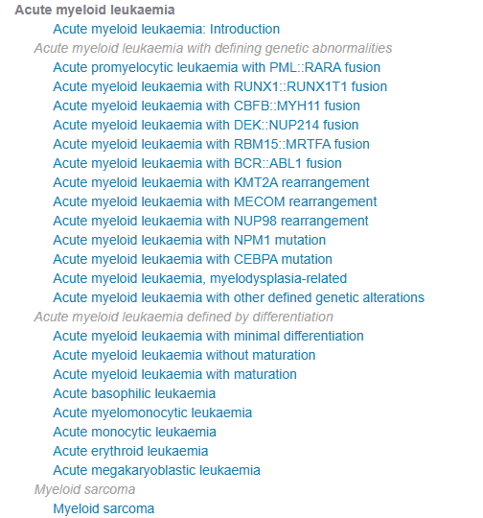
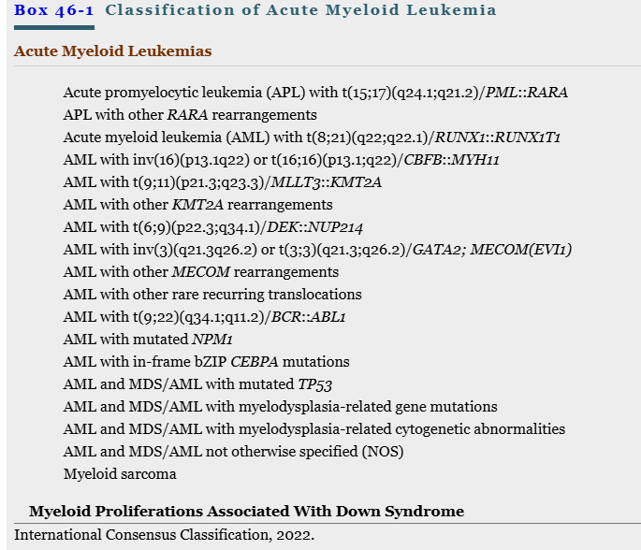
WHO 5th ed and ICC Classification Part I
WHO 5th ed haematolymphoid tumors
Box 46-1, p.890, Jaffe’s Hematopathology 2025
Notes:
Rodak’s Hematology 2025 p. 571. The 2022 WHO clas­sification for myeloid malignancies has categorized AMLs into two broad categories, those defined by genetic abnor­malities and those defined by differentiation, in addition to a section for myeloid sarcoma, as shown in Box 31.1. The subtypes under the category defined by genetic abnormali­ties are listed in Table 31.4.6 The subtypes defined by genetic abnormalities no longer require 20% blasts for diagnosis, except for AML with BCR::ABLl and AML with CEBPA mutation. Fluorescence in situ hybridization, next-generation sequencing (NGS), polymerase chain reaction-based muta­tional analysis, and chromosomal analysis by karyotyping are commonly employed modalities to assess underlying genetic abnormalities (Chapters 28 to 30). p. 567: Hematologists and pathologists are now moving toward more precise classification of many of the leukocyte neoplasms based on recurring chromosomal and genetic lesions found in many patients. These lesions are related to disruptions of oncogenes, tumor suppressor genes, and other regulatory elements that control proliferation, maturation, apoptosis, and other vital cell functions. In 2001 the World Health Organization (WHO) pub­lished classification schemes for nearly all the tumors of hemato­poietic and lymphoid tissues,5 and in some cases WHO blended the older morphologic schemes with the newer schemes. For instance, in the WHO classification scheme for acute myeloid leukemias (AMLs), there are some remnants of the old FAB classification, but new classifications were introduced for leukemias associated with consistently recurring chromosomal transloca­tions . According to the WHO classification, a finding of at least 20% blasts in the bone marrow is required for diagnosis of the majority of AMLs, and testing must be performed to detect the presence or absence of genetic anomalies. Although there is no specific blast percentage required for acute lymphoblastic leukemias (ALLs), a diagnosis of ALL is usually not made if blasts are less than 20%. The most recent (2022) WHO classification was- _ r elease-d because of further insights into the molecular biology of the entities, with updates reflected in some of the classifica­tions.6 In-depth discussion of each of the subclassifications is beyond the scope of this book; only the most common subtypes of ALL and ALL are defined. Additionally, in 2022, the International Consensus Classification of Myeloid Neoplasms and Acute Leukemias was published, which built upon the prior WHO 4th edition classi­fication released in 2017. This second classification system has some key differences from the most recent WHO classification; however, there are many similarities. The entities addressed in this chapter will be based on the WHO Classification of Haematolymphoid Tumours (5th edition). WHO Classification system 5th ed haematolymphoid tumors and international consensus classification 2022. Although many AML types have distinctive morphologic, clinical, and prognostic features in addition to the specific cytogenetic and molecular genetic findings,18,20 the ICC approach to AML is primarily based on genetics with nongenetically defined disorders placed in the ever-shrinking category of AML, NOS.12 In addition to a more genetic approach, the ICC also makes major changes related to blast cell counts required for an AML diagnosis. Many of the genetically defined abnormalities in de novo AML types define biologically distinct entities in which the biology does not change based on blast cell count. The best characterized of these is APL with t(15;17)(q24.1;q21.2)/PML::RARA and the core binding factor leukemias (AML with t(8;21)(q22;q22.1)/RUNX1::RUNX1T1 and AML with inv(16)(p13.1q22) ort(16;16)(p13.1;q22)/CBFB::MYH11) and prior classifications have allowed for a diagnosis of AML in such cases without regard to blast cell count.40 The ICC expands the list of de novo type genetic groups, but there is less data on some of these types to be confident that such a finding in the absence of an increase in blasts warrants a diagnosis of AML. Additionally, mutations in NPM1 may be secondary, such as in the setting of chronic myelomonocytic leukemia (CMML),41 and such a finding in that context should not automatically trigger a diagnosis of AML. For consistency among disease groups, the ICC requires at least 10% peripheral blood or bone marrow blasts for a diagnosis of AML, understanding that rare cases, especially with features of APL or core binding factor leukemias, may be exceptions to this cutoff. One exception to this approach, however, is AML with (9;22)(q34.1;q11.2)/BCR::ABL1 for which the 20% blast requirement is retained because of difficulty in distinguishing accelerated phase of CML from AML in cases with less than 20% blast cells. For cases of AML with mutated TP53, AML with myelodysplasia-related gene mutations, AML with myelodysplasia-related cytogenetic abnormalities, and AML, NOS, the 20% blast requirement is retained, but a new category of MDS/AML is introduced in which peripheral blood or marrow blasts are 10% to 19%. Such cases should be treated based on their clinical behavior, with some being slowly progressive, similar to MDS, and others progressing quickly, similar to AML.42

Slide 29
WHO 5th ed and ICC Classification Part 2
Although many AML types have distinctive morphologic, clinical, and prognostic features in addition to the specific cytogenetic and molecular genetic findings, : the ICC approach to AML is primarily based on:
  genetics with nongenetically defined disorders placed in the ever-shrinking category of AML, not otherwise specified (NOS).
In addition to a more genetic approach, the ICC also makes major changes related to blast cell counts required for an AML diagnosis. Blast count #s not needed for:
  APL with t(15;17)(q24.1;q21.2)/PML::RARA and the core binding factor leukemias (AML with t(8;21)(q22;q22.1)/RUNX1::RUNX1T1 and AML with inv(16)(p13.1q22) or t(16;16)(p13.1;q22)/CBFB::MYH11)
  For consistency among disease groups, the ICC requires at least 10% peripheral blood or bone marrow blasts for a diagnosis of AML, understanding that rare cases, especially with features of APL or core binding factor leukemias, listed above.
One exception to this approach, however, is AML with (9;22)(q34.1;q11.2)/BCR::ABL1 for which the 20% blast requirement is retained because of difficulty in distinguishing the accelerated phase of CML from AML in cases with less than 20% blast cells.
Notes:
Hematopathology, 2025, p. 892. The ICC expands the list of de novo type genetic groups, but there is less data on some of these types to be confident that such a finding in the absence of an increase in blasts warrants a diagnosis of AML. Additionally, mutations in NPM1 may be secondary, such as in the setting of chronic myelomonocytic leukemia (CMML),41 and such a finding in that context should not automatically trigger a diagnosis of AML. For consistency among disease groups, the ICC requires at least 10% peripheral blood or bone marrow blasts for a diagnosis of AML, understanding that rare cases, especially with features of APL or core binding factor leukemias, may be exceptions to this cutoff. One exception to this approach, however, is AML with (9;22)(q34.1;q11.2)/BCR::ABL1 for which the 20% blast requirement is retained because of difficulty in distinguishing accelerated phase of CML from AML in cases with less than 20% blast cells. For cases of AML with mutated TP53, AML with myelodysplasia-related gene mutations, AML with myelodysplasia-related cytogenetic abnormalities, and AML, NOS, the 20% blast requirement is retained, but a new category of MDS/AML is introduced in which peripheral blood or marrow blasts are 10% to 19%. Such cases should be treated based on their clinical behavior, with some being slowly progressive, similar to MDS, and others progressing quickly, similar to AML.42

Slide 30
WHO 5th ed and ICC Classification Part 3
The ICC expands the list of de novo type genetic groups, but there is less data on some of these types to be confident that such a finding in the absence of an increase in blasts warrants a diagnosis of AML.
Additionally, mutations in NPM1 may be secondary, such as in the setting of chronic myelomonocytic leukemia (CMML), and such a finding in that context should not automatically trigger a diagnosis of AML.
For cases of AML with mutated TP53, AML with myelodysplasia-related gene mutations, AML with myelodysplasia-related cytogenetic abnormalities, and AML, NOS, the 20% blast requirement is retained, but a new category of MDS/AML is introduced in which peripheral blood or marrow blasts are 10% to 19%. Such cases should be treated based on their clinical behavior, with some being slowly progressive, similar to MDS, and others progressing quickly, similar to AML.
Notes:
Hematopathology, 2025, p. 892.

Slide 31
Clonal Hematopoiesis (CH): Part 1: A product of Aging
CH: Characterized by the expansion of distinct, clonal blood cell subpopulations which arise from the hematopoietic stem cell
First published in 2014, CH occurs in 1% of 60 year olds, 10% in 70 yrs, 30% of 90 years old, and not showing a blood picture of hematologic malignancy
Now called Clonal hematopoiesis of indeterminate potential (CHIP)
CH detected in individuals with unexplained cytopenia is designated as “clonal cytopenia of undetermined significance” (CCUS)
Dr Kishtagari, 10-25-2025, Do I have Bad Blood, Vanderbilt U, podcast: Blood Cancer Talks

Slide 32
Clonal Hematopoiesis (CH): Part 2
Analysis of > 30,000 people identified CH as a common age-dependent occurrence in healthy people that was associated with an increased risk of hematological cancers, cardiovascular diseases, and all-cause mortality (#of deaths, specific group over a period of time).
The term “clonal hematopoiesis of indeterminate potential” (CHIP) was coined to denote the presence of myeloid cancer–associated somatic mutations in otherwise healthy individuals without underlying myeloid neoplasia or unexplained blood count abnormalities. A variant allele frequency (VAF) cut-off point of ≥ 2% has been proposed as a criterion for CHIP.
CHIP is regarded as a premalignant state, and risk factors for clonal expansion, and ultimately cancer progression, are beginning to be identified. Although screening hematologically normal individuals for CHIP outside the research setting is not routinely advocated at this stage, CHIP may be incidentally discovered in persons undergoing genetic sequencing for other conditions including direct-to-consumer genetic tests.
CH detected in individuals with unexplained cytopenia is designated as “clonal cytopenia of undetermined significance” (CCUS) and confers a significant risk of progression to hematological cancers. In this edition, CCUS includes any demonstrable molecular or cytogenetic clonal event detected in an individual with cytopenia lacking morphological evidence of myeloid neoplasia. It is anticipated that data will emerge in the coming years to help risk-stratify CCUS patients and identify optimal management approaches accordingly. In the absence of evidence of clonality, sustained unexplained cytopenia(s) should be referred to as “idiopathic cytopenia of unknown significance”.
Eric Topel: as been a prominent advocate for recognizing clonal hematopoiesis of indeterminate potential (CHIP) as a clinically significant biomarker, not just a laboratory curiosity. In his “The Missing CHIP” post, he emphasized that CHIP — defined as somatic mutations in hematopoietic stem cells with a variant allele frequency (VAF) ≥2% — conveys independent risk information for cardiovascular disease, cancer, blood clots, and other conditions Ground Truths Podcasts
Notes:
National cancer institute: all cause mortality: A term that refers to death from any cause. In statistics, all-cause mortality is usually a measure of the total number of deaths from any cause in a specific group of people over a specific period of time. For example, all-cause mortality may be reported for people who live in one area of the country or who are of a specific gender, age, race, or ethnic group. WHO 2025 said: The recently described CH-related disorder referred to as VEXAS syndrome (vacuoles, E1 enzyme, X-linked, autoinflammatory, somatic UBA1 mutations) is listed under the section on CH in this edition (see section Clonal haematopoiesis). As additional data continue to emerge on this disorder, it is likely that it might constitute a distinct disease entity/type in future editions of the WHO classification. CH is nearly always an incidental finding without associated clinical features. An exception includes the recently recognized CH-related disorder referred to as VEXAS syndrome, which has specific clinicopathological associations { 33108101 ; 37084382 }. All patients with VEXAS syndrome described to date have somatic mutations involving the X-linked gene UBA1, and they usually have a progressive systemic autoinflammatory syndrome involving the skin, lungs, blood vessels, joints, and cartilage, and/or various haematological conditions, including cytopenias { 36692560 }. Epidemiology
The estimated prevalence of CH is linked to sequencing depth and analytical sensitivity { 31672865 }. However, CH is rare in individuals younger than 40 years of age, increases steadily in incidence in those aged > 65 years, and affects 10–40% of elderly individuals { 25426837 ; 28655780 }. Etiology Ageing is the dominant risk factor for CH{ 25326804 ; 25426837 ; 25426838 ; 25732814 }, but smoking { 25426838 ; 28483762 ; 33057201 }, male sex { 25426837 }, exposure to cytotoxic therapies { 29954749 ; 33106634 }, and aplastic anaemia { 26132940 } have been associated with an increased risk of certain mutations. Several germline variants have been associated with a predisposition to CH { 28483762 ; 33057201 }. Germline deletion in intron 3 of the telomerase reverse transcriptase gene (TERT) may predispose to CH { 28483762 }. Hispanic ancestry is associated with a decreased risk of CH { 25426837 ; 33057201 }, but few other predisposing sociodemographic factors have been identified to date. he mutations that cause CH are most often base substitutions or small insertions/deletions, but CH due to acquired chromosomal mosaicism is increasingly recognized { 22561516 ; 22561519 }. The reason for the selective advantage (fitness) of a particular clone may be gene-dependent, mutation-specific, and influenced by the clinical context and timing of acquisition { 32217721 }. The most frequently reported mutations in CH occur in the key epigenetic modifiers DNMT3A, TET2, and ASXL1. Mice with loss of function of Tet2 or Dnmt3a display stem and progenitor cell expansion, but the mechanisms underlying these changes remain obscure { 21723200 ; 22138693 }. Mutations in PPM1D and TP53 may permit haematopoietic stem cells to bypass cell-cycle checkpoints after DNA damage, therefore leading to clonal expansion in the setting of chemotherapy { 29954749 }. Less is known about the mechanisms of clonal expansion for other genes associated with CH, such as ASXL1, SF3B1, SRSF2, and U2AF1, in part because murine models for these mutations show no clonal advantage for mutated haematopoietic stem cells { 29643185 ; 27622333 ; 25965569 ; 25965570 }. Clonal expansion can also occur in the absence of a known driver mutation, possibly due to unknown driver mutations or genetic drift in older individuals with a relatively depleted active haematopoietic stem cell pool {
Clonal haematopoiesis of indeterminate potential. Essential: detection of one or more somatic mutations involving the CH driver genes listed in #32521Table 2.02 with a variant allele frequency (VAF) of ≥ 2% (≥ 4% for X-linked gene mutations in male patients) in DNA from blood or bone marrow cells; absence of unexplained cytopenias; absence of features diagnostic for defined myeloid neoplasms. Staging Not relevant Prognosis and prediction CHIP is recognized as a precursor state that is distinct from haematological neoplasms and has a predominantly benign natural history { 25426837 ; 25426838 ; 28655780 }. CHIP progresses to frank malignancy at a rate of about 0.5–1% of cases per year { 25426837 ; 25426838 }, but the risk varies considerably according to several variables. The presence of a large clone or multiple gene mutations usually portends an increased risk of progression to myeloid malignancy. The risk of progression is greater for CHIP driven by mutations in TP53, U2AF1, SRSF2, IDH2, IDH1, SF3B1, and ASXL1 { 29988082 ; 29988143 ; 29988142 }. Also, the concomitant presence of mosaic clonal genetic alterations is an independent risk factor for progression to leukaemia { 33436578 }. Mutations involving CH driver genes with a very low VAF (< 2%) may be highly prevalent by middle age { 27546487 }, but such clones have not been demonstrated to have pathological consequences. CHIP is also associated with an increased risk of all-cause mortality, possibly due to atherosclerotic cardiovascular disease { 25426837 ; 25426838 ; 31707836 ; 34239136 } and with autoimmune diseases { 34139005 }. MDS in the context of VEXAS syndrome appears to have lower-risk features and few mutations besides those involving UBA1 { 37084382 }.

Slide 33
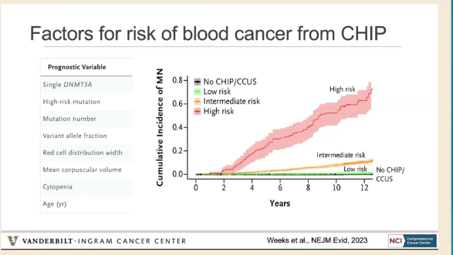
Factors of Risk for CHIP and CCUS
Clonal Hematopoiesis of Indeterminate Potential; Clonal Cytopenia of Undetermined Significance
CCUS
CHIP
Dr Kishtagari, 10-25-2025, Do I have Bad Blood, Vanderbilt U, podcast: Blood Cancer Talks
Notes:
We analyzed sequenced exomes of healthy U.K. Biobank participants (N5 438,890) in separate derivation and validation cohorts. Genetic mutations, laboratory values, and MN outcomes were used in conditional probability–based recursive partitioning and Cox regression to determine predictors of incident MN. Combined statistical weights were used to define a clonal hematopoiesis risk score (CHRS). Independent CHIP/CCUS patient cohorts were used to test the prognostic capability of the CHRS in the clinical setting. Figure 1. Features Influencing the Risk of MN in U.K. Biobank Participants with CHIP/CCUS. Panel A shows the cumulative incidence of myeloid neoplasms (MN) in individuals with clonal hematopoiesis of indeterminate potential (CHIP)/clonal cytopenia of undetermined significance (CCUS) compared with those without CHIP/CCUS. (Panel B) Subtypes of MN among patients with CHIP/CCUS in whom MN develops. Univariate Cox proportional-hazards regression analysis for the 14 most commonly mutated genes in CH (Panel C) and for groups of mutations, including single mutations in DNMT3A, TET2, or ASXL1 (single D-T-A), splicing factor mutations (SRSF2, SF3B1, and ZRSR2) and acute myeloid leukemia (AML)-like mutations (IDH1, IDH2, FLT3, and RUNX1) (Panel D). (Panel E) Univariate analysis of single DNMT3A, TE T2, and ASXL1. (Panel F) Cumulative incidence of MN for CHIP/CCUS possessing a single DNMT3A mutation (green) compared with the cumulative incidence for all other CHIP/CCUS genotypes (red) and individuals without CHIP/CCUS (black). (Panel G) For U.K. Biobank participants with at least 10 years of follow-up (n510,559), recursive partitioning analysis was performed on the basis of conditional probability of incident MN within 10 years. Of these, 207 incident MN events were recorded. Each node is annotated with the number of individuals and probability of incident MN. Nodes are color coded as follows: probability of 0.02 or lower is green, 0.02 to 0.4 is yellow, and more than 0.4 is red with white typeface. Partitioning variables are all binary (presence vs. absence of feature) and include high-risk mutation (mutations in SRSF2, SF3B1, ZRSR2, IDH1, IDH2, FLT3, RUNX1, and JAK2), single DNMT3A, having two or more mutations, a variant allele fraction (VAF) of 0.2 or more, having CCUS instead of CHIP, red cell distribution width (RDW) of 15% or more, mean corpuscular volume (MCV) of 100 fL or more, and being 65 years of age or older. (Panel H) Multivariable Cox regression adjusted for assigned sex at birth, history of cancer, and any history of smoking as confounders was performed on the entire cohort (N511,337) using features selected in recursive partitioning analysis. For all Cox regression models, hazard ratios are shown with error bars representing 95% confidence intervals and numerical values for hazard ratios (95% confidence intervals) and P values for each feature analyzed. MDS denotes myelodysplastic syndrome; and MPN, myeloproliferative neoplasm

Slide 34
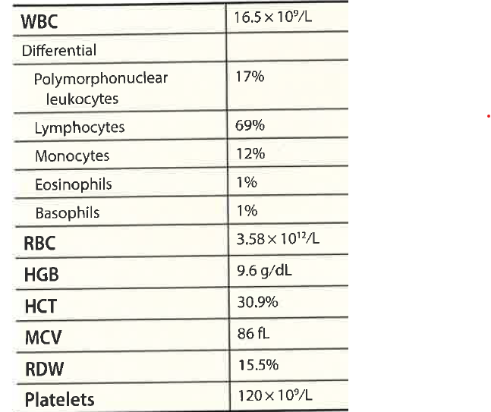

Case Study 1: Part 1
A 78 year old man was noted incidentally to have a leukocytosis on a CBC.
Morphology of the peripheral smear: small, mature-appearing lymphs, “soccer ball-like” nuclei and some smudge cells.
Flow cytometry: CD5+,CD19+, CD20 dim, CD23+, CD43 dim, CD79b dim, CD200 +, CD10 neg, CD38 neg,
FISH: 13q14.3 62% of cells, 17p13.1 deletion 76% of cells. Neg for trisomy 12, t (11;14) CCND1-IGH, and deletion 11q.
Targeted next generation sequencing panel:TP53 mutation
Diagnosis:___________________________
Think absolute #s
11,385
Beck R, Moore E. Molecular Hematopathology, 2021, p. 152-147.
Notes:
(COS+, CD23+, CD2Odim, CD200+ clonal B cell population), in the presence of an absolute clonal lymphocyte count >5 x I}e /L, the minimum level required for the diagnosis of CLL' A bone marrow or lymph node biopsy is not necessary to establish the
diagnosis. The main differential diagnosis includes leukemic mantle cell lymphoma (tvtcl), which was excluded in this case based on the absence of the 17o/o t( r t; t+) (qrr;q32) CCNDI -rGH. FISH for t( r r; t+) or immunostaining for cyclin Dl to exclude MCL is recommended in suspected CLL cases, because

Slide 35
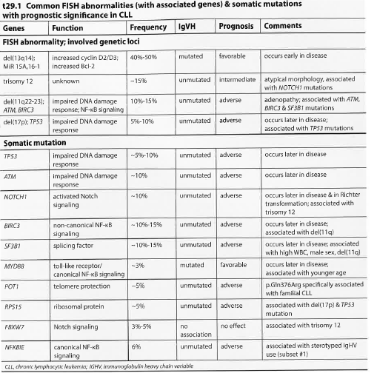
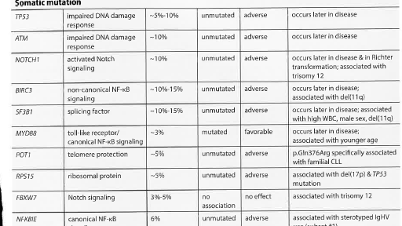
Case 1: Part 2, Common FISH Abnormalities and Somatic Mutations in CLL
Notes:
Beck 2021, p. 154TP53 mutation and del( 17p) often occur together in CLL (as in this case) and adversely affect time to
therapy, overall survival (median 32 months), and response to therapy. TP53 mutations are most often
encountered in exons 4-8, in the DNA binding domain, but may also affect other regions of the molecule.
These mutations are particularly deleterious because p53 protein triggers cell cycle arrest after DN,A. damage,
allowing for DNA repair. When p53 function is perturbed, replication following DNA damage occurs
more readily, allowing for the potentially permanent incorporation of harmful DNA mutations. Even minor
TP53-mutated subclones in CLL impart an adverse prognostic effect. Other frequently detected FISH abnormalities in
CLL are del(t tq) and trisomy 12 (the second most common cytogenetic abnormalityin CLL). Trisomy
l2 car¡ies an intermediate prognosis, with median survival of -111 months, similar to patients with CLL
having a normal karyotype. Prognosis in CLL patients with trisomy 12, however, is negatively affected by the
occurrence of additional chromosomal aberrations such as del(ttq) or del(l7p) fas is the case wirh
del(13q)]. Trisomy 12 is often associatedwith atypical CLL morphology, including cells with clefted nuclei and increased prolymphocytes in the peripheral blood, as well as NOTCHI mutations and unmutated IGFIV regions (as described later). The third most common cytogenetic abnormality in CLL, del(11q), is known to be associated with extensive adenopathy and more rapid
disease progressiory with shortened median survival (-79 months) compared ro patients with del(13q)
or trisomy 12. Therapeutic approaches incorporating alþlating agents maybe beneficial in CLL patients with del(rrq).

Slide 36
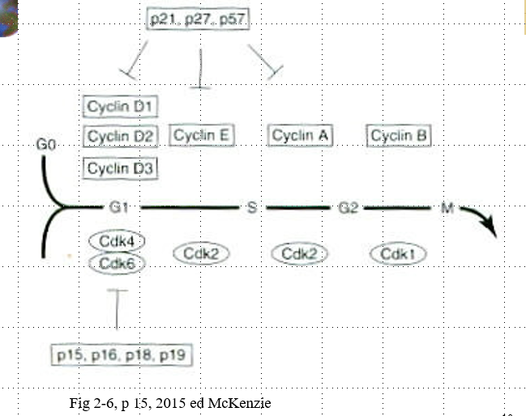
Genetics and Epigenetics in CLL
Genetic mutations:
  del 13q14 most common abnormality: 50% of patients
  Trisomy 12: 15-20% of patients
  del 11q22.3: 10-15% of patients
  Others: del 6q21, del 17 p13.1
In general loss and gain of chromosomes is common whereas balanced translocations are not common
RNA expression of noncoding micro RNAs ( miRNAs or miRs) serve as a model for disease pathogenesis. For example, loss of 13q14 results in a loss of a tumor-suppressor gene and results in short noncoding miRNA. This modulates the expression of various pro and antiapoptopic proteins of relevance to CLL.
del 17p13.1 leads to the deletion of the tumor protein p53 (TP53)
G₁ – checks for DNA damage
  Rb (retinoblastoma susceptibility gene)
  P53(TP53) – molecular policeman, tumor suppressor gene; most commonly mutated gene in human tumors
G₂-M checkpoint monitors the accuracy of DNA replication during S-phase
Metaphase checkpoint ( mitotic – spindle checkpoint) – fxns to ensure that all chromosomes are properly aligned on the spindle apparatus prior to initiating chromosomal separation and segregation at anaphase
Notes:
McKenzie, 2015, p. 15 – Cell- cycle checkpoints: cell proliferation and differentiation depends on the accurate duplication and transfer of genetic information, which requires the precise ordering of cell-cycle events. Cells achieve this coordination by using cell-cycle checkpoints to monitor events at critical points in the cycle and, if necessary, halt cycle’s progression. The main functions of checkpoints are to detect malfunctions within the system and to assess whether certain events are properly completed before the cell is allowed to proceed through the next phase of the cycle. When problems are detected checkpoint mechanisms interrupt cell cycling to allow correction of the problem or elimination of the defective cell. Four major cell-cycle checkpoints have been described. The G₁ checkpoint checks for DNA damage and prevents progression into S phase if the genomic DNA is damaged. The S-phase checkpoint monitors the accuracy of DNA replication during S phase and checks for damaged or unreplicated DNA; it can block mitosis if any ( damaged or unreplicated DNA) is found. Williams? Pathogenesis involves a hematopoietic stem cell predisposition to CLL, epigenetic programing that becomes locked at the stage of differentiation in which B-cell transformation occurs, loss of specific noncoding RNA entities and specific coding, and noncoding DNA mutations. In addition, epigenetic dysregulation and/or programming of super enhancer and transcription factors contributes to disease progression to the Richter transformation, progression of CLL into an aggressive high-grade, large B cell non-Hodgkin lymphoma. Williams, 2021, Ch. 91, p. 1618: Other deletions, such as the del 17p13.1, are present in less than 10% of pts with CLL and frequently involve the deletion of the tumor protein p53 (TP53) gene that encodes the p53 protein that is critical for cellular apoptosis or repair, especially in response to cytotoxic stimuli. Most patients with deletion of TP53 also have an inactivating mutation on the other allele. These patients do not respond to cytotoxic therapy and have a higher risk of Richter transformation to more aggressive lymphomas over the course of their disease; they also have a high frequency of genomic instability with complex karyotypes. Next-generation sequencing of both the whole genome and whole exon has further extended our understanding of CLL pathogenesis. ~ 100 recurrent mutations have been observed to occur in CLL, although validation of many is required. This is particularly true when using error- corrected, highly sensitive sequencing that will also ID clonal hematopoiesis aberrations that are acquired with age. A large sequencing effort in CLL ID 44 recurrently mutated genes, 23 putative genes, and 11 recurrent somatic copy numbers, with less than 10% having at least one driver. The mutational load is also low in CLL compared with solid tumors. Mutational aberrations generally are associated with the origin of the B-cell transformation (IGHV-mutated vs unmutated) IGHV-mutated CLL is associated with mutations in MYD88 and KLHL6, whereas IGHV unmutated CLL is associated with many mutations, including SF3B1 ( splicing factor 3B subunit 1, NOTCH1 ( Notch homologue 1), translocated-associated) TM, TP53, XPo1 ( gene encoding exportin-1, FBXW7, RPS15, POT1, KRAS, and ERK1 ( extracellular signal regulated kinase 1) . A number of genes have been shown to have noncoding mutations, including the promoter of PAX5 and NOTCH1, which also contribute to pathogenesis. Acquisition of additional mutations and expansion of aggressive subclones as disease progresses or in the context of chemotherapy has been documented and generally is associated with both disease progression and transformation. Epigenetic changes of the genome may drive both silencing and over expression of genes important to the pathogenesis of CLL. Silencing can involve chronic gene suppression through methylation, and transient silencing through repressor complexes driven by histone acetylation changes or other chromatin modifications. Similarly, disease-specific super-enhancer activation leads to overexpression of numerous genes related to the pathogenesis of CLL including TCL1, SYK, BCL2, MCL1, and many others. Integrating chromatin immunoprecipitation with bromodomain-containing protein ( BRD) 2/4 inhibitors (BRD-profiling) have confirmed multiple genes involved in CLL pathogenesis driven by super-enhancers. Similar studies integrating chromatin immunoprecipitation with histone deacetyl inhibitor rx have demonstrated pathogenic miRs involved in CLL pathogenesis. The repertoire of genetic aberrations driving CLL pathogenesis are complex, whereas converging biology around critical features such as BCR signaling make CLL vulnerable to therapeutic targeting.

Slide 37
CLL Biology: Bruton Tyrosine Kinase
Bruton tyrosine kinase (BTK) mediated intracellular signaling of the B-cell receptor(BCR) is critical for B Cell development, expansion, and survival.
BTK is an enzyme that exists in most kinds of blood cells.
In CLL, BTK enzyme is overactive, causing the B lymphocytes to become defective and grow out of control.
BTK, a member of the tyrosine kinase expressed in carcinoma (TEC) kinase family, is a nonreceptor tyrosine kinase and an essential component of the BCR signalosome.
During BCR signaling BTK phosphorylation leads signal transduction via multiple pathways, culminating in the nuclear translocation of transcription factors, including NF-kappaB.
Activated BCR signaling contributes to the initiation and maintenance of B cell malignancies
Aberrant BCR signaling has been strongly linked to lymphomagenesis and plays a crucial role in the pathobiology of CLL, mantle cell lymphoma and other hematologic malignancies.
BTK is an essential component of BCR signaling, as demonstrated by the observed effects of mutations interfering with its functions both in animals and humans.
BTK was clinically validated as a target in B-cell malignancies by the first-in-class inhibitor ibrutinub which currently has 6 US FDA approved indications including CLL, MCL, lymphoplasmacytic lymphoma ( Waldenstrom macroglobulinemia) , and marginal zone lymphoma
Notes:
Signalosome: large supramolecular protein complexes. Lymphomagenesis: lymphoma growth and development (Munoz J, et al) Bruton tyrosine kinase (BTK) mediated intracellular signaling of the B-cell receptor(BCR) is critical for B Cell development, expansion, and survival. BTK, a member of the tyrosine kinase expressed in carcinoma (TEC) kinase family, is a nonreceptor tyrosine kinase and an essential component of the BCR signalosome. During BCR signaling BTK phosphorylation leads signal transduction via multiple pathways, culminating in the nuclear translocation of transcription factors, including NF-kappaB. Activated BCR signaling contributes to the initiation and maintenance of B cell malignancies. Aberrant BCR signaling has been strongly linked to lymphomagenesis and plays a crucial role in the pathobiology of CLL, mantle cell lymphoma and other hematologic malignancies. BTK is an essential component of BCR signaling, as demonstrated by the observed effects of mutations interfering with its functions both in animals and humans. BTK was clinically validated as a target in B-cell malignancies by the first-in-class inhibitor ibrutinub which currently has 6 US FDA approved indications including CLL, MCL, Waldenstrom macroglobulinemia, and marginal zone lymphoma.

Slide 38
Case 1: Part 3 Diagnosis and Treatment
In this case, the patient’s CLL carried a mutated IGHV that was not IGHV3-21, carried a biallelic deletion of 13q14, both favorable findings. Nonetheless, del( 17p) and a TP53 mutation were present and the relatively high percentage of del(13q)-positive cells make this case a high-risk CLL.
Because of the minimally affected blood cell counts and absence of symptoms, the patient is currently being monitored without therapy.
He will likely need therapy in the near future based on the adverse genetics, requiring either a Bruton tyrosine kinase (BTK) or BCL-2 inhibitor as frontline treatment. Long-term outcome is expected to be poor.
Genetic analysis including FISH, IGHV mutation status, and assessment for TP53 mutation is recommended for all new diagnoses of CLL, for prognostication purposes.
- Unfavorable chromosomal abnormalities in CLL include del(17p), del(11q), and complex karyotype (>3 abnormalities).
Somatic mutations in TP53, ATM, NOTCHI, SF3B1, BIRC3, RPSI5 and NFKBIE are associated with adverse prognosis. Targeted NGS panels for evaluation of lymphoid neoplasms may include these genes.
Molecular assessment of lGHV gene mutation status is important in the diagnostic workup, since unmutated IgHV (defined as >98% homology with
germline sequences) has an unfavorable prognosis and is associated with expression of CD38, ZAP -7 0, and cD49d.
- Cases of CLL having del(l7p) or TP53 mutations are typically refractory to standard chemotherapy and benefit from therapy with either BTK or BCL-2 inhibitors.
Notes:
Beck 2021, p. 155-156: TP53 mutations and del(17p) are associated with poor response to conventional chemotherapy in CLL.
Therefore, current suggested front-line treatment regimens for these cases are the Bruton tyrosine kinase (nff) inhibitors ibrutinib or acalabrutinib, or the BCL-2 inhibitor venetoclax in combination with anti-CD20 monoclonal antibody. However, therapy with these reagents has led to development o fresistance. BTK resistance has been correlated with acquired mutations in the BTI( gene itself or phospholipase C-12, PLCG2. More recentl¡ resistance to venetoclax has been described to be mediated by a Glyt0lVal mutation.inßCL2. As such, NGS panels evaluating lymphoid neoplasms may also evaluate for these aberrations. The lGHlzgenes are a family of genes encoding a component ofthe antigen recognition portion of the B-cell receptor (nCR), with each individual BCR using a single IGHVgene. Somatic mutations occur in these genes after antigen exPosure as part ofthe honing of the normal B-cell immune response. Approximately 50%-600/o of patients with CLL have IGHVgenes with somatic mutations, defined as <98% homologywith germline IGHV gene sequences' IGFfV-unmutated CLL is associated with poor prognosis and significant decreased survival compared with CLL having mutated IGFIV, and is associated with CD38, CD49d, and
ZAP-70 expression as well as adverse genetic mutations, including thos e in TP 53, ATM, NOTCHI' SF3B1, and BIRC3. Interestingly, preferential IGHV3-21 gene usage is also associated with poor outcome, irrespective of the mutational status. Approximately 30% of CLL patients carry quasi-similar, if not identical, BCRs, a phenomenon termed BCR stereotyp¡ which suggests that antigen stimulation may underlie the pathogenesis of CLL. The stereotyped BCRs have been grouped into different subsets, some of which have been shown to some of which have been shown to affect prognosis. Beck, 2021, p. 154: Genetic studies are important for determining prognosis and therapy in CLL and have become an essential part ofthe diagnostic evaluation. Standard genetic studies for CLL include FISH for del(13/13q), del(t tq), del(l7p), and trisomy t2 as well as for t(1t;14) ; IGHV gene mutational analysis and evaluation for somatic mutations, particularly TP53, are also recommended. When performed, karyotype assessment requires stimulation of CLL cells with CpG oligonucleotides, because CLL cells rarely divide in cuiture without stimulation. A complex karyotype (having >3 unrelated chromosome abnormalities) is a poor prognostic factor. A surnmary of typical genetic abe¡rations found in CLL and their significance is shown in table t29.1. This patient had biaiielic deletion of 13q14. Deletion of clrromosome region I 3q14, typicallymonoaìlelic, rs_the most common structural genetic abnormalityin CLL. Patients with this abnormality have a favorabie prognosis, witl-r a median survival of ,l l years ilï O",llatl4-) is present as rhe sole cyrogeneric lilïu,,r. Biaileric r3q t4 detetion 1*i.,"rã bott., :i::i:::i.' demonstr.ate the deletion) occurs in e /o- Lv"/o ot patients and a favorable 0.";;;.;;:apPears to convey simi I arly ï::::":ìn * .'...ü.ïl jÏlî i:[l"'iÍl (>607o-8eo/e dependinion srudy) and the size of the deletion (large size with delerion of the RBJ gene) appear to adversely affect outcome, although the Iatter is rarely evaluated unless microarray studies are performed. When present in combination with adverse factors such as del(11q) or del(17p), del(t:ql+) modestly mitigates these poor prognostic factors.

Slide 39
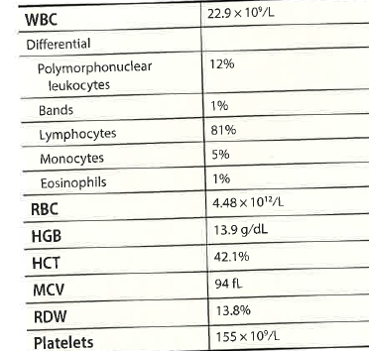

Case 2: Part 1
An 83-year-old man with a 2-year history of atypical CLL presented for management of his lymphocytosis.
Peripheral blood morphology: predominance of lymphocytes, medium-sized, moderate amount cytoplasm and round to oval nuclei, with single prominent nucleoli.
Bone marrow morphology: 44% lymphocytes, similar morphology as above.
Flow cytometry: CD5+, CD19+, CD19+, CD38(dim), CD43, CD79b, +, Kappa light chain +, CD10-,CD11c-, CD23-, CD43_, CD200-.
Immunohistochemistry for cyclin D1 and SOX11:negative.
Chromosome karyotype : 47,X,-Y,+ l ,del ( 1)(p13) +3,t (3;18) ((p26;q21.2),der (14) t(1;14)(q21;q32)
FISH was positive for deletion of IGH (14q32)in 52.8% of cells, negative for del(11q), neg for trisomy 12, neg for del 17p.
Fish positive for MYC (8q24) 46% of cells, IGH-MYC, t(8;14) not detected.
NGS: TRAF3pK429c.1285A>T, variant allele 45%
Diagnosis:__________________________
Think absolute #s
18,549
Beck R, Moore E. Molecular Hematopathology, 2021, p. 158-163.
Notes:
AI said c-MYC is a proto-oncogene that encodes a transcription factor regulating the expression of thousands of genes, playing essential roles in cell growth, division, metabolism, and stem cell biology, but whose dysregulation is a hallmark of many cancers. C-myc is a basic helix-loop-helix-leucine zipper transcription factor encoded by the MYC gene on chromosome 8 in humas. It functions by forming a heterodimer with the MAX protein, bidnignt to DNA sequences called E-boxes (CACGTG) and turning target genes on or off. This makes c-MYC is a master regulator of multiple cellular programs. When c-myc becomes an oncogene it becomes continually, constitutively overexpressed- due to gene amplific ation, choromosomal translocation or other regulatory changes- it can promote uncontrolled cell growtyh and is found in many cancers, including Burkitt lymphoma, breast, colon, lung and other cervical cancers. C-MYC regulates about ~15% of the human genes, influencing both cell-intrinsic processes and the tumor microenvironment. WHO: A sequence alteration relative to a transcript reference sequence is reported using the prefix “c.” for the coding DNA sequence, followed by the nucleotide number and the nucleotide change. The predicted protein sequence change then follows the prefix “p.”, specifying the reference amino acid, the amino acid number, and the variant amino acid resulting from the mutation. NGS: TRAF3pK429c.1285A>T, variant allele 45%. C coding DNA sequence, nucleotide ( Base+PO4, sugar) , nucleotide ( Building block of DNA) change

Slide 40
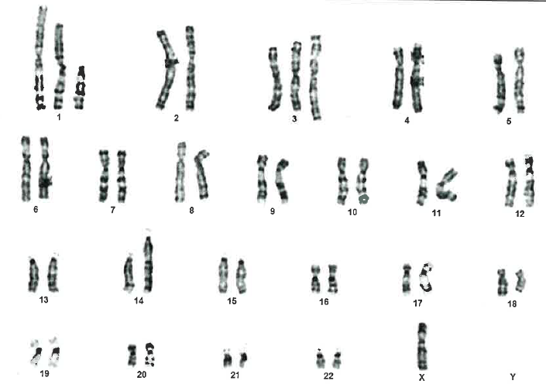
Case 2: Part 2
Prolymphocytic leukemi (PLL) diagnosis, now called CD5+ non-mantle B-cell neoplasm, with at least 15% prolymphs in periph blood and bone marrow.
> 55% prolymphocytes ( of total lymphs) ( I prefer abs # value)
No specific immunophenotype for PLL.
Cyclin D1 and SOX 11 should be negative for B-PLL.
Differentiate from mantle cell lymphoma which has a CCND1 rearrangement.
Chromosome karyotype : 47,X,-Y,+ l ,del ( 1)(p13) +3,t (3;18) ((p26;q21.2),der (14) t(1;14)(q21;q32)
Notes:
B-Prolymphocytic Leukemia: Chronic lymphocytic leukemia (CLL) with prolymphocytic progression is a new disease entity defined in the 5th edition World Health Organization (WHO) classification as a CD5+ non-mantle B-cell neoplasm with at least 15% prolymphocytes in the peripheral blood or bone marrow, partially replacing the prior classification of B-cell prolymphocytic leukemia (B-PLL).
Does CLL truly progress to B-PLL? Beck, 2021, p. 161. In addition to leukemic MC! based on morphology. the differential diagnosis of B-PLL also includes CLL with increased prolymphocytes and hairy cell leukemia variant (HCI- -v). The atypical cells in HCL-v are
nucleolated similar to prolymphocytes, which can cause diagnostic confusion; however, the two disorders can usuallybe distinguished based on immunophenotype and genetic frndings. In addition, HCL-v cells tend to be smaller, with smalle¡ nucleoli, often with cytoplasmic projections. Cases of HCL-v typically do not express CD5 or CDl0, but instead display moderate expression of CDllc and CD103, markers not seen in B-PLL. At the molecular level, mutations
of MAP2I{1 are seen in 30o/o-40o/o of HCL-v cases but are not observed in B-PLL. The circulating cells of CLL often include a variable amount of prolymphocytes, making distinction between B-PLL and CLL dificult. Careful evaluation ofcells in the thin areas of the peripheral smear usually reveals a substantially smaller percentage of prolymphocytes in CLL. Some CLL cases have cells that are on a continuum from small lymphocytes to slightly enlarged cells having small indistinct nucleoli to prolymphocytes, making the enumeration of prolymphocytes problematic. In these cases, the flow cytometric features can be helpful since

Slide 41
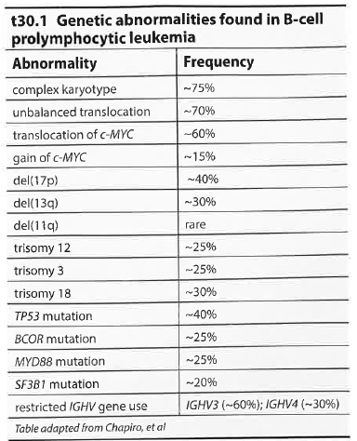
Case 2: Part 3
No unifying genetic abnormality defines B-PLL. But B-PLL frequently demonstrates a complex karyotype (at least 3 unrelated cytogenetic abnormalities), abnormalities of c-MYC, deletion of 17p, and BCOR mutations.
This patient demonstrated a complex karyotype including trisomy 3 and an unbalanced translocations as well as del(14q32) IGH and gain of c-MYC .
Of note, gains of c-MYC in cases of B-PLL have been associated with a highly complex karyotype (at least 5 cytogenetic abnormalities) and trisomy 3 as seen here.
Mutations of TRAF3 have been described in various B-lymphoproliferative disorders, including CLL , SMZL, and lymphoplasmacytic lymphoma. Approximately 10 % of low-grade B-cell lymphoproliferative disorders with del( 14q32) will also have a TRAF3 mutation, as seen in this case.
The patient is currently being followed without therapy’ The decision not to treat was based on the lack of poor clinical prognostic factors, including absence of anemia and relatively low lymphocyte count, as well as lack of the highly adverse genetic finding of coexisting c-MYC and TP53 mutations.
Notes:
Splenic marginal zone lymphoma Beck 2021 p. 162: - Other B-cell l1'rnphoproliÊerative disorders that closely resemble B-PLL include leukemic orblastoid MC! CLL with increased pro\.rnphoc¡es, and HCL-v’ Diagnosis ofB-PLL can usuallybe made based on a combination of morphology, immunophenotyPe, and genetic testing. ln particular, cases with pro\.'rnphocytic moqphology but with t( 1 1 ; 14) .{GH-CCNDI should be , classified as MCL. -- The most common genetic aberations found in B-PLL are abnormalit ies of c-MYC, a complex karyofire, and deletion andlor mutation of TP53. - Patients with B-PLL having b oth a c-MYC anà TP 53 aberration have a particularly poor prognosis. - BCOR mutations are found in 25o/o ofB-PLL cases and are relativeþunique to B-PLL amonglow-grade B-cell lymphoproliferative disorders. Beck p. 161. In addition to leukemic MC! based on morphology. the differential diagnosis of B-PLL also includes CLL with increased prolymphocytes and hairy cell leukemia variant (HCI- -v). The atypical cells in HCL-v are nucleolated similar to prolymphocytes, which can cause diagnostic confusion; however, the two disorders can usuallybe distinguished based on immunophenotype and genetic frndings. In addition, HCL-v cells tend to be smaller, with smalle¡ nucleoli, often with cytoplasmic projections. Cases of HCL-v typically do not express CD5 or CDl0, but instead display moderate expression of CDllc and CD103, markers not seen in B-PLL. At the molecular level, mutations of MAP2I{1 are seen in 30o/o-40o/o of HCL-v cases but are not observed in B-PLL. The circulating cells of CLL often include a variable amount of prolymphocytes, making distinction between B-PLL and CLL dificult. Careful evaluation ofcells in the thin areas of the peripheral smear usually reveals a substantially smaller percentage of prolymphocytes in CLL. Some CLL cases have cells that are on a continuum from small lymphocytes to slightly enlarged cells having small indistinct nucleoli to prolymphocytes, making the enumeration of prolymphocytes problematic. In these cases, the flow cytometric features can be helpful since the typical CLL phenotype (CDs+, CD23+, CD200+, dim CD20, dim to negative surface light chain) is usually lacking in B-PLL. Genetics may also be useful as c-MYC abnormalities are indicative of B-PLL (as described herein) rather than CLL. The common FISH abnormalities found in CLL, del(l3q), del(tZp) and trisomy 12, may also occur in cases of B-PLL, although del(t tq) is quite infrequent in B-PLL.. C-\\LYC aberrations, including mutually exclusive gains and translocations imost commonly t(8;14) IGH-LIYCf , are present in three-quarters ofcases and are correlated with expression of CD38. Other nonspecific, unbalanced translocations are very common, occurring in almost all cases of B-PLL that lack c-MfC translocation. Although mutation studies are limited, somatic mutations in the TP53 gene are the most frequentþ encountered abnormality in B-PLL and often coexistwith del(17p). TP53 mutations and c-MYC aberrations occur together in -20o/o-25% of cases and may confer a particularþpo prognosis. BCOR mutations have been observe dn-25Vo of cases and are also associated wíth c-MYC translocation. Lnterestingly BCOR mutations are not seen in Burktt l1'rnphoma ! but translocati on oî c-MYC ts invariably present in that I disease. B-PL! similarto CLL and SMZ! demonstrates ] immunoglobulin heary chain variable (IGHV) stereot¡py with preferential use of IGFW3 and IGFW4 subgroups l (-90% of .rr.r). IGHVIs frequentþ mutated.

Slide 42
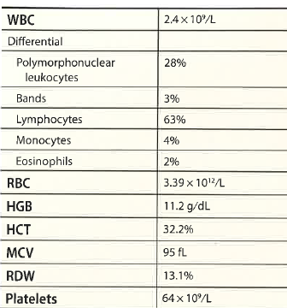

Case 3: Part 1
A 56-year-old female presented with fatigue, abdominal discomfort with bloating and pancytopenia. Imaging studies revealed mild splenomegaly with no other abnormalities.
Peripheral blood morphology: unremarkable, but a low WBC, neutropenia, anemia and thrombocytopenia.
Bone marrow morphology: hypocellular, decreased granulocytic elements, 20% slightly enlarged lymphocytes, oval to kidney shaped nuclei, with fine cytoplasmic projections.
Trephine biopsy: 40% cellular, monocytoid nuclei, fried egg appearance.
Immunohistochemistry: CD20+, BRAFV6000E positive
Flow cytometry: CD5-, CD10-, CD11c+, CD19+, CD20+, CD22+, CD25+, CD38-, CD103+, CD123+, kappa+
Cytogenetics: 46, XX
PCR: BRAFV600E c.1799T>A
Diagnosis:_______________________
672
Think absolute values!
1512
96
Beck R, Moore E. Molecular Hematopathology, 2021, p. 158-163.

Slide 43
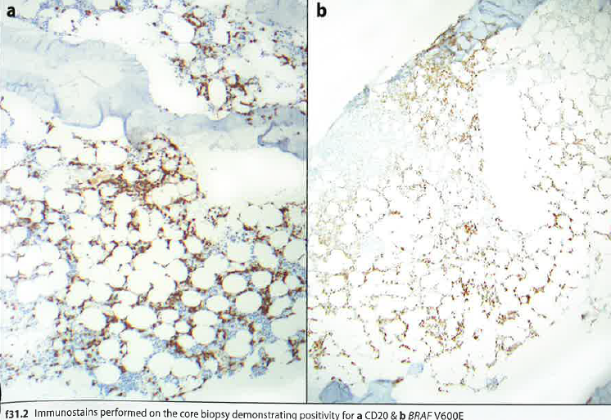
Case 3: Part 2
HCL typically presents in middle-aged adults with a male predominance (M:F = 4:1). Patients usually have pancytopenia with splenomegaly and a 'dry tap“ upon bone marrow aspiration (due to the extensive fibrosis associated with HCL), with a diffuse infiltrate of a typical lymphocytes present in core biopsy sections, as seen in this case. Patients often present with marked monocytopenia and neutropenia, which may lead to infectious complications.
HCL cells have a unique immunophenotype and are almost always CD11c+, CD25+, CD103+, and CD123+. CD 20-,CD22-, CD79b-.

Slide 44
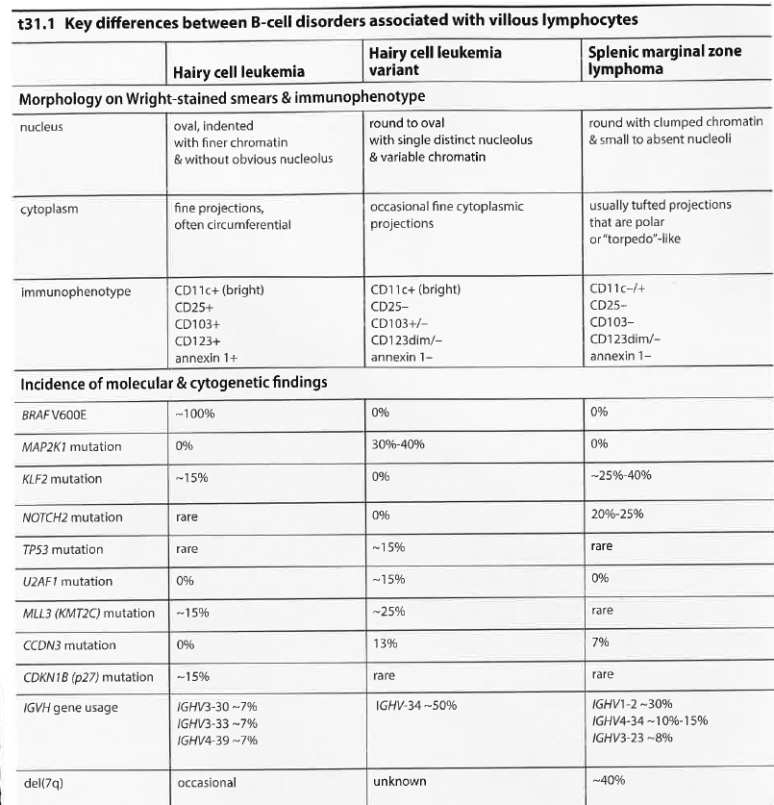
Case 3:Part 3
In this case, the presence of BRAF V600E confirmed the diagnosis of classic HCL and the patient was started on a purine analog, which led to complete remission and appropriate recovery of peripheral blood counts one year later.
HCL can be distinguished from HCL-v by mutation profiling. HCL is characterized by near universal presence of BRAFV600E, whereas HCL-v always lacks BRAFV600E and has preferential usage of IGVH4-34 immunoglobulin receptor in 50% of cases, as well as mutated MAP2KL in30 %-40% of cases.
- As opposed to HCL, HCL-v does not respond to purine analogs, and response to purine analogs correlates to the presence of BRAFV600E. Thus, BRAF mutation analysis should be performed in all suspect cases of HCL.
- A phenotype that is positive for CD1lc ( bright), CD25 (moderate-bright), CD723,and CDl03 is virtually diagnostic for HC! whereas HCL-v lacks CD25.
A BRAFV600E specific monoclonal antibody is available that can be used to detect disease in cases with low tumor burden or where sequencing is not possible.
Notes:
Beck, 2021, p. 167: Cyclin D1 is also weaklypositive HCL cells but they lack a CCNDI translocation. cells may also express CD10 and rare cases have shown to be CD5 positive; therefore, expression CD10 or CD5 does not exclude a diagnosis of HCL. SMZL cells typicallylack CD103 and CDI23 and may have low to absent CD25 expression. CDllc is generally low or absent inSMZL, although occasional cases may express CDllc at high levels. HCL-v cells usually have strong expression of CDllc as well as partial expression of CD103, whereas CD123 is generally low or absent. HCL-v cells are universally negative for CD25, a key feature in distinguishing HCL-v from classic HCL. More recently, markers shown to be differentially expresse between HCL and HCL-v include CD43 , CD81, CD200 with CD43 and CD200 having stronger expression and CD81 havingweaker expression in HCL, as compared to HCL-v. It is critical to discriminate HCL from SMZL and HCL-v, because therapy differs for these neoplasms. Of particular importance is distinguishing HCL-v from HCL, because HCL-v is associated with a more aggressive disease course and poor response to the purine analogs typically used to treat HCL. Positive response of HCL to therapy correlates with the presence of the BRAFV600E mutatior¡ which is observed in nearly I00% of HCL cases and absent in HCL-v. BÃAFV600E in exon 15 is almost universally present in HCL, with very rare patients having BRAF mutations located in exon 11. ABRAFV600E-speciflc monoclonal antibody can be used to detect disease in cases with low tumor burden or in which mutation analysis is not possible. possible. The BRAFgene encodes a serine/threonine kinase that plays an important role in the RAS/R {F/MEI(/ERI( mitotic signaling pathway. The BRAFV600E protein product is constitutively active, leading to uncontrolled phosphorylation ofMEK and subsequently ERK; ERK then phosphorylates multiple targets which drive cellular activation and proliferation. Among B-cell neoplasms, BRAFV600E is not specific to HCL and rarely occurs in chronic lymphocytic leukemia,
SMZL, splenic diffuse red pulp lymphoma, and B-cell prolymphocytic leukemia. The clinical impact ofB-RAF mutations in these other B-cell lymphoproliferative disorders is unclear at present. In addition to BRAF, other genes that are recurrently mutated in HCL include CDI<N18, KLF2, andKMT2C (MLß), among others (frequencies shown in t31 .1 ). Mutations in CDI{NIB andl{MT2C (UttLS) are inactivating, whereas the pathogenic nature of KLF2 mutations is uncertain. The effect of these mutations on disease course is unclear but one study found that CDKNIB mutations did not affect prognosis. KLF2 is more commonlymutated in SllfZL, occurringin -25o/o-40o/o of cases, and mutations are structurally distinct from those in HCL; KLF2 alterations in HCL are characterized by amino acid substitutions whereas in SMZL the I(LF2 mutations afFect splicing or lead to frameshifts (see also Case 36).,ts mentioned HCL-v is characterized by the absence ofBRAF Vó00E, instead having mutatio ns ín MAP2KL in 30%-40o/o of cases. Thus, molecular profiling may help to distinguish these three disorders in dificult cases. HCL-v is also notable for heavily biased use of the I GHV4 -34 immunoglobulin receptor gene, present in -50% ofcases. If sequencing of IGHV is available, this analysis may be of value in cases in which the distinction between HCL and HCL is otherwise difficult.

Slide 45
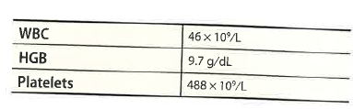
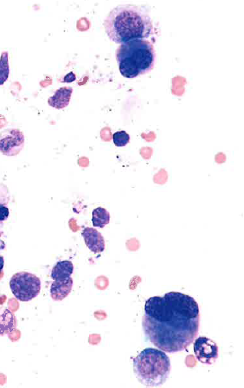
Case Study #4: Part 1
A 10 year old female presented with neutropenia. She did not return until 4 yrs later with leukocytosis and thrombocytosis.
Morphology bone marrow: marked increase in megakaryocytes with widely spaced nuclear lobes. The myeloid series demonstrated left-shift maturation with aberrant nuclear lobation, and the erythroid series demonstrated forms with irregular nuclear contours. Hypercellular bone marrow, with 5% myeloid blasts, CD34, CD117, CD13,CD33, MPO, and HLA-DR+.
Karyotype:45,XX,-7 (20).
FISH: Monosomy 7 (95% of cells).
NGS: GATA2p.H51fs
Diagnosis:_____________________________
Beck R, Moore E. Molecular Hematopathology, 2021, p. 54-59.
Notes:
Beck, 2021, p. 54(c. 1 5 4 _t7 9 del/';C GAG GTG G,{CGTCTTCTIC,{,{TCAC) variant allele frequency (Vm) ZZl"
ASXL 1 p.D879ß* (c.2636 _z637insT) VAF 50% , sETBpl p.G870S (c.2ó08G>A) vAF 50%
NRAS p.G1 3D (c.38G>A) yAF 23o/o, NA,AS p.G12D (c.35G>A) VAF g%, PTPNI I p. A7 2T (c.21 4G> It) yAF t Io/o

Slide 46
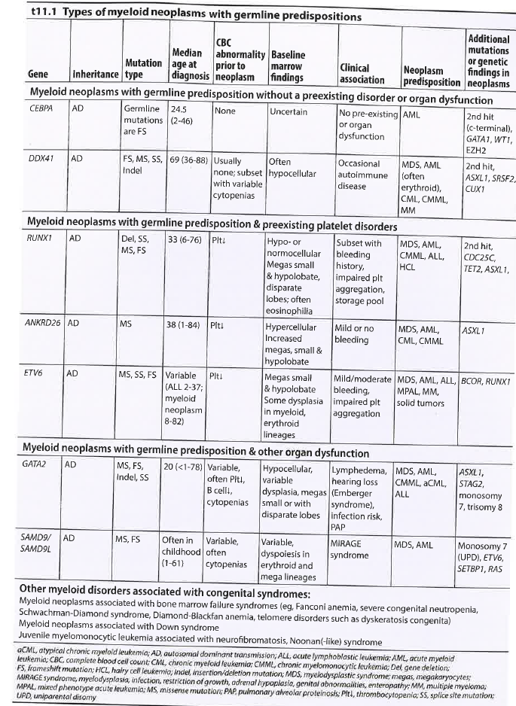
Case Study 4: Part 2
Extensive gene sequencing has demonstrated that the vast majority of myeloid neoplasms (>90%) have identifiable gene mutations that act as oncogenic drivers. Th identification of these mutations is important for diagnosis, prognosis, and treatment, to the point that targeted gene sequencing is now standard of care in the evaluation of myeloid malignancies.
Although most mutations found in myeloid neoplasms are somatically acquired, a small subset of cases contains inherited or germline mutations that confer predisposition to the development of hematologic malignancies and other diseases. Variable penetrance lead time, and limited or protean manifestations
Prior to the development of malignancy may obscure the identification of syndromes caused by these mutations. In addition, some mutations associated with germline predisposition syndromes are also Seen in sporadic malignancy so their identification as germline is dependent on sequencing benign tissue such as fibroblasts. In the last decade, the expansion of knowledge surrounding these inherited or germline mutations, combined with the clinical importance of their identification, led to the creation of a separate category in the 2017 and 2022 World Health Organization classification of hematologic neoplasms, namely "myeloid neoplasms with germline predisposition."

Slide 47
A List of Mutations, Not all-Inclusive: Part 1
1. Chronic Myeloid Leukemia presenting with t(9;22)(q34.1;q11.2)BCR-ABL1 & trisomy 8
2. Polycythemia vera with JAK2 V617F & ASXL1 mutation
3. Essential thrombocytosis with CALR type 1 mutation
4. Chronic neutrophilic leukemia with CSF3RT618I
5. Chronic eosinophilic leukemia with clonal abnormalities
6. Systemic mastocytosis with an associated hematopoietic neoplasm
7. Clonal cytopenia of undetermined significance with U2AF1 mutation
8. Myelodysplastic syndrome with excess blasts-1 with iso(17q) & mutations in SRSF2 & SETBP1
9. Myelodysplastic syndrome with isolated del(5q)
10. Myelodysplastic syndrome with ring sideroblasts & SF3B1 mutation
11. Myelodysplastic syndrome with germline GATA2 mutation
12. Chronic myelomonocytic leukemia with mutations in TET2 & SRSF2
13. Juvenile myelomonocytic leukemia with NRAS mutation
14. Atypical chronic myeloid leukemia with mutations in SETBP1, SRSF2, ZRSR2 & GATA2
15. Myelodysplastic/myeloproliferative neoplasm with ring sideroblasts & thrombocytosis, with mutations in JAK2 & SF3B1
16. Myeloid neoplasm with eosinophilia & FIP1L1-PDGFRA
17. Secondary polycythemia with JAK2 V617F clonal hematopoiesis of indeterminate potential
18. Aplastic anemia with clonal hematopoiesis
19. Acute myeloid leukemia with t(8;21)(q22;q22) RUNX1-RUNX1T1 & KIT mutation
20. Acute promyelocytic leukemia with subsequent therapy-related myeloid neoplasm (myelodysplastic syndrome)
21. Acute myeloid leukemia with mutated NPM1 & FLT3-ITD
22. Acute myeloid leukemia with biallelic mutation of CEBPA
23. Acute myeloid leukemia with mutated RUNX1 & concurrent isolated trisomy 1
24. Therapy-related acute myeloid leukemia with t(8;16)(p11.2;p13.3) KATA-CREBBP
25. Therapy-related myeloid neoplasm presenting as a myeloid sarcoma with rearrangement of KMT2A (MLL)

Slide 48
A List of Mutations, Not all-Inclusive: Part 2
41. Plasma cell myeloma with rearrangement of CCND1
42. T-cell large granularlymphocytic leukemia with STAT3 mutation
43. T-cell prolymphocytic leukemia with inv(14)
44. Hepatosplenic T-cell lymphoma with RHOA mutation
45. Anaplastic large cell lymphoma, ALK-negative, with rearrangement of DUSP22
46. Angioimmunoblastic T-cell lymphoma with RHOA mutation
47. B-lymphoblastic leukemia/lymphoma with rearrangement of KMT2A (MLL)
48. B-lymphoblastic leukemia/lymphoma with t(1;19)(q23;p13.3) TCF3-PBX1
49. B-lymphoblastic leukemia/lymphoma with iAMP21
50. B-lymphoblastic leukemia/lymphoma with t(9;22)(q34.1;q11.2) BCR-ABL1
51. B-lymphoblastic leukemia/lymphoma BCR-ABL1-like, with P2YR8-CRLF2
52. Early T-cell precursor lymphoblastic leukemia with t(10;11)(p12;q14) MLLT10-PICALM
53. Mixed phenotype acute leukemia with t(9;22)(q34.1;q11.2) BCR-ABL1
54. Histiocytic sarcoma arising from a monocytic neoplasm in bone marrow, with mutations in KRAS, SRSF2 & TET2
26. Therapy-related acute myeloid leukemia with complex karyotype including amplification of KMT2A (MLL)
27. Acute megakaryoblastic leukemia with RAM phenotype & CFBA2T3-GLIS2
28. Transient abnormal myelopoiesis of Down syndrome with GATA1 mutation
29. Chronic lymphocytic leukemia/small lymphocytic lymphoma with TP53 mutation
30. B-cell prolymphocytic leukemia with gain of c-MYC
31. Hairy cell leukemia with BRAF V600E
32. Mantle cell lymphoma with t(11;14)(q13;q32) CCND1-IGH & mutations in NOTCH2 & ATM
33. Follicular lymphoma with del(1p36)
34. Pediatric-type nodal follicular lymphoma with MAP2K1 mutation
35. Lymphoplasmacytic lymphoma with mutations in MYD88 & CXCR4
36. Splenic marginal zone lymphoma with del(7q) & mutations in CARD11 & CXCR4
37. Extranodal marginal zone lymphoma with t(11;18) BIRC3-MALT1
38. High grade B-cell lymphoma with MYC & BCL2 & BCL6 rearrangements
39. Primary mediastinal large B-cell lymphoma with 9p24.1 amplification
40. Large B-cell lymphoma with IRF4 rearrangement

Slide 49
Hematologic Malignancies’ Therapies
Car T-cell therapies, bispecific antibodies, antibody-drug conjugates, and novel combinations are transforming care and increasing clinical and operational complexity.
Hematology-Oncologists are now managing;
  Cytokine release syndrome ( CRS), Immune effector cell-associated neurotoxicity syndrome (ICANS) and prolonged cytopenias
  Infection risk and monitoring logistics
  Biomarker results that directly influence treatment selection
  Minimal residual disease (MRD)
Notes:
CRS- cytokine

Slide 50
What is Happening Now in Molecular Testing?
Molecular tests being done in the lab: One company offers:
  a PCR testing menu covering a wide range of diseases, including
    respiratory infections,
    blood virology,
    women's and sexual health
    tuberculosis,
    emerging infectious diseases
    healthcare-associated infectious diseases
    Oncology
    human genetics
Molecular biology opportunities:
  ASCP Molecular biology certification, Specialist in molecular biology
  Programs that specialize in investigative genetic genealogy: Ramapo College in New Jersey
Notes:
AI said: ASCP: Also a MB certification. Molecular biology specialty The ASCP offers a Specialist in Molecular Biology (SMB) certification, validating expertise in molecular techniques for diagnostics and research, with various eligibility routes for candidates.
Overview of the SMB Certification
The Specialist in Molecular Biology (SMB) certification is administered by the American Society for Clinical Pathology (ASCP). This credential is designed for professionals specializing in molecular biology, focusing on techniques used in diagnostics, research, and biotechnology. The certification validates a professional's expertise in molecular biological methods and their applications in various medical fields, including the diagnosis of diseases.
Vivian Health+1 Eligibility Requirements To qualify for the SMB certification, candidates must meet specific eligibility criteria, which can vary based on their educational background and experience. Here are some common routes to eligibility:
Route 1: A non expired MB (ASCP) certification, a bachelor’s degree, and three years of practical experience in a molecular biology laboratory.
Route 2: A master’s degree in a relevant field and three years of clinical experience in a molecular biology laboratory.
Route 3: A PhD in a relevant field, with post-doctoral fellowship or clinical experience in molecular biology.
Route 4: Three years of acceptable clinical experience in a molecular biology laboratory or related research experience.
Route 5: Teaching experience in clinical molecular biology at an accredited institution.

Slide 51
Summary
Hematologic malignant mutations:
  Are numerous
  Knowledge of the type of mutation will provide pathways for treatment
Where will the Medical laboratorian fit into the picture of laboratory testing
  hopefully will perform the molecular studies
  Most likely PhD and MD molecular biology specialists will be reporting the molecular interpretations and results, maybe alsoe the DCLS’s.

Slide 52

Dedicated to Kayleen Larson and her Grandfather James Bettendorf
My niece-in-law Sarah said: lost my youngest daughter, Kayleen, to AML when she was 9 years old, in 2013. She had a big personality, a big heart, and a lot of brains. I wish every day I could have seen what her life would have been these last 13 years, and beyond. She had so much to give the world. Since then I have been passionate about looking toward a world where no other parent has to hear, or tell their child, the words "Treatment has failed".
Sarah said: In 2021 we also lost my dad to AML, long before we should have and certainly before we were ready to.
Sarah Larson has been nominated as a candidate for LLS's 2023 Mission, 'Visionaries of the Year' campaign kicking off this week. Candidates across the country form fundraising teams, and compete in honor of two local blood cancer survivors to raise the most funds for blood cancer research. Leukemia and Lymphoma Society is now called Blood Cancer Network

Slide 53
References
Beck R, Moore E. Molecular Hematopathology: an integrated Case-Based Approach. Chicago: ASCP Press. 2021
Buckingham L. Gene Mutations. In: Buckingham L (ed): Molecular Diagnostics, Fundamentals, Methods, and Clinical Applications. 4th .ed. Philadelphia: FA Davis, 2026
Jaffe ES, Arber DA, Campo E, Orazi A, Quintanilla-Martini L, Rimsza L, Swerdlow SH. Hematopathology. 3rd ed. Philadelphia: Elsevier. 2025. ISBN: 978-0-323-83165-9.
Landis-Piwowar K. Cellular Homeostasis. In: McKenzie SB, Landis-Piwowar K, Williams JL (eds): Clinical Laboratory Hematology, 4th ed. Upper Saddle River, NJ: Pearson. 2020;9-26.
Siebert R: WHO Classification of Tumours of Haematopoietic and Lymphoid Tissues. Revised 5th Ed. Herndon, VA: Stylus Publishing. 2022. Not available through the bookstore: Order directly from the publisher: Stylus Publishing LLC 22883 Quicksilver Drive PO Box 605, Herndon, VA 20172-05, Telephone 1-800 232 0223 or 1 -703-661-1501. ebook or hardcopy available in 2025

Slide 54


